Slide 1

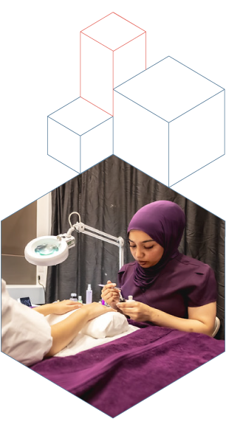
Championing Skills Excellence: WorldSkills UK
<Presentation author>
Notes:
Please use these slides for any talks you are delivering as a Skills Champion. You can add and tailor your personal content as you see fit, but please do not alter the template or branding.

Slide 2

Content
About WorldSkills UK
Overview of competitions
Benefits of taking part
Top tips
Get involved
Notes:
Suggest content overview, please edit as you see fit.

Slide 3



About me
<Use this slide to introduce yourself as a Skills Champion to your audience. You can include photos or any content that bring to life your experience and journey. You might like to talk about:>
Who you are, what you do <role, sector, where you work or study?
Give an overview of your WorldSkills UK technical education journey <this can be brief as you’ll elaborate later>
Why you became a Skills Champion, <what you are passionate about and what you are talking about today>.
Competing
Next steps and now
What are you up to now or how did your competition experience propel you further? Share about what you do (your job or course or any projects you are working on).
Notes:
Use this slide to introduce yourself and contextualise your presentation. You’ll speak more about your experience and journey later on, but can give a short overview here. The next few slides are about WorldSkills UK.

Slide 4

About WorldSkills UK
A proud member of WorldSkills, a global movement of over 80 countries. The insights gained from training as part of this global network enables WorldSkills UK to embed world-class training standards across the UK to help drive investment, jobs and economic growth.

Slide 5


About WorldSkills UK
WorldSkills UK is a four nations partnership between education, industry and UK governments. It is a world-class skills network acting as a catalyst for:
raising standards, through international benchmarking and professional development
championing future skills, through analysis of rapidly changing economic demand
empowering young people, from all backgrounds, through competitions-based training and careers advocacy.

Slide 6
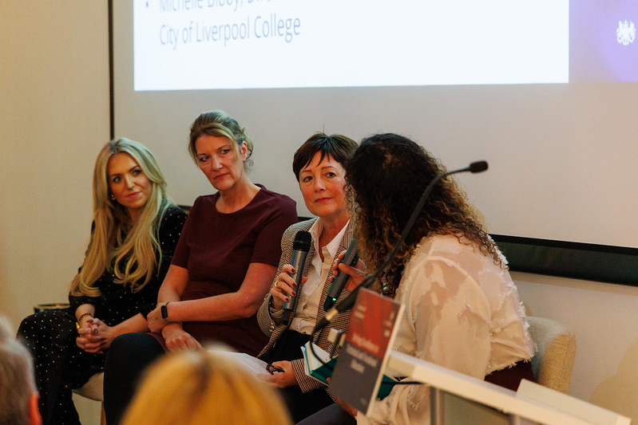
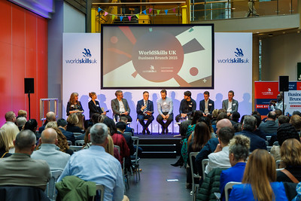
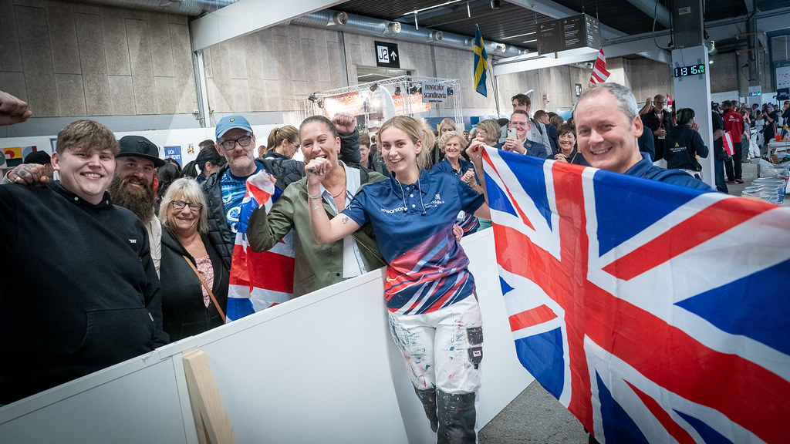
Who WorldSkills UK help
Educators and tutors
We develop educators, by sharing international best practice, to deliver
high-quality training
and assessment.
Employers and organisations
We innovate to help employers by benchmarking with skills systems from across the world to inform policy and practice, ensuring
high-quality skills and boosting the UK economy.
Young people and parents
We inspire young people, whatever their background,
to choose high-quality apprenticeships and technical education as prestigious
career routes.

Slide 7

What are skills competitions?
Competitions are designed by industry experts, and assess an individual’s knowledge, practical skills and employability attributes against set criteria in a competitive timed environment.
Competitors benefit from the fine tuning of critical skills, attributes and behaviours valued by employers, such as problem-solving, self-reflection, time management and ability to work under pressure.
There are four competition sectors:
Digital, Business and Creative
Health, Hospitality and Lifestyle
Construction and Infrastructure
Engineering and Technology
Notes:
Please go through these slides.

Slide 8




You can compete in
Hairdressing
Plumbing and heat pumps
Welding
Health and social care
CNC Milling
Electrical installation
Graphic design
Aircraft maintenance
3D Digital game art
Digital Media Production
SFX for hair and make up
Foundation Skills: Enterprise
Mechatronics
Cyber security
Web design
Beauty therapy
Computer Aided Design
Renewable energy
… and much more!
1
Notes:
Brief overview of the Skills competitions. You can pinpoint which yours was or ask students which they'd chose.

Slide 9

Competition overview
25-35
Competitors are selected and trained for international competition forming Team UK
Squad/Team Development
Selection process for Squad UK for WorldSkills subject to meeting criteria such as age eligibility; performance and competing in the correct competition and level
100 +
National Finals
Take place over in November, competitors test their skills in time limited environment to industry standards, showcasing excellence in skills and competing to be the best in a particular skill
550 +
No. of competitors
National Qualifiers
Competitors are entered to participate in a local competition or online test during Spring/Summer. Highest scoring competitors in each skill are invited to take part in the UK national final
2,500 +
Entry stage
National Competitions are open to learners, apprentices and employees from 16 years + and are either working towards or have recently completed Level 2, 3 or 4 qualifications in their related skill. This involves a simple online/remote test or task
My story
3,000 +
Notes:
You can give an overview of the stages – don’t worry about the number of competitors details, but use this to give an overview of competition progression.

Slide 10
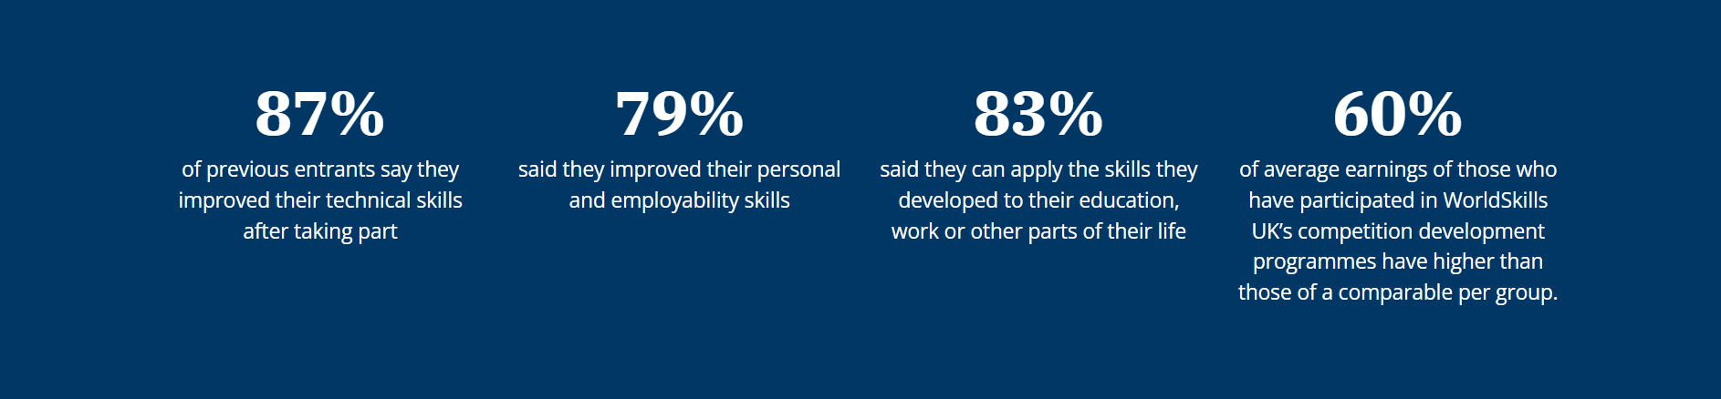
The impact of WorldSkills UK competitions
Helps to achieve qualification goals
Improves self-esteem and confidence
Develops personal, technical and employability skills
Builds on strengths and identifies areas for development
Raises aspirations and ambitions
Developing networks with peers and industry
Notes:
Talk here about the benefits of competing – feel free to highlight any that resonate the most with you.

Slide 11

My journey – my experience
<Share here what courses you did and how this led you to take part in WorldSkills UK.>
Course
Why I choose this course
My study experience
How I got involved in competitions and what were my thoughts at the time
<The next slide is where you can focus on your competing journey. >

Slide 12
My journey – competing
<Talk about your competition experience and share any pictures if possible. >
What did this involve?
How did it help me grow and hone my skills?
What was my highlight?
How has competing benefitted me professionally and personally?
<Add anything else you’d like to share. >

Slide 13

My journey – now and next steps
What are you up to now because of your experience?
<Reflect on how your WorldSkills UK competition experience has influenced where you are today. What doors have opened since then, and how has it shaped your current work or studies?>
How has your competition experience impacted this?
<Dive into how the skills, knowledge, and confidence gained through your WorldSkills UK journey have played a role in your current path. Did it offer you new opportunities? >
What are you looking to do next or aiming to be in the future?
<Outline your aspirations moving forward. What goals do you have in the near and distant future, and how do you see your WorldSkills UK experience contributing to your ongoing journey?>

Slide 14

Top tips
<Share here any top tips you have for students to inspire their career planning and get involved in competitions. >
If college students, share any tips about how to get involved in in competitions, such as speak to your educator or employer if an apprentice and visit the WorldSkills UK website to find out more.
If educators, share advice on how best to engage and encourage students to take part. You can signpost to our educator resources found on the WorldSkills UK Learning Lab, designed to support educators to inspire and develop excellence in students and apprentices.

Slide 15

Competition timeline
Spring
Registration
Spring
Entry Stage
Spring / Summer
National Qualifiers
Summer
Announcement of Finalists
Autumn
Finalists Development Training
November
UK National Finals
X
X
X
X
X
X
X
Notes:
Educators might find this slide more useful than students, but it’s helpful to outline the process and stages, particularly if registration is about to launch.

Slide 16

<Slide title>
[Additional slides follow for any content, graphs, charts, images or photos you may wish to add]

Slide 19
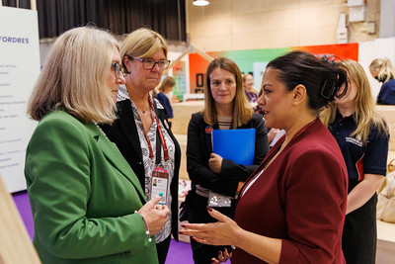
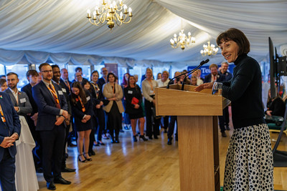


Slide 20


Visit the WorldSkills UK website to find out more!
Notes:
To find out more about our WorldSkills UK programmes and educator resources including CPD, visit the WorldSkills UK website.

Slide 21

Thank you
Any questions?

