Slide 1

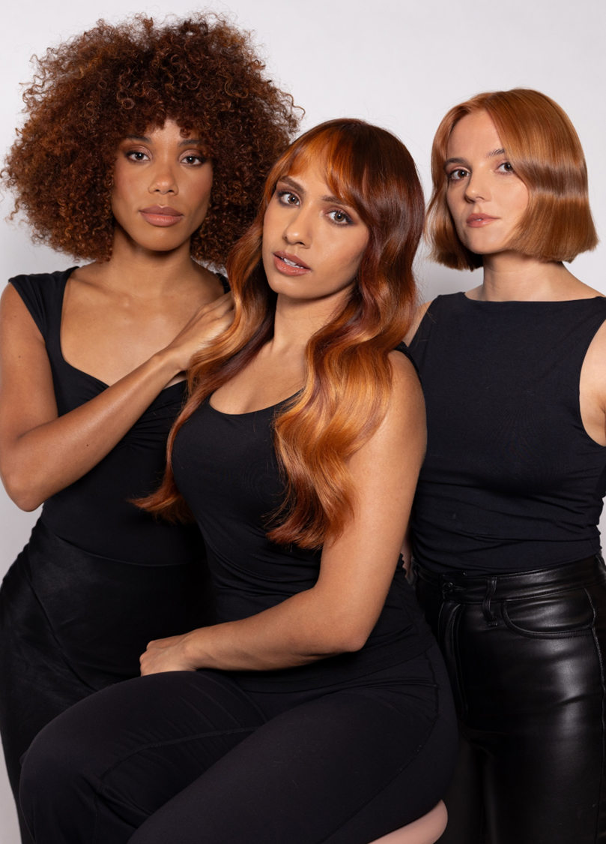

Test Project
Hairdressing
National Competition 2026
Stage 1 – Photographic Entry Submission Document
In partnership with

Slide 2

Entry Submission
You will need to submit 4 photos of your work
These should be from the following aspects
Front
Left
Back
Right
Please insert your photos onto the attached template
Please return the photograph layout and competitor details form to Richard Howell via email
Richard.howell@loreal.com

Slide 3
Competitor Details
Competitor Name :-
Competitor Email :-
Competitor Tel No :-
Tutor Name :-
Tutor Email :-
Preferred National Qualifier Heat ( Date & Venue )
____________________________________________________
Second Choice Qualifier Heat ( Date & Venue )
____________________________________________________

Slide 4
FRONT
LEFT
RIGHT
BACK

Slide 5
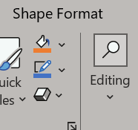
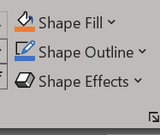
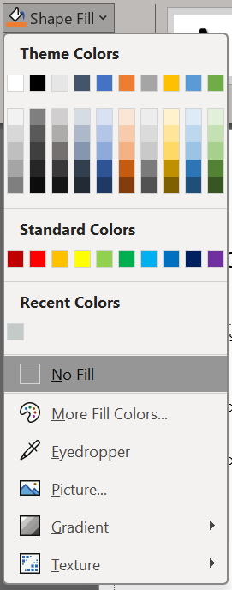
How to insert your photos
1 – Click on the shape that you want to insert your photo into
2 – select – Shape Format
3 – Select Shape Fill
4 – select Picture
5 - select your desired image and
click insert

