Slide 1

Championing Skills Excellence: WorldSkills UK
<Presentation author>
Notes:
Please use these slides for any talks you are delivering as a Skills Champion. You can add and tailor your personal content as you see fit, but please do not alter the template or branding.

Slide 2

Content
About WorldSkills UK
Overview of competitions
My journey
Top tips
Get involved
Notes:
Suggest content overview, please edit as you see fit.

Slide 3

About me
Competing
Use this slide to introduce yourself as a Skills Champion to your audience. You can include photos or any content that bring to life your experience and journey. You might like to talk about
Who you are, what you do (role, sector, where you work or study)
Give an overview of your WorldSkills UK technical education journey (this can be brief as you’ll elaborate later)
Why you became a Skills Champion, what you are passionate about and what you are talking about today.
Next steps and now
What are you up to now or how did your competition experience propel you further? Share about what you do (your job or course or any projects you are working on).
Notes:
Use this slide to introduce yourself and contextualise your presentation. You’ll speak more about your experience and journey later on, but can give a short overview here. The next few slides are about WorldSkills UK.

Slide 4

About WorldSkills UK
We’re a proud member of WorldSkills, a global movement of over 80 countries. The insights we gain from training as part of this global network enables us to embed world-class training standards across the UK to help drive investment, jobs and economic growth.
Notes:
Please go through these slides.

Slide 5

About WorldSkills UK
WorldSkills UK is a four nations partnership between education, industry and UK governments. It is a world-class skills network acting as a catalyst for:
• raising standards, through international benchmarking and professional development
• championing future skills, through analysis of rapidly changing economic demand
• empowering young people, from all backgrounds, through competitions-based training and careers advocacy.
Notes:
Please go through these slides.

Slide 6
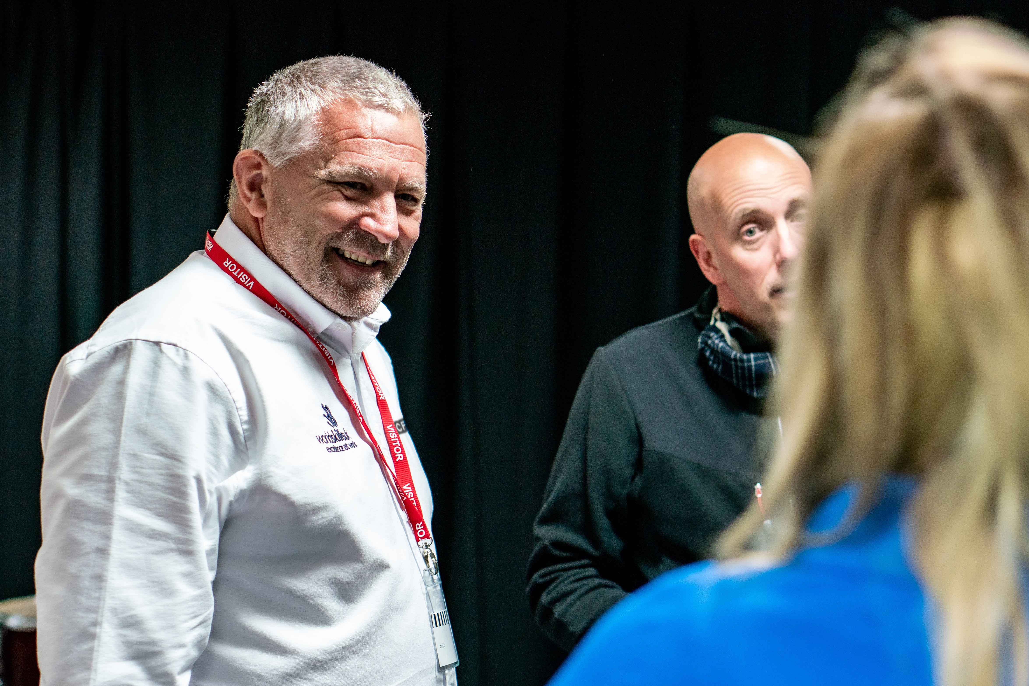
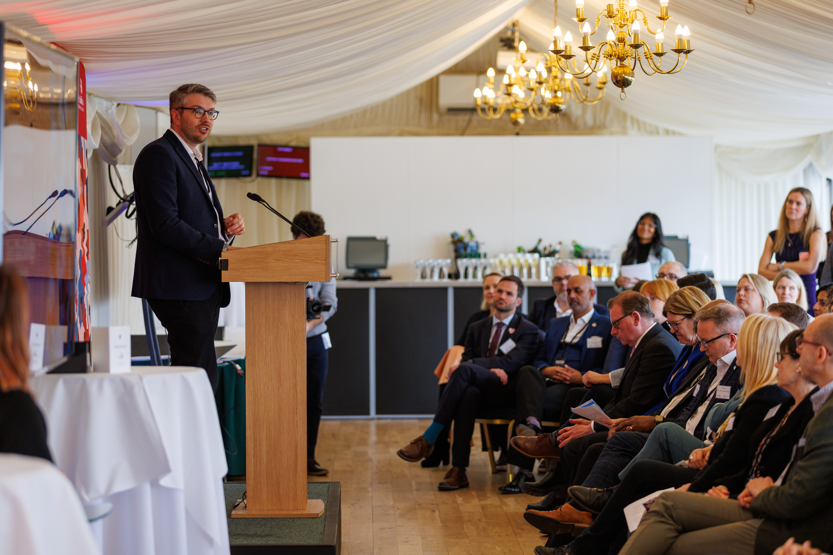
Who WorldSkills UK help
Educators and tutors
We develop educators, by sharing international best practice, to deliver high-quality training and assessment.
Employers and organisations
We innovate to help employers by benchmarking with skills systems from across the world to inform policy and practice, ensuring high-quality skills and boosting the UK economy.
Young people and parents
We inspire young people, whatever their background, to choose high-quality apprenticeships and technical education as prestigious career routes.
Notes:
Please go through these slides.

Slide 7
What are skills competitions?
Skills competitions are designed by industry experts, and assess an individual’s knowledge, practical skills and employability attributes against set criteria in a competitive timed environment
individuals benefit from the fine tuning of critical skills, attributes and behaviours valued by employers; problem-solving, self-reflection, time management and ability to work under pressure
our programmes enable participants to bring world-class skills back to their organisations, improving productivity
competitions enable business and education to benchmark against national and international standards of performance
Notes:
Please go through these slides.

Slide 8




Competition overview
Health, Hospitality and Lifestyle
Digital, Business and Creative
4 Sectors
A range of Skills competitions
Construction and Infrastructure
Engineering and Technology
1
Notes:
Brief overview of the Skills competitions. You can pinpoint which yours was or ask students which they'd chose.

Slide 9

Competition overview
25-35
Competitors are selected and trained for international competition forming Team UK
Squad/Team Development
Selection process for Squad UK for WorldSkills subject to meeting criteria such as age eligibility; performance and competing in the correct competition and level
100 +
National Finals
Take place over in November, competitors test their skills in time limited environment to industry standards, showcasing excellence in skills and competing to be the best in a particular skill
550 +
No. of competitors
National Qualifiers
Competitors are entered to participate in a local competition or online test during Spring/Summer. Highest scoring competitors in each skill are invited to take part in the UK national final
2,500 +
Entry stage
National Competitions are open to learners, apprentices and employees from 16 years + and are either working towards or have recently completed Level 2, 3 or 4 qualifications in their related skill. This involves a simple online/remote test or task
My story
3,000 +
Notes:
You can give an overview of the stages – don’t worry about the number of competitors details, but use this to give an overview of competition progression.

Slide 10


Competition timeline
Spring
Registration
Spring
Entry Stage
Spring / Summer
National Qualifiers
Summer
Announcement of Finalists
Autumn
Finalists Development Training
November
UK National Finals
X
X
X
X
X
X
X
X
Notes:
Educators might find this slide more useful than students, but it’s helpful to outline the process and stages, particularly if registration is about to launch.

Slide 11
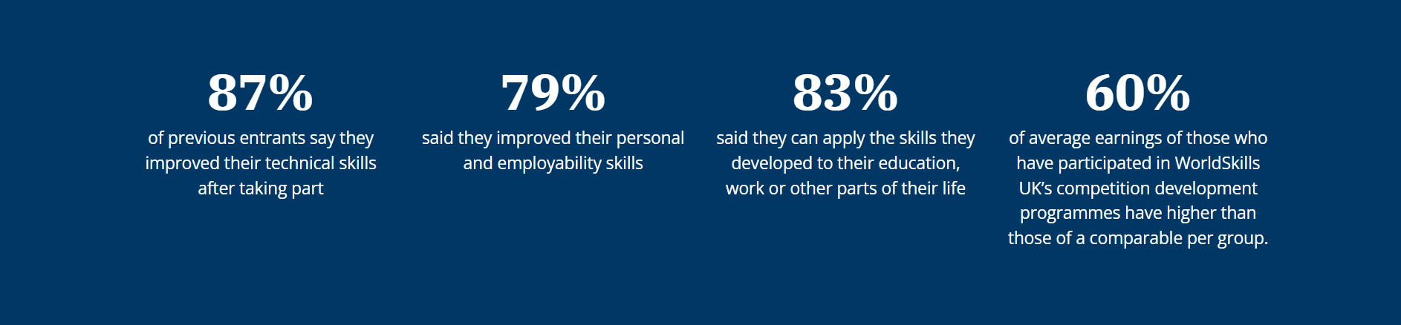

The impact of WorldSkills UK competitions
Helps to achieve qualification goals
Improves self-esteem and confidence
Develops personal, technical and employability skills
Builds on strengths and identifies areas for development
Raises aspirations and ambitions
Developing networks with peers and industry
Notes:
Talk here about the benefits of competing – feel free to highlight any that resonate the most with you.

Slide 12
My journey – my experience
Share here what courses you did and how this led you to take part in WorldSkills UK.
Why did you choose this course?
What was your study experience like?
How did you get involved in competitions and what did you think at the time?
The next slide is where you can focus on your competing journey.

Slide 13
My journey – competing
Talk about your competition experience and share any pictures if possible.
What did this involve?
How did it help you grow and hone your skills?
What was your highlight?
How has competing benefitted you professionally and personally?
Add anything else you’d like to share.
Notes:
Whether you’re talking to students or educators, share about what competing is like and the benefits, so listeners are inspired to get involved.

Slide 14

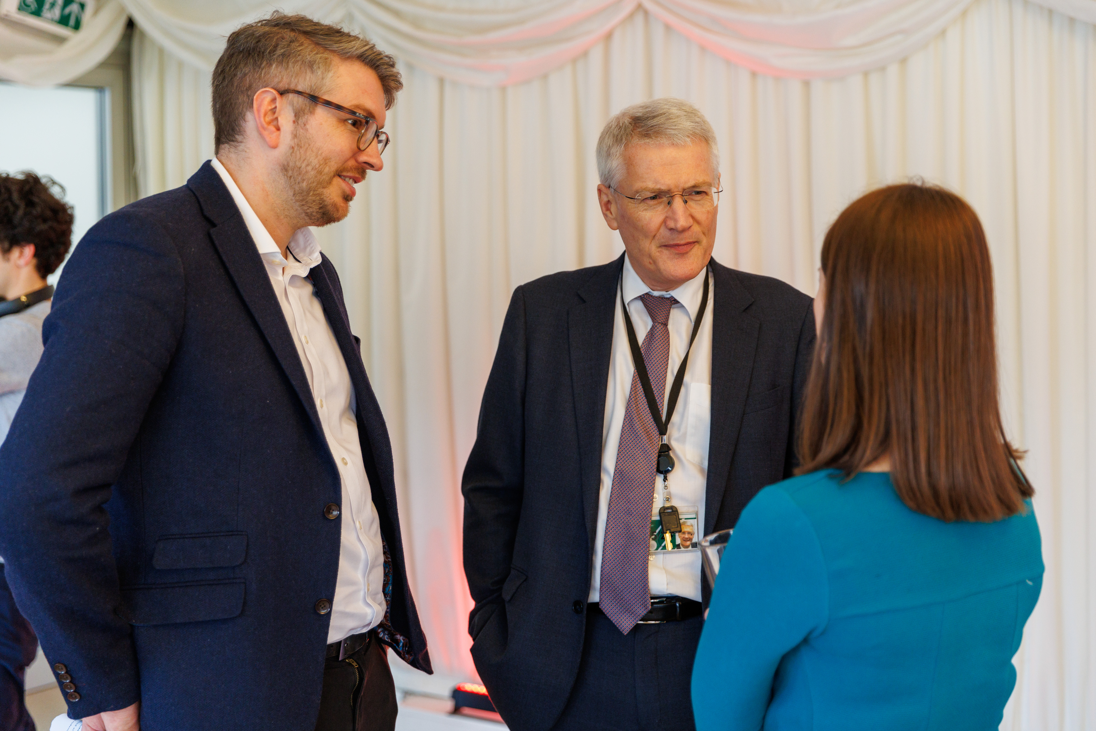
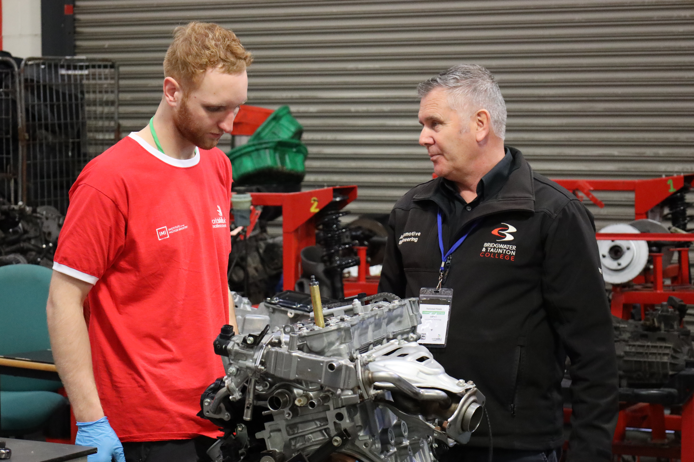
My journey – now and next steps
What are you up to now because of your experience?
Reflect on how your WorldSkills UK competition experience has influenced where you are today. What doors have opened since then, and how has it shaped your current work or studies?
How has your competition experience impacted this?
Dive into how the skills, knowledge, and confidence gained through your WorldSkills UK journey have played a role in your current path. Did it offer you new opportunities?
What are you looking to do next or aiming to be in the future?
Outline your aspirations moving forward. What goals do you have in the near and distant future, and how do you see your WorldSkills UK experience contributing to your ongoing journey?

Slide 15

Top tips
Share here any top tips you have for students to inspire their career planning and get involved in competitions.
If college students, share any tips about how to get involved in in competitions, such as speak to your educator or employer if an apprentice and visit the WorldSkills UK website to find out more.
If educators, share advice on how best to engage and encourage students to take part. You can signpost to our educator resources found on the WorldSkills UK Learning Lab, designed to support educators to inspire and develop excellence in students and apprentices.

Slide 16

<Slide title>
[Additional slides for any content or photos]
Notes:
Spare slides – delete if not needed.

Slide 17
<Slide title>
<Body copy>

Slide 18
<Slide title>
<Body copy>

Slide 19
<Slide title>
<Body copy>

Slide 20

<Slide title>

Slide 21

Find out more www.worldskillsuk.org
Notes:
To find out more about our WorldSkills UK programmes and educator resources including CPD, visit the WorldSkills UK website.

Slide 22

Thank you
Any questions?

