Slide 1
Install and Start Fusion 360
Before beginning this course, please do the following:
Log into the computer
Log onto the internet
If needed, create a free Autodesk Account, and download and activate Autodesk Fusion 360 from Autodesk Education Community: www.autodesk.com/workshop (use your school email address)
Start Fusion 360

Slide 2
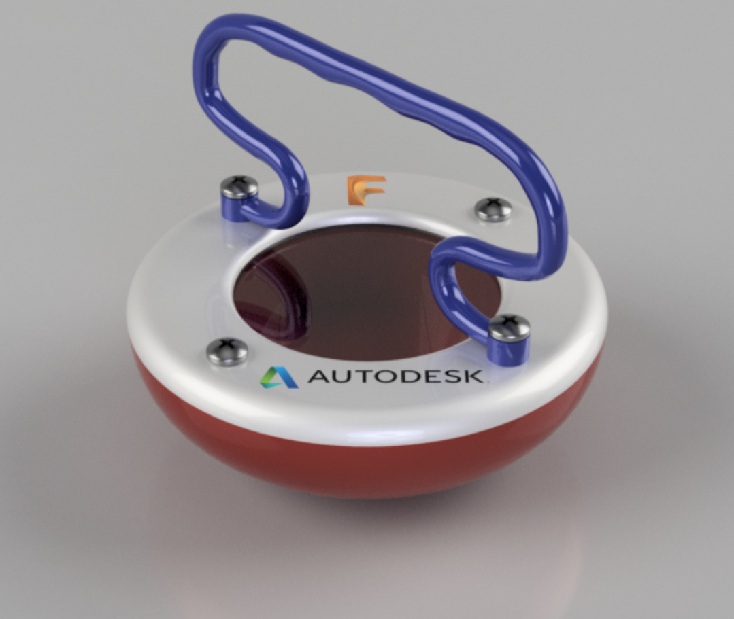
Hands-on Workshop
Enclosure inspired by Cy Keener: https://www.autodesk.com/artist-in-residence/artists/cy-keener

Slide 3
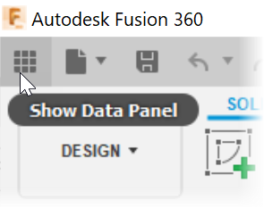
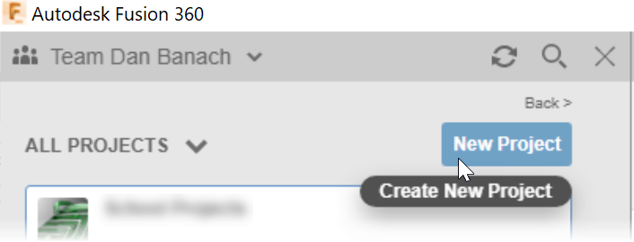
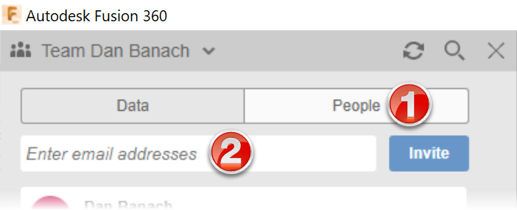
Projects
Data Panel
Invite People
Notes:
Ensure “Z” is up
Review Projects

Slide 4
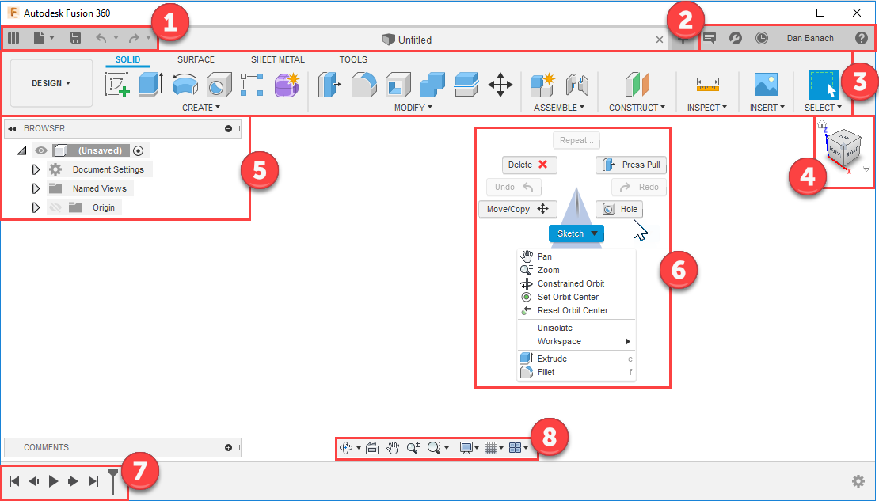
User Interface
Application bar
Profile & help
Toolbar
ViewCube
Browser
Canvas & marking menu
Timeline
Navigation bar & display settings bar

Slide 5
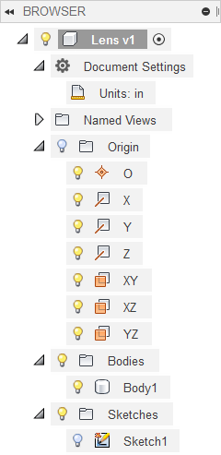
Browser and Timeline
Browser
Left side of screen
Top level data: components, joints, etc.
Timeline
Bottom of screen
List of features
Edit features
Change order of a feature
Delete features
Notes:
Discuss the differences between the Browser and the Timeline

Slide 6
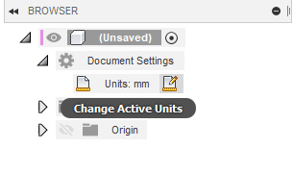
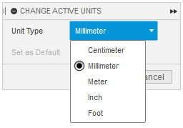
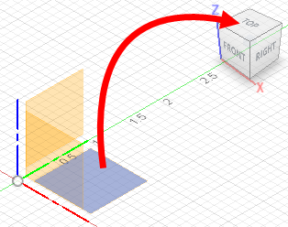
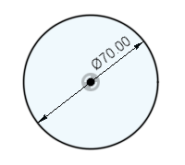
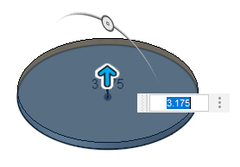
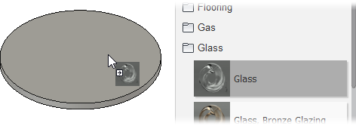
Create the Lens
If needed change the Units to mm
Sketch a 70mm circle that is on the plane that is parallel to the Top plane
Extrude the circle 3.175mm
Change the material to Glass
If desired change the appearance
Save the file with the name Lens
Notes:
Change the Unit to Inch
The Lens component will later be inserted into an assembly

Slide 7
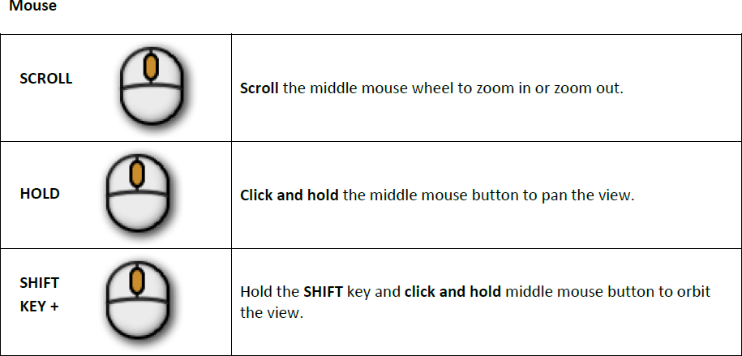
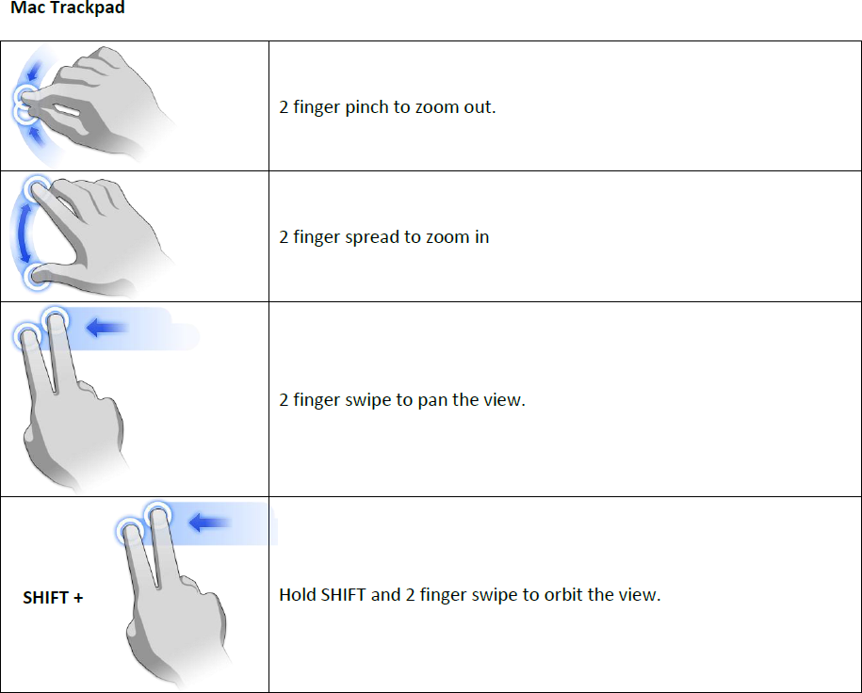
Navigation
Notes:
Review Navigation options for Windows and Macs

Slide 8
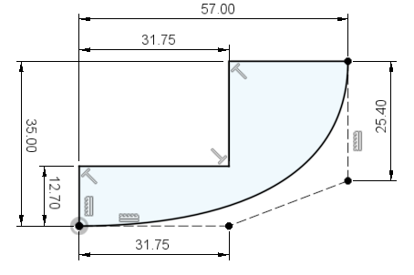
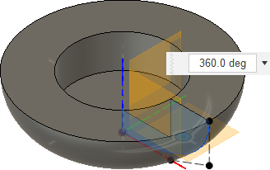
Create the Base
Start a new file +
Create a new component with the name Base and ensure it’s active
Sketch, constrain, and dimension the profile as shown
Create the sketch on the plane that is parallel to the Front plane
For the outside profile draw a Control Pint Spline with 4 points, add a horizontal & vertical constrain to the construction outside lines
Revolve the profile around the inside vertical line of the profile
Notes:
Start a New file (this will become the assembly file)
Create a New Component in the context of the assembly

Slide 9
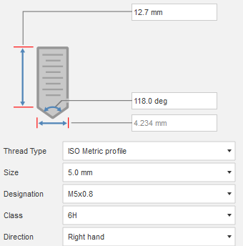
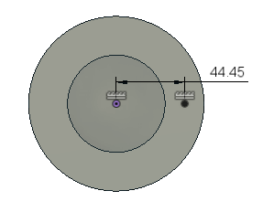
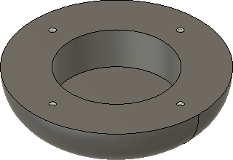
Add Features to the Base
Create a tapped hole
Place and dimension a Sketch Point on the top planar face
Place a M5x0.8 deep tapped hole
Circular Pattern the tapped hole with a quantity of 4
Save the file with the name Enclosure Assembly
Notes:
Add hole and pattern the hole

Slide 10
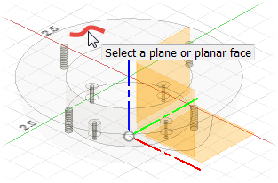
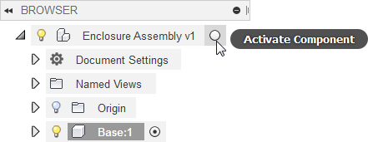
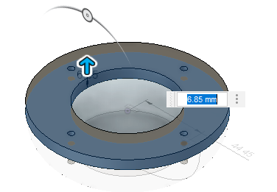
Create the Cover
Make the top-level Enclosure Assembly active
Create new component with the name Cover and ensure it’s active
Create a sketch on the top horizontal plane of the Base
Extrude the inside and outside profiles 6.85mm
Notes:
Discuss how in Fusion you can either create components in the context of an assembly or insert (reference) components into an assembly
Create a new component for the Cover
Extrude the profile based on the top of the Base

Slide 11
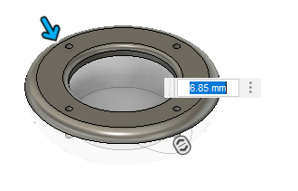
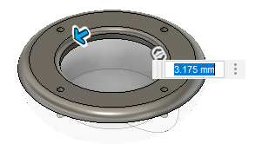
Add features to the Cover
Add a 6.85mm fillet to the top-outside edge
Add a 3.175mm fillet to the top-inside edge
Make the top-level assembly active
Save the file and a description “Added Cover”
Notes:
Round the corners by placing fillets and save the file

Slide 12
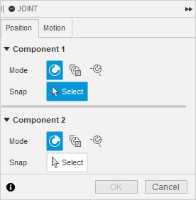
Assembly Joints
Before applying Joints, ground at least one Component that will NOT move
If needed insert a model into the assembly
From the Data Panel right-click on file and click Insert into Current Design
Files must already exist in a Project you have access to
Apply Assembly Joints
Joints can only be applied to components
Assembly > Joints
Joints are applied to points, axes and planes
Edit Joints via the Browser
Notes:
Discuss Assembly Joints and how they work

Slide 13
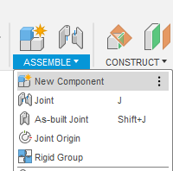
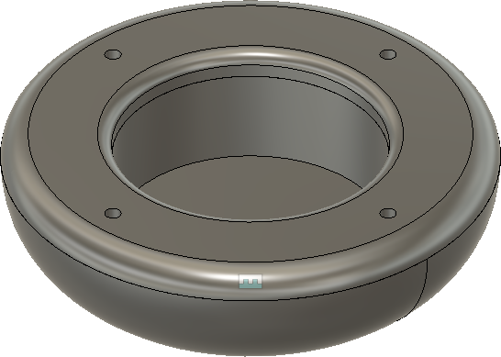
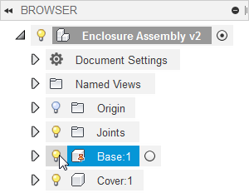
Constrain the Base and Cover Components
Prove that the Cover can move by clicking and dragging on the Cover
Stop moving the Cover by pressing the Esc key (the Cover should return to its original position)
Since the Base and Cover components are in the correct location, constrain them with an As Built Joint with Rigid as the Type: Assemble > As-built Joint
Turn off the visibility of the Base
Notes:
Add an As-built Joint between the Base and the Cover

Slide 14
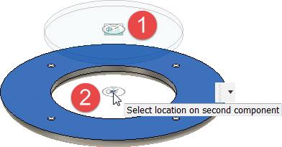
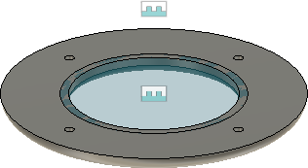
Place the Lens into the Assembly
From the Data Panel drag the Lens component into the Enclosure Assembly
Add a Rigid joint between the Lens and the Cover
Rotate the viewpoint so you can see the bottom of the Cover
Select the bottom circular face and then the center point of the Lens
Select the bottom circular face and then the center point of the Cover Note: Always select the component that will move first
Notes:
Insert the external Lens component into the assembly
Add a Rigid Joint between the Cover and the Cover

Slide 15
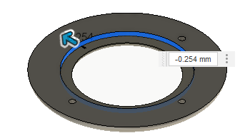
Remove Material from the Cover
Use the Combine command to remove the area where the Lens interferes with the Cover: Modify > Combine
Target = Cover
Tool Bodies = Lens
Operation = Cut
Remove additional material for the Lens to fit
Turn off the visibility of the Lens
Right-click and click the Press Pull command from the menu
Select the inside circular face out -0.254mm
Turn the visibility of the Lens back on
Notes:
Use the Combine command to remove the interference between the Cover and the Lens

Slide 16
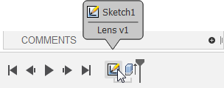
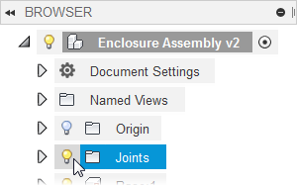
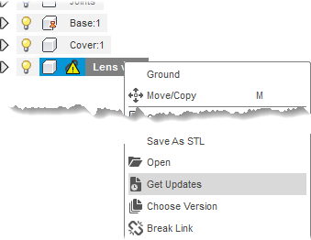
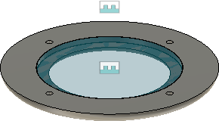
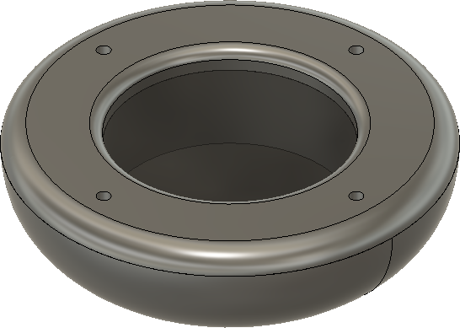
Edit the Lens & Update the Assembly
Make the Lens file current
Edit Sketch1 and change the diameter to 76.5mm
Save the file and add the description Changed diameter
Make the Enclosure Assembly file current
You’ll be alerted that the Lens file is out of date, update to the latest version by right-clicking on the Lens entry in the browser and click Get Update
Turn on the visibility of the Base component
Turn off the visibility of the Joints
Save the file and add the description Updated Lens
Notes:
Make the Lens file active
Edit the diameter of the Lens, save the file and add a description
Make the Assembly file active
Discuss versions

Slide 17
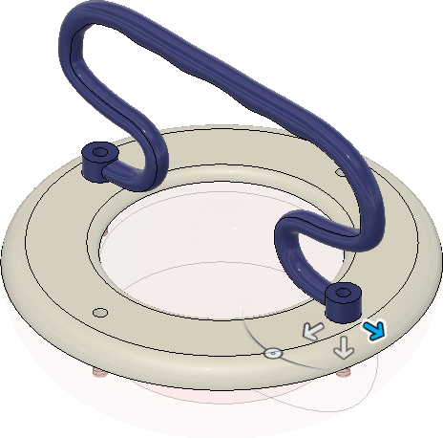
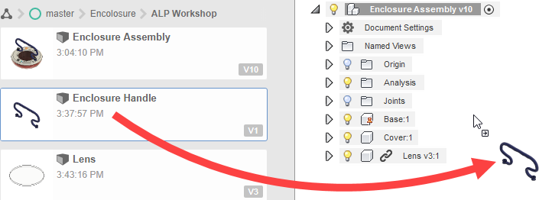
Insert and Assemble the Handle
Open the Enclosure Handle.f3d file from Samples > Workshop & Events > Education > ALP
Save the Enclosure Handle to the project where the Enclosure is saved
Insert the Enclosure Handle into the Enclosure Assembly
Add a Rigid Joint between the Enclosure Handle and the Cover
Notes:
I was unable to right click on this file, have to do a save as into my workspace to us in my assembly

Slide 18
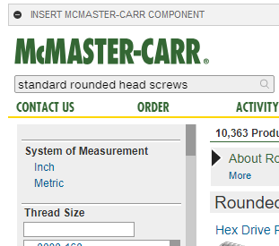
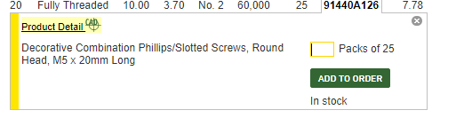
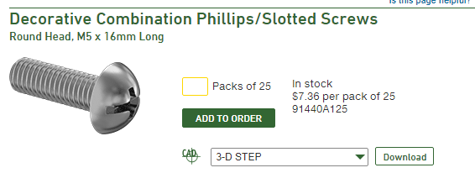
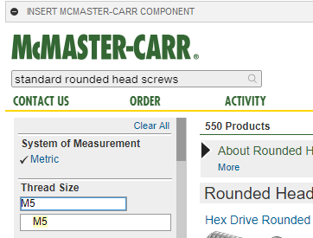
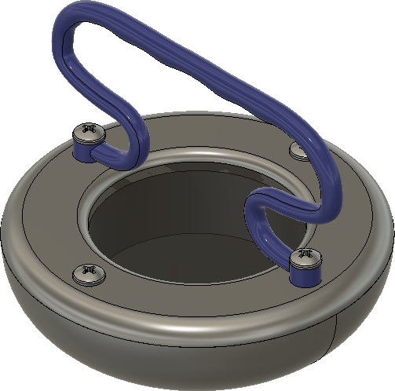
Insert Screws from McMaster-Carr
Insert a M5x16mm & a M5x20mm Round Head Screw
Change the file type to STEP
Add a Rigid Joint between the screws and the holes on the Handle and the Cover: Assemble > Joint
Notes:
Insert a Round Head Screw from McMaster-Carr

Slide 19
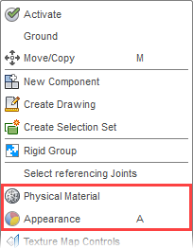
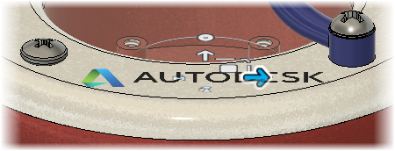
Change the Material and Appearance
Change the Material of the components: In the browser, right-click on a local component > Material and drag a material onto a component
Change the Appearance of components: In the browser, right-click on a local component > Appearance and drag an appearance onto a component. Note: Appearances only change how a component or face looks
Add a Decal (needs to be saved on your computer): Insert > Decal
Save the file, and add the description Added Decals
Notes:
Change the Material and Appearance of the local components
Add a decal

Slide 20
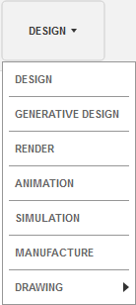
Workspaces
DESIGN: Create solids with hard edges and flat faces
GENERATIVE DESIGN: Input design goals along with parameters such as materials, manufacturing methods, and using cloud computing you explore alternate designs
Render: Set up the environment and create photo-realistic renderings
Animation: Create exploded views, use for assembly instructions
Simulation: Run an analysis on a component or assembly
Manufacture: Create and simulate tool-paths then generate G code for subtractive manufacturing
Drawing: Create 2D views or a component or assembly

Slide 21
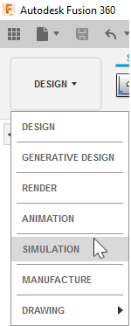
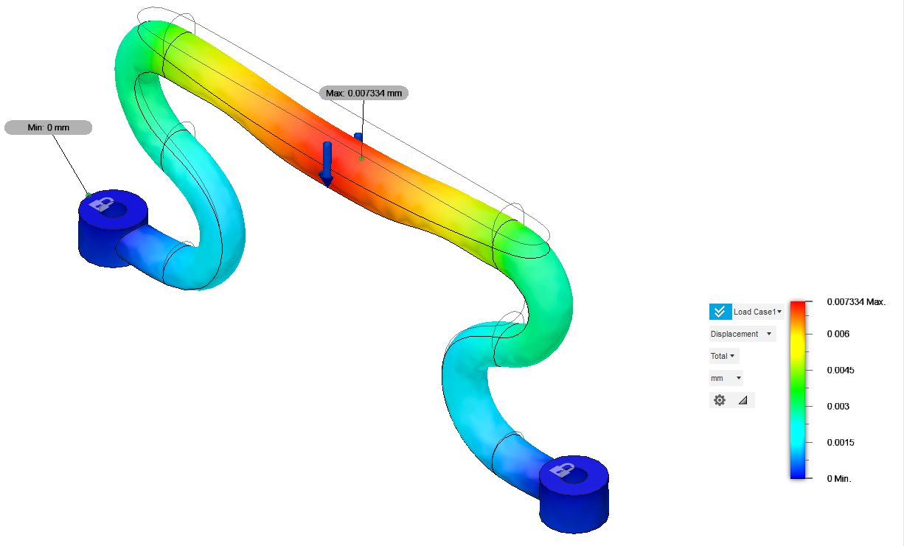
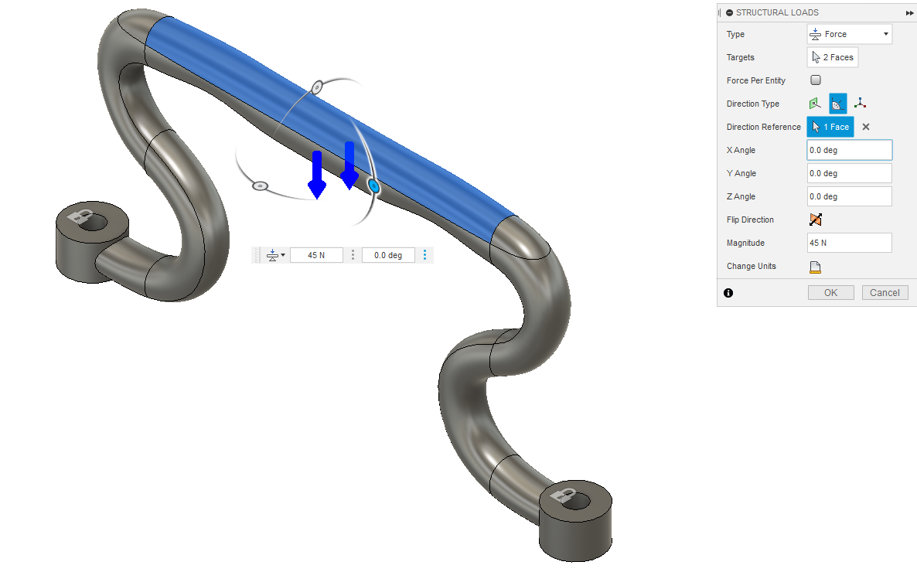
Static Stress Simulation
Open the Enclosure Handle file
Make the Simulation workspace current
For the Study Type, click Static Stress
Add the following Loads
Constraints = two top faces of the bosses
Loads = 45 N on the handle
Run the simulation in the cloud
Review the results
Notes:
Introduce Simulation / FEA and why they should use it
Determine if the design will work when forces or loads are applied to it
How do we know what faces are selected here? Add a load to the handle what faces?

Slide 22
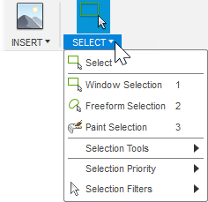
Selection Techniques & Tools
Window (left to right): Selects only what’s 100% in the area
Crossing (right to left): Selects what’s in the area & what the rectangle touches
Ctrl and Shift keys: Adds or removes data
Double-click an edge: Selects the entire loop
Freeform: Define a closed area by dragging mouse
Paint: Drag mouse
Notes:
Review the different selection techniques, use this information with the Sculpt tools

Slide 23
Edit the Enclosure Handle (Optional)
Open the Enclosure Handle file
Use the Edit Form command to:
Move, Rotate, Scale, Points, Edges, Faces
Reorient Triad Direction
Use Selection Filter
To add faces, hold Alt key while editing
Save the file and update the assembly
Notes:
Optional
Open the Handle file and save it to the project that contains the Enclosure assembly
Discuss that the Sculpt tools are used to easily create organic shapes

