Slide 1

WORLD-CLASS SKILLS FOR PEOPLE AND PLACES

Slide 2






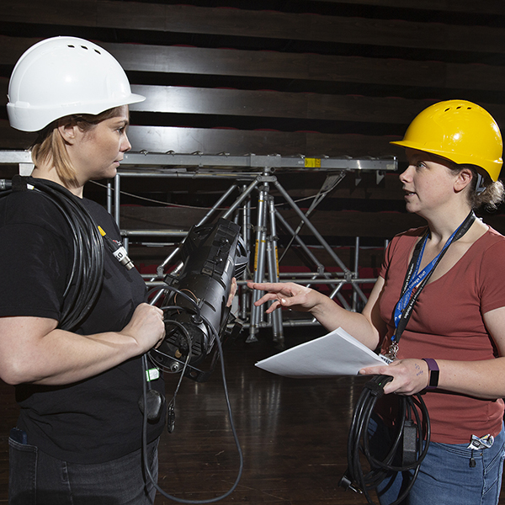
The emergence of FE & Skills
A world-class skills system with ‘Gold Standard’ Technical Qualifications
LSIPs - putting employers at the heart of the system…
The time to focus on Technical Skills

Slide 3
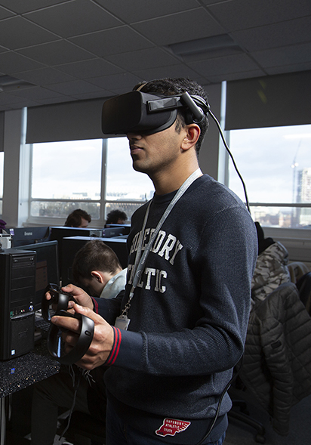

Delivering our Strategy to 2030 and our Vision
Talent Pipeline and alignment to priorities
Green Skills partnership work
Industry Advisory Boards
Meeting needs and delivering our NCG Mission

Slide 4

Skills competitions for talent development
WorldSkills UK Centre of Excellence
Exceptional Teaching and Learning
Positive impact on the region’s workforce and economy

