Slide 1
VET Facing the Future
Idea exchange
El Iza Mohamedou
Head of the OECD Centre for Skills

Slide 2
Megatrends are changing skill needs
14% of jobs could be fully automated in the coming years, and an additional 32% of jobs can see significant changes due to automation.
The share of highly skilled jobs has increased by 25% in the past two decades, and today 50% of employment is in digital-intensive sectors. However, six out of ten adults lack basic ICT skills or have no computer experience
Populations are ageing, and in more than two-thirds of OECD countries at least one quarter of the population will be over 65 years of age by 2050.
The green transition implies a the adoption of greener technologies by employers, and a shift to clean and sustainable consumption.
COVID-19 crisis is accelerating some of these trends
2

Slide 3
VET can equip people with the right skills for the labour market
Employment rate of adults aged 25 to 34, by educational attainment
Notes: 2019 or latest year available Source: OECD Education at a Glance 2020
3

Slide 4
The UK’s VET sector is average in size…
Share of learners in upper-secondary education who are enrolled in vocational programmes (2018)
Note: In Italy, upper secondary vocational programmes include post-secondary non-tertiary programmes.
Source: OECD (2020_{[13]}), Education at a Glance 2020: OECD Indicators, https://dx.doi.org/10.1787/69096873-en
4

Slide 5
… also at the higher technical level (Level 4-5)
Entrants into tertiary education programmes, by programme type
5
1. Data for Belgium for short-cycle tertiary programmes refer to the Flemish Community only.
Source: OECD (2020_{[13]}), Education at a Glance 2020, Figure B4.2, https://doi.org/10.1787/69096873-en.

Slide 6
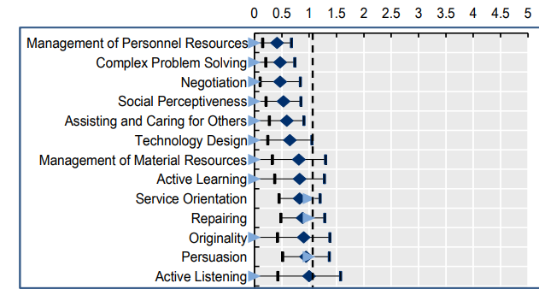
Some skills remain hard to automate
Skills and abilities with the lowest degree of automatability
Source: Lassébie and Quintini (2022_{[5]}), What skills and abilities can automation technologies replicate and what does it mean for workers?: New evidence; https://doi.org/10.1787/646aad77-en
6

Slide 7
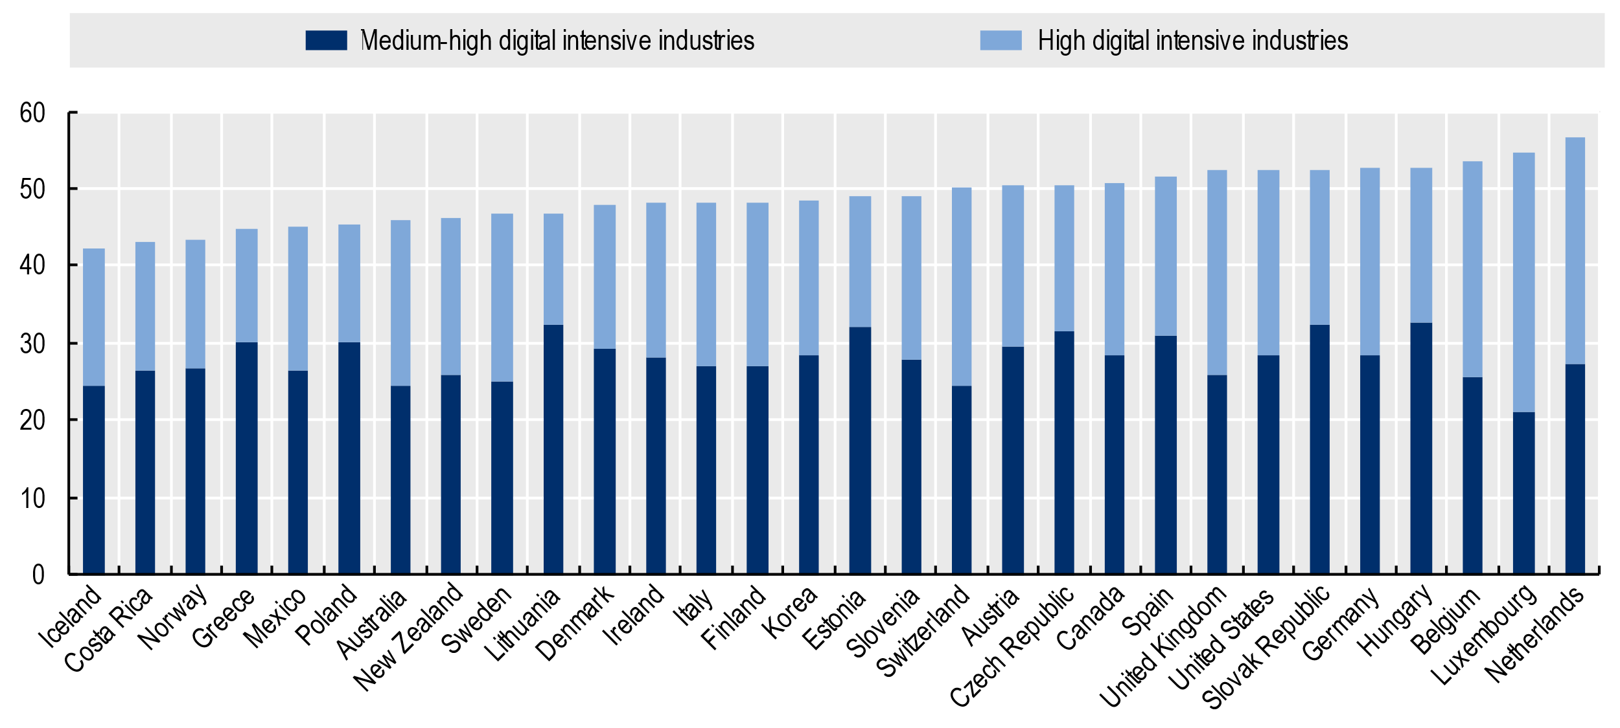
Employment in digital-intensive sectors is on the rise
Employment in digital intensive industries, 2018
Share of total employment
Note: Digital intensity is defined according to the taxonomy described in Calvino et al. (2018_{[7]})
Source: The OECD Going Digital Toolkit, based on the OECD Structural Analysis (STAN) Database, http://oe.cd/stan and the OECD Trade in Employment Database, http://oe.cd/io-emp.
7

Slide 8
VET covers many fields
Distribution of graduates and new entrants by field
Note: the remaining category is “unspecified field” Source: OECD Education at a Glance database
8

Slide 9
There is scope to expand to growing/emerging fields
Share of graduates in ICT field
Source: OECD Education at a Glance database
9

Slide 10
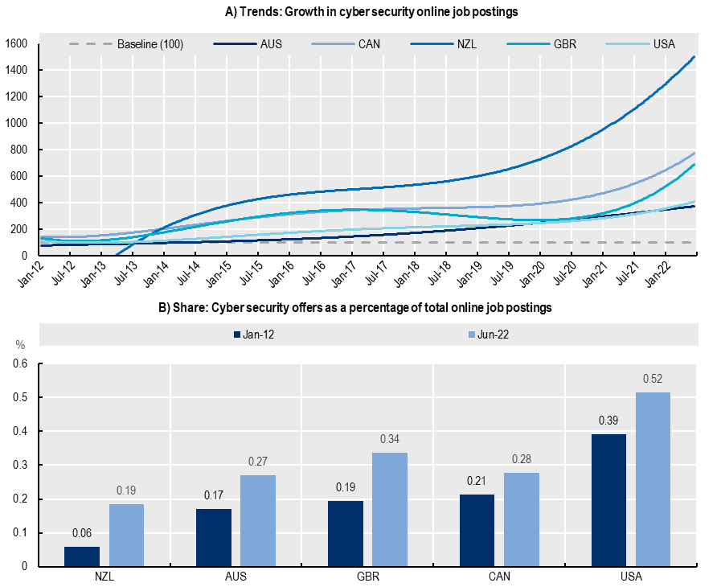
Example: The demand for cyber security professionals
Robust and increasing demand for cyber security professionals in Australia, Canada, New Zealand, the United Kingdom and the United States → The share of cyber security vacancies over the total amount of new job postings has increased over time
…even during the pandemic
Smaller markets show stronger growth than more consolidated markets (New Zealand vs. the United States)… a sort of “catch-up” effect…
Note: For panel A, polynomial trends are calculated on a standardised index (Jan-12 = 100) for the monthly count of job postings. This index shows the evolution in the demand for a given profession in comparison to this month. Data for NZL starts on January 2013.
Source: OECD calculations based on Lightcast data.
10

Slide 11
Example: Cyber security VET programmes in England (UK)
Level 2 and 3 FE programmes
Higher Technical education (Level 4 and 5)
Theses courses typically offer an introduction to the cyber security field.
Level 2
T-Levels
Apprenticeships
These courses allow learners to develop cyber security skills at more advanced levels.
Higher Technical Qualifications (HTQs).
Level 3
Cyber security technician at level 3 (intermediate)
cyber security technologist at level 4 (Higher level)
cyber security technical professional at level 6 (degree level).
Bootcamps
DfE Skills Bootcamps are free, flexible courses of up to 16 weeks at Levels 3-5, available in England, giving people the opportunity to build up sector-specific skills and fast-track to a job interview with a local employer once the training is completed
11

Slide 12
Re-engineering VET for the future
Responsiveness: Aligning training with skill needs
Innovation: Adopting innovative technology and pedagogical approaches
Supporting transitions: Developing transversal skills
Flexibility & inclusiveness: Making VET accessible to a diverse group of learners
12

Slide 13
Evidence-based policy making: International VET Assessment
Goal: To support countries in achieving high quality skills by developing, piloting and implementing an internationally standardised assessment of outcomes of initial VET programmes, the analysis of the results of which will enhance comparative policy insights on how to improve the relevance, quality, equity and effectiveness of initial VET programmes.
Focus on:
Automotive technicians
Business and administration workers
Electricians
Healthcare assistants
Hotel receptionists
with aspects of the green and digital transition covered as cross-cutting dimensions
Comprehensive dataset on VET
Beyond participation & employment rates
Internationally comparable data on the performance of VET systems
Peer learning opportunities
Raising the image of VET
13

Slide 14
Find out more
14
www.oecd.org/skills/ // El-Iza.MOHAMEDOU@oecd.org // https://twitter.com/ElIzaMohamedou

