Slide 1

GLOBAL BEST PRACTICES, INNOVATIVE SOLUTIONS TO FUTURE SKILLS CHALLENGES
09/03/2023
Presenter: Dipiloane Phutsisi (Prof.)
President: SAPCO
Date: 25 May 2023
Venue: New Castle College, UK

Slide 2
Table of contents
The Rationale – Future skills
Future world skills needed
PQM and best practices
TVET Colleges in RSA
SAPCO Mandate

Slide 3

About SAPCO
South African Public Colleges Organization (SAPCO) is an independent association of all 50 South African Technical, Vocational Education and Training Colleges, comprising of a National General Council.
The National Office Membership of the association is voluntary.
In terms of Governance, SAPCO accounts to its members in terms of the SAPCO Constitution/ Memorandum of Incorporation (as adopted in 2017 NGC).
Has a National Executive Committee (NEC) and office bearers comprised of elected Principals that are responsible for the affairs of the organization.
Is administered by a Chief Executive Officer.
SAPCO is funded through a combination of sources, including membership fees as its primary source of income.

Slide 4

SAPCO Mandate and Strategic Role
SAPCO derives its mandate from that of Department of Higher Education , Science and Innovation
SAPCO has a mandate to represent, promote and protect the interests of all public colleges, amongst its other objectives.
It provides common policy positions on numerous issues and to voice TVETs interest, as well as provide solutions to the challenges currently facing TVETs.
Has 50 member institutions, with 300 campuses and the total enrolment of 700 000 students

Slide 5
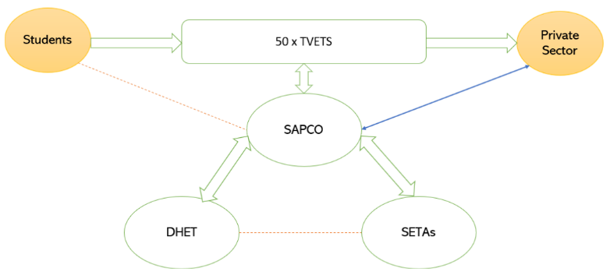

SAPCO Strategic Partnerships Framework

Slide 6

SAPCO Alignment – Government Imperatives
SAPCO’s government imperatives systems approach:
-NDP
-NSDP
-DHET Strategy
- SETAs Strategy Plan
-ERRP
- PYEI
-Industry demand (Social compact)
SAPCO TVET Support Programs
TVET Support outcome assessment

Slide 7
South African TVET Colleges sector
The history of technical and vocational education provision in South Africa has different origins, and their development was informed by quite different contexts.
The origin of the institutions formerly known as technical colleges in South Africa dates as far back as the 1800s. The demand for technical education to be made available to young people was a response to the industrial development in the late 1800s (mining)
Industrial education after the 1890s was associated with the social rehabilitation.

Slide 8
South African TVET Colleges sector
Introducti of the National Certificate: Vocational
Strengthening management and governance capacity
Merger of 152 former technical colleges and colleges of Education
Establishment of FET Colleges - 2002
Emergence
of 50 FET Colleges
Amendment of the FET Act 98 of 98, Colleges a National competency
Emergence of TVET Colleges

Slide 9
The Legislative Framework and the critical role of TVET Colleges
The National Skills Development Plan (NSDP) seeks to ensure that South Africa has adequate, appropriate and high quality skills that contribute towards economic growth, employment and social development.
NSDP derives its mandate from the National Development Plan (NDP), which emphasizes the importance of skills development against the skills deficit in our country.
Chapter 9 of the National Development Plan sets out a range of objectives to be met by 2030. Among others the following apply:
Expansion of the college system with a focus to improve quality. The recommended participation rate in the TVET College sector is 1,25 million enrolments
Production of 30 000 artisans by 2030.
The NDP situates TVET Colleges as critical pillars of the Post School Education and Training System, vital for social and economic development
The Continuing Education and Training Act (previously known as Further Education and Training Colleges Act) 16 of 2006 as amended, is the primary legislation that establishes TVET Colleges.

Slide 10
TVET COLLEGES AND SUSTAINABLE DEVELOPMENT GOALS
The key role of Technical,vocational education training is one of the easiest way to get away from poverty and improve your skill. In addition to achieving the following sustainable development goals: goal 4, goal 5, goal 8, goal 9 and goal 10. These includes (1). end poverty in all its forms everywhere (2). promote sustained, inclusive and sustainable economic growth (3). full and productive employment and decent work for all (5). reduce inequality within and among countries, ensure inclusive and equitable quality education and promote lifelong learning opportunities for all will be achieve with effective and efficient TVET. All these SDG, s and the main trust of our education polices and regulatory framework in South Africa.

Slide 11




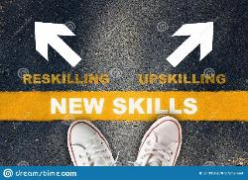
The rationale – future skills and sustainability
COVID-19 crisis
Digitization of customer interactions and company operations
Online teaching and learning

Slide 12
Defining skills needed in the future world of work in relation to SGDs
Digital and AI technologies transformed the world of work and that today’s workforce will need to learn new skills
Research has shown that high-level skills have become increasingly important.
The need for manual and physical skills, as well as basic cognitive ones, decline, but demand for technological, social and emotional, and higher cognitive skills is growing
Governments are keen to help their citizens develop in these areas, but it is hard to devise curricula and the best learning strategies without being more precise about the skills needed.

Slide 13
Defining skills needed in the future world of work
World Economic Forum's Future of Jobs Report, which maps the jobs and skills of the future
For those workers who stay in their roles, the share of core skills that will change
Forum estimates that by 2025, 85 million jobs may be displaced by a shift in the division of labour between humans and machines.
Critical thinking and problem-solving top the list of skills that employers believe will grow in prominence in the next five years.
Greater adoption of technology-demand of new skills across jobs, and skills gaps will continue to be high.
Newly emerging this year are skills in self-management such as active learning, resilience, stress tolerance and flexibility.

Slide 14
Future of work in RSA
McKinsey paper, The future of work in South Africa: Digitisation, productivity, and job creation (2019) states that: “ Digitisation and automation could result in a net gain of up to 1.2 million jobs in South Africa by 2030, and companies need to move fast to capitalise on these opportunities.”
The advance of technologies such as machine learning, artificial intelligence, and advanced robotics will have a far-reaching impact on South Africa’s workplaces. Although digitisation will be disruptive, it has the potential to raise productivity and operational efficiency in businesses across sectors, to deliver better outcomes for both customers and citizens, and to create millions of high-quality jobs.

Slide 15
Future of work in RSA
While digitisation disrupts the world of work, overall, it creates more jobs than it destroys.
Technology-enabled jobs will require higher skills levels than most of the jobs displaced. Digitisation could result in demand for an additional 1.7 million employees with higher education by 2030. Unless a higher percentage of South Africa’s graduates take technology-related jobs, much of that demand will go unmet—resulting in a serious skill shortfall across the economy.
South African decision makers, across sectors, must move boldly to ensure that reskilling is sufficient to help reabsorb workers into the workforce. They also need to strengthen the education system to generate technology-related and life skills at sufficient scale. Only then will South Africa successfully manage the massive workforce transformation ahead.

Slide 16
Critical Artisanal skills Needed in South Africa
South Africa has a startling unemployment rate of 34.5% (7,9 million) which is quite concerning.
We are currently only producing 15000 qualified artisans per year, but per the National Development Plan (NDP, 2030) targets, 30,000 is required by 2030, and we are only 42.9% of the way there since the implementation of the NDP in 2012.
There are countless trades that fall within the artisan field, but the top artisan trades in highest in demand are:
Bricklayers, Electricians, Millwrights, Boilermakers, Plumbers, Mechanics (including automotive), Diesel Mechanics, Carpenters and Joiners, Welders, Riggers, Fitter andTurners, Mechanical Fitters and Pipe Fitters
The highest in demand are the trades within the construction industry.
Historically, artisanship has been a male driven industry with less than 10% of artisans being women.
However, it is pleasing to see women participating as artisans increasing
In 2017, 57% of students that enrolled in a technical and vocational college were female.

Slide 17
Aviation Sector and Critical Skills Needed
There is a demand for newly qualified aviation personnel (602,000 new pilots, 610,000 new maintenance technicians, 899,000 new cabin crew members will be needed to fly and maintain the global commercial fleet over the next 20 years. (Pilot & Technician outlook for 2022 -2041)
Projected skills required: pilot, aircraft technician and cabin crew demand is wholly dependent on industry's investment in a steady pipeline of newly qualified personnel to replace those who have left or will soon leave the industry through retirement, recent layoffs and furloughs, and ongoing attrition.
The global aviation industry will need to keep a sharp focus and engage in collective efforts to build a robust, diverse talent pipeline through more educational outreach and recruitment programs, development of new pathways to aviation careers, investment in early-career learning opportunities,

Slide 18
IT Sector and Critical Skills Needed
The Future of Jobs Report projects that, by 2025, people and machines will work the same amount of hours.
Automation will displace around 85 million jobs – mostly manual and repetitive roles, ranging from assembly factory workers to accountants.
The same report predicts that the following skills will be in high demand by 2025:
Data Science & Cloud Computing (Cloud computing goes hand in hand with data science, and cloud computing jobs range from architects and developers to data scientists)
Artificial intelligence (AI) and machine learning (ML)
Big Data Science
Digital Marketing & Strategy
Process Automation
Business development
Digital Transformation
Information Security (including the cybersecurity subset of information security)
Software and Application Development (UX/UI, blockchain programming)
Internet of Things

Slide 19
Agricultural Sector and Critical Skills Needed
Emerging technologies are changing the role of farmers, agronomists and agricultural intermediaries.
Every job in farming will require some reskilling in the coming decade.
As the human-robot relationship is defined, data analysis skills will be particularly important.
Emerging technologies in the field such as artificial intelligence, computer vision and robotics will play a key role in the ability to improve the productivity and performance needed to feed a growing population.
The following skills are in demand in agricultural sector :
Landscaper
Horticulturist
Farming Manager
Fisheries Manager
Pest control Specialist
Arborist
Agricultural Equipment Representative

Slide 20
BEST PRACTICES ON RESPONSIVENESS AT TVET COLLEGES
A random sample of colleges , 1 college per Province considered
Focus was on how responsive colleges are, considering their different levels
Intent: To showcase the progress made by colleges on their own and in some cases supported by various stakeholders
This exercise is meant to assure a good return on invest done as well as the level of expertise and capacity available at colleges

Slide 21


SEDIBENG TVET COLLEGE IN GAUTENG PROVINCE

Slide 22

PARTNERSHIP WITH INDUSTRIES
The College believes that offering skills programmes in partnership with industries in these two sectors will provide opportunities to grow better relationships that may be extended to increase funding and student placement opportunities.

Slide 23

APPRENTICESHIP PROGRAMME OFFERED
No. of Learners Approved: |  | 488 |  | No. of Learners Reported: |  |  |  | 251
TRADE | APPROVED |  | ENROLLED |  | DROP -OUTS | COMPLETED | Awaiting Trade-Test/ Placement
Electrical | 106 |  | 107 |  | 8 | 20 | 68
Fitting & Turning | 86 |  | 90 |  | 25 | 11 | 44
Panel Beating & Spray Painting | 26 |  | 26 |  | 0 | 26 | 0
Administration | 28 |  | 22 |  | 0 | 22 | 0
Business Management |  |  | 1 |  | 0 | 1 | 0
Hospitality |  |  | 1 |  | 0 | 1 | 0
Human Resource Management |  |  | 1 |  | 0 | 1 | 0
Marketing |  |  | 3 |  | 0 | 3 | 0
TOTALS | 246 |  | 251 |  | 33 | 85 | 112
The following programmes were not implemented due to non/ Expired Accreditation:
TRADE | APPROVED NO. |  |  |  | NB: There is a discrepancy of 5 learners in the reported numbers above. This is due to the fact that the college enrolled more learners in the Electrical Engineering and Fitting and Turning trades.
Beauty and Nail Technology | 42
Basic First Aid | 200
TOTALS | 242

Slide 24
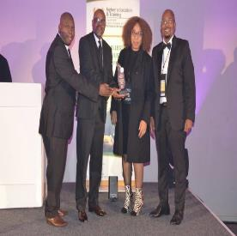
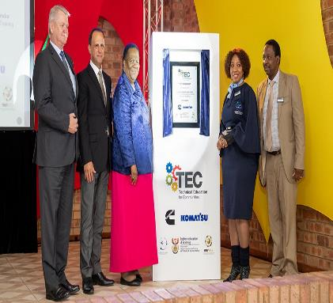


INTERNATIONAL PARTNERSHIPS
The Cummins and Komatsu have a Technical Education for Communities (TEC) programme at the Sedibeng Technical and Vocational Education and Training (TVET) College.

Slide 25
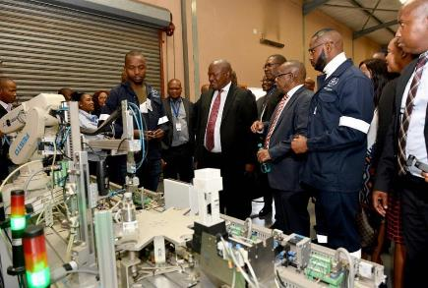
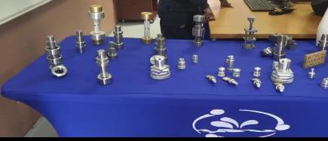
INTERNATIONAL PARTNERSHIPS
The Cummins and Komatsu donated equipment, and trained staff and students at their plants as well as at the college.
30 students from NC(V) level 2 in Automotive and electrical Engineering participating.
Upon completion of NC(V) level 4, students are selected for an apprenticeship at Cummins and Komatsu.
The first 11 graduates were placed within the industry in 2021 and 2022, respectively

Slide 26
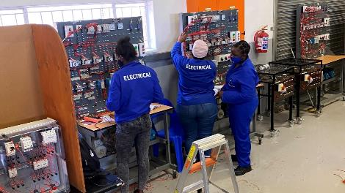
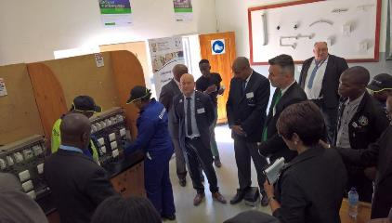
INTERNATIONAL PARTNERSHIP
Schneider Electric South Africa has partnered with Sedibeng TVET College since 2016 to enhance the vocational and practical training of students in the energy field. Sedibeng TVET College has reported more than 1,800 students trained in their laboratories on Schneider Electric state of the art equipment over the years.
The student figures reported for 2021 and 2022 year to date are as follows:
2021: 398
2022 YTD: 177
TOTAL: 575

Slide 27
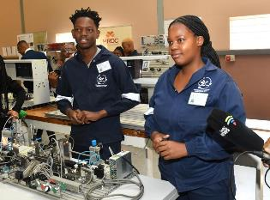
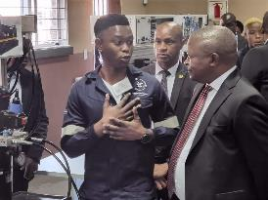
WSC - MECHATRONICS
The participation of the two Mechatronics students at the world skills completion in Russia, Kazan, has been a milestone. Thabang Isaac Modise and Tebogo Shabangu, both from Vereeniging Campus, obtained gold medals in the national competitions that were held in Durban in 2019.
They both represented South Africa in 2019 at the World Skills competitions in Russia in the field of Mechatronics.
After the WSC, Thabang and Tebogo were appointed by FESTO to complete the apprenticeship in mechatronics.

Slide 28


VHEMBHE TVET COLLEGE

Slide 30
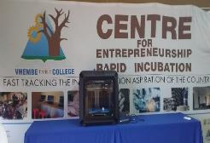
4 IR Lab in Partnership with ETDP SETA, ( Assembling Arm Robots and CYBER Security equipment robots

Slide 31
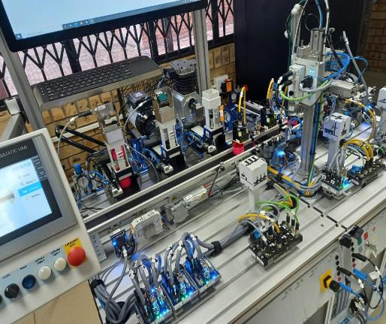
4 IR Lab in Partnership with ETDP SETA, (Assembling Arm Robots and CYBER Security Equipment)
36
Robotics (Bionic and Microcontrollers)
Industrial Robotics
Mobile Robotics
Automation Technology
Intelligent Components and Industry 4.0 System
Drones.
Coding machines
Digital designs
Agriculture ( Water smart)

Slide 32
HP Life centre in Partnership with HP and Hemmerberg. Online Centre with 32 programs of entrepreneurship, Advertising online, Business finance, Business communication. Students do online courses and get a certificate upon completion. Open for Community as well.

Slide 33
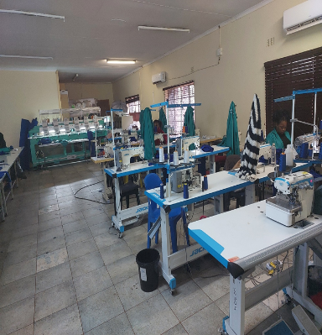
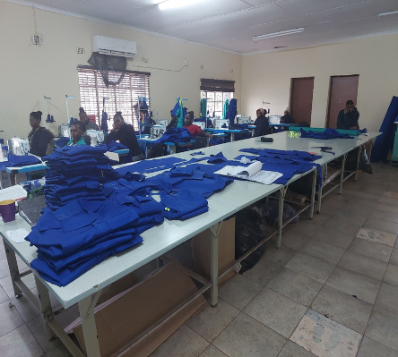
Clothing Production Plant Producing work suits, serves as workplace for N6 students. Mass production and supply of protective clothing for the college and local institutions and workplaces

Slide 34
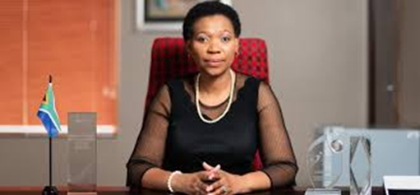
Best Practice- Elangeni TVET College (Leadership & Management)
For effective administration of the College, Management has:
Developed sound systems and processes that guides institutional operation.
Staff Development
Effective Student Support Services
Consequence Management
Staff Wellness
International partnerships

Slide 35
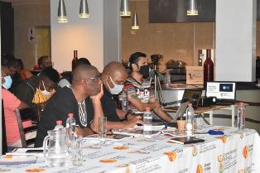
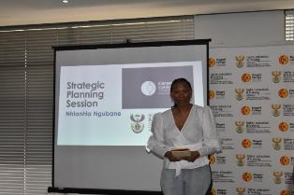
Elangeni TVET College-
(The role of College Council)
Elangeni TVET College has effective College Council structure, will all sub-committees of council.
For ETVET College, Council plays a critical role in ensuring good governance by:
Preforming oversight function
Development of policies
Development of a College Strategic Plan
Ensuring accountability by Management

Slide 36




International Partnerships-Elangeni TVET College
USA CCI Programme
Chines Cultural Exchange Programme
British Council
Nuffic Project

Slide 37
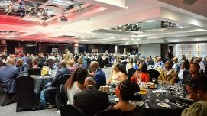
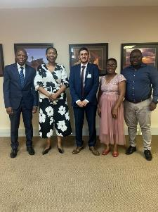
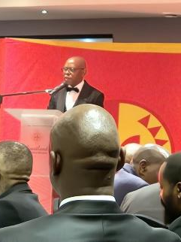
Public Private Partnership at Elangeni TVET College
The College is working towards building a strong Public partnerships
The College is working towards building a strong Public partnerships with various stakeholders through the following stakeholder engagement strategy:
Hosting Gala Dinners
Business breakfast
Various community Forums

Slide 38




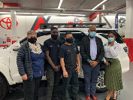





Continued…..

Slide 39












Western Cape TVET Colleges

Slide 40

Centres of Specialisation
(CoS)
Implementation of the Dual Model
A ground breaking Skills
Development Initiative that aligns to and supports the Artisanal skills needs of Industry and the Economy at large.

Slide 41
How does it work?
‘Dual system’ apprenticeships that combine
  technical education at a TVET college with..
  simulated practical training and…
  lots of authentic work experience
in a single, integrated learning programme, presented through a re-iterative process
With employers in the driver’s seat!

Slide 42




What is a Centre of Specialisation?
A skilled and capable workforce to support inclusive economic growth
A national programme aimed at producing:
Increased availability of critical technical artisanal skills
Increased delivery of qualified artisans in 13 priority trades
Substantively enhanced capacity of public TVET colleges to deliver critical skills in demand by the economy

Slide 43
CoS SUCCESS INDICATORS: 2019 COHORT
CoS Qualifications | COLLEGES | # ENROLLED | # MET REQUIREMENT | # PASSED TRADE TEST | # IN THE PROCESS OF BEING TRADE TESTED/ARPL
Automotive Motor Mechanic | CCT | 24 | 22 | 22 | N/A
Bricklayer | SCC | 18 | 13 | 8 | 5
Fitter and Turner | NLC | 32 | 32 | 31 | 1 (ARPL)
Mechanical Fitter | FBC | 27 | 24 | 24 | N/A
Pipe Fitter Group 1 &2 | WCC | 62 | 49 | 8 | 41
Plumber | CCT | 18 | 18 | 1 | 17
Rigger | FBC | 30 | 27 | 27 | N/A
Welder | BLC | 30 | 20 | 4 | 16
TOTAL # |  | 241 | 205 | 125 | 80
% |  |  | 85% met requirement (measured against enrolled) | 61% Passed TT (measured against met requirement) | 39% (measured against met requirement)

Slide 44
Expansion of Dual Training beyond CoS
2023 WC Colleges expansion of Non-Trade specific qualifications
Focus Area and Model | Current Occupational Programmes | # Per Qualification
Agri/Dual | OC: Orchard and Vineyard Foreman | 1
Business/Dual | OC: Management Assistant | 1
Business/Dual | OC: Project Manager | 2
ICT/Dual | OC: Computer Technician | 3
Services/Dual | OC: Youth and Child Care | 1
Services/ECD/Dual | OC: Early Childhood Development Practitioner | 2
Services/Hairdressing/Dual | OC: Hairdresser | 2
Services/Hospitality/Dual | OC: Chef | 2
# of New OC Non Trade Qualifications using Dual Training Model |  | 14

Slide 45

UMFOLOZI TVET COLLEGE –KZN PROVINCE

Slide 46










Occupational Programmes : Artisan development
COS
Occupational Certificate Plumbing
TRADE TEST CENTRES
Occupational Certificate Millwright
Alton Training Centre
Occupational Certificate Rigging
CENTRE OF SPESIALISATION
Occupational Certificate Boilermaking
Esikhawini Civil Training Centre
TRADE TEST
Occupational Certificate Rigging
APPRENTICESHIP TRAINING
Richtek Technical Training Centre
Electrician
Mchanical Machiinst / Turner
Mandeni Technical Training Centre
Millwright
OCCUPATIONAL PROGRAMMES
Fitter and Turner
Sundumbili Technical Training Centre
Mechanical Fitter
SKILLS DEVELOPMENT PROVIDER
Welder
Occupational Certificate Fitter

Slide 47
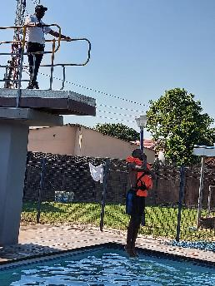
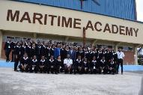
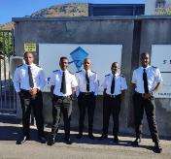
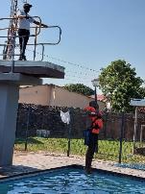



Maritime Academy; Samsa Accreditation
Maritime STUDIES
Nated Programme
Maritime Engineering Workshop Training
STCW Courses
Mathematics N4
Engineering Science N4
Industrial Electronics N3
Engineering Drawing N3
Power Machines N5
Electrotechnics N4
Mechanotechnics N4
Maritime Nautical and Engineering Programmes
Marine Law
Engineering Knowledge
Naval Architecture
Personal Safety and Social responsibility
Proficiency in Survival Techniques
Elementary First Aid At Sea
Step to step Computers
Pneumatics; Hydraulics
Diesel Mechanics
Fitting and Machining
Welding
Electrical
Fire Fighting
Sheetmetal
Security Awareness
Marine Motorman Higher Grade Programme
2 March 2020– 1 March 2023
2 March 2020– 1 March 2023
Marine Motorman Grade 2
Personal Safety and Social Responsibility
2 March 2020– 1 March 2023
Marine Engineer Officer Programme (as per SAMSA Code):Engineering Knowledge
Marine Engineer Combined Workshop Skills Training
Naval Architecture -Marine Law
Personal Survival Technique
Security Awareness -Designated Security Duties
Fire Prevention - Fire Fighting Medical First Aid
Computers - Marine English
Non- Accredited Courses
Marine Motorman Grade 2
2 March 2020– 1 March 2023
16 March 2020 – 15 March 2023
10 June 2019-9 June 2022
10 June 2019-9 June 2022
Submitted
Outsourced
Renewal
Programme Qualification Mix

Slide 48
Entrepreneurship : IRM Hub
Entrepreneurship Programme
17 SMME’s
Training of the Trainer Programme
  Online Training
Artisan Recognition of Prior Learning (ARPL)
ARPL Toolkit Assessment
Trade Test Preparation
Trade Testing : Electrical and Mechanical
Assistant Handyman Programme
Carpentry, Plumbing, Domestic Wiring, Painting and Flooring
49 Candidates
ASSISTANT HANDYMAN
PPE STORGE AND DISTRIBUTION
IRM HUB
IRM HUB

Slide 49
GOLDFIELDS TVET COLLEGE CFERI

Slide 50
Self-Sustainability – Revenue Generating Strategy.
Joint Funding Application – SETA’s
Public Private Partnership – CSI and Government Grants
Enterprise Supplier Development.
Post Graduate SMME’s Support to Centre Strategy.
Use Available Resources for Income Generating.
Cost CFERI programme outside the Centre.

Slide 51
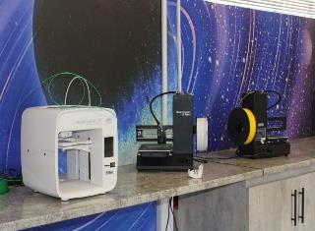
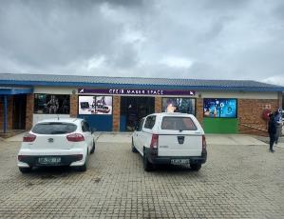
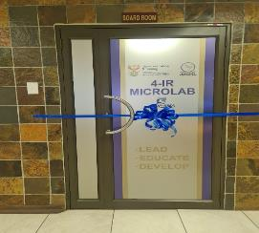
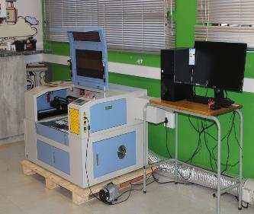
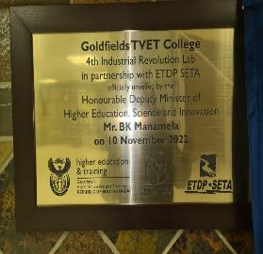
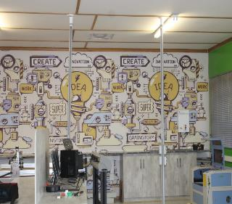

Slide 52



West Coast College
Solar Photovoltaic Service Technician (SPVT)
MerSETA -ICT4APP

Slide 53
Solar Photovoltaic Service Technician
Training students with the Merseta ICT4 App and completing their practical exposure and assessment at the Vredenburg Campus in the following:
Solar Photovoltaic System Mounter (Stand-alone Installation), NQF Level 2, Credits 84
Solar Photovoltaic Installer (Stand-alone Installation), NQF Level 4, Credits 218
Solar Photovoltaic Technician (PV Farm), NQF Level 5, Credits 229
Solar Photovoltaic (PV) Service Technician (Stand-Alone Installation), NQF Level 5, Credits 245

Slide 54
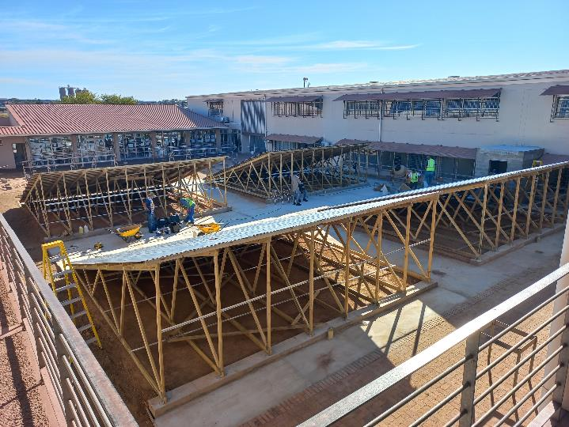

Slide 55

MOTHEO TECHNICAL VOCATIONAL EDUCATION AND TRAINING COLLEGE
A GATEWAY TO EMPLOYABILITY

Slide 56
Motheo TVET Academic Programmes.
In the previous five years Motheo TVET College focused on the following areas, among others:
Digitization of college application and registration systems,
Improvement of ICT Infrastructure
Rolling out quality management system,
Review of programme qualification mix towards responsiveness and employability
Accreditation of workshops,
Commercialization of the college workshops, salons, restaurant and other centres
Review of programme qualification mix in response to the needs of the labour market,
Contribution to artisan development,
Creation of opportunities for work place exposure for both lecturers and students,
Expansion of deliverables for the rapid incubator and centre for entrepreneurship as well as
Implementation of blended learning at all College sites and introduction of 4IR
Improvement of infrastructure
In addition, the College embarked on establishment of Meaningful Partnerships with business and industry, locally, nationally and internationally. Over and above that the College experienced a significant increase in subject pass rate as well as throughput rate.

Slide 57
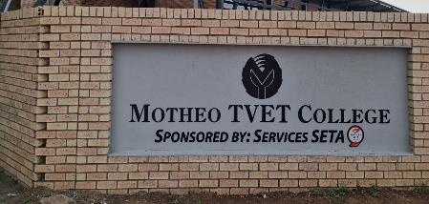
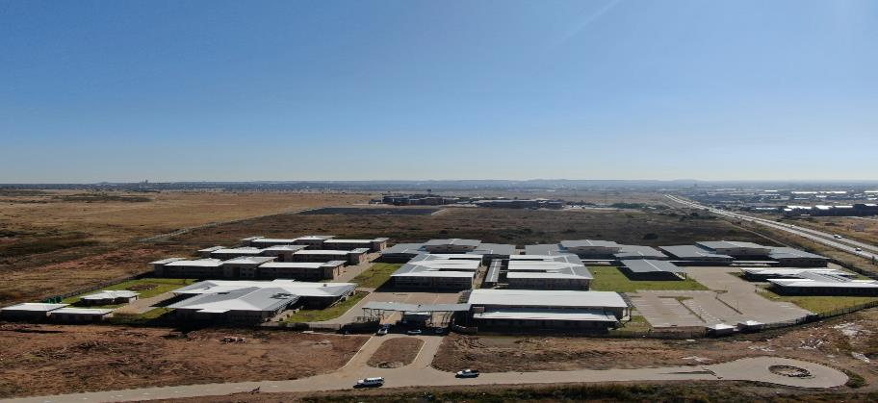
National Artisan Development Academy

Slide 58
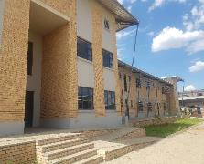
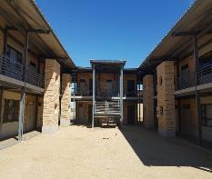
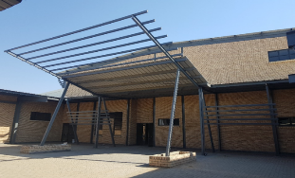
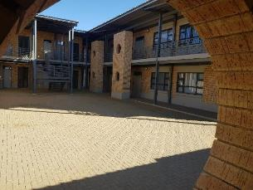
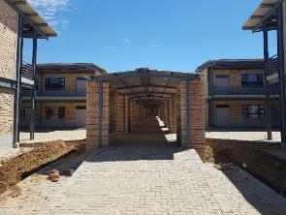
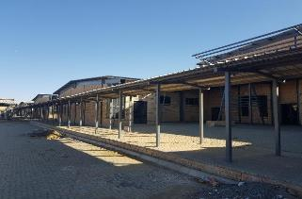
Available facilities
3 Buildings with 12 Workshops
Hostels
7 Learning Spaces per Building
Capacity of about 360 learners/sitting
16 Standard Theoretical, 16 Computer labs/hub
35 Learners per learning Spaces
Capacity of 560 Learners

Slide 59
Grouping of occupations by level of similarity
Group 1 | Group 2 | Group 3 | Group 4 | Group 5
Electrician Millwright | Bricklayer Plasterer Wall and Floor Tiler | Carpenter Carpenter and Joiner | Pipe fitter Plumber | Boilermaker Welder Structural Plater Patternmaker
Group 6 | Group 7 | Group 8 | Group 9 | Single: no group
Fitter and Turner Moulder Industrial Machinery Mechanic Fitter Packaging Manufacturing Machine Setter Metal Machinist | Transportation Electrician / Auto Electrician Diesel Mechanic Automotive Motor Mechanic Heavy Equipment Mechanic | Wood Machinist Upholsterer | Goldsmith Diamond and Gemstone Setter | Earthmoving Plant Operator (General) Rigger Instrument Mechanician Screen Printing Technician Panelbeater

Slide 60
Occupational Certificates (OC) – New Apprenticeship
No. | Programme | Entry Requirements | Number/Year
1. | OC: Hairdresser | Grade10, NQF L2 or equivalent | 60
2. | OC: Goldsmith | NQF Level 4 qualification | 15
3. | OC: Bricklayer | NQF Level 3 qualification | 60
4. | OC: Carpenter | NQF Level 3 qualification | 30
5. | OC: Plumber | NQF Level 3 qualification | 30
6. | OC: Hot Water System Installer (Heat Pump Installer) | NQF Level 3 with Mathematics | 15
7. | OC: Hot Water System Installer (Solar Water Installer) | NQF Level 3 with Mathematics | 15
8. | OC: Painter | NQF Level 1 with Mathematics | 30
9. | OC: Electrician | NQF Level 1 qualification with Mathematics and Science | 60
10. | OC: Solar Photovoltaic Service Technician | NQF Level 4 qualification with mathematics | 15

Slide 61
Occupational Certificates (OC) – New Apprenticeship
No. | Programme | Entry Requirements | Number/Year
12. | OC: Welder | NQF Level 1 with Mathematics and Science | 30
13. | OC: Boilermaker | NQF Level 1 with Mathematics and Science | 30

Slide 62
Programmes at the ICT Hub
The College formed a strategic partnership with MICT SETA and Tshwane University Technology(TUT) as an ICT centre of excellence
ICT Related programmes to be offered at the Artisan Academy from 2023 are:
  Industry 4.0
  Water Technology
  Electronic Waste Management
  Robotics
  CAD/CAM
  Pneumatics & Hydraulics
  Artificial Intelligence
  Mechatronics
  Renewable Energy
  First Research Chair for IT Programmes First TVET College

Slide 63
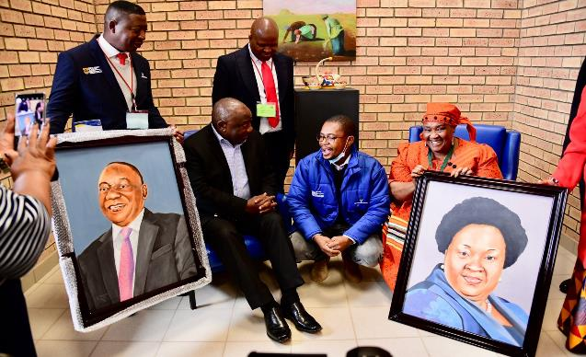
A day to remember when Pres. Ramaphosa received his portrait done Art &Design Lecturer and students

Slide 64
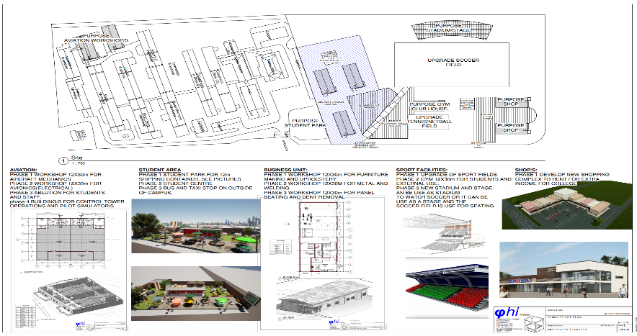
Future Changes – Furniture Factory, Aviation Workshop & SSS Centre

Slide 65
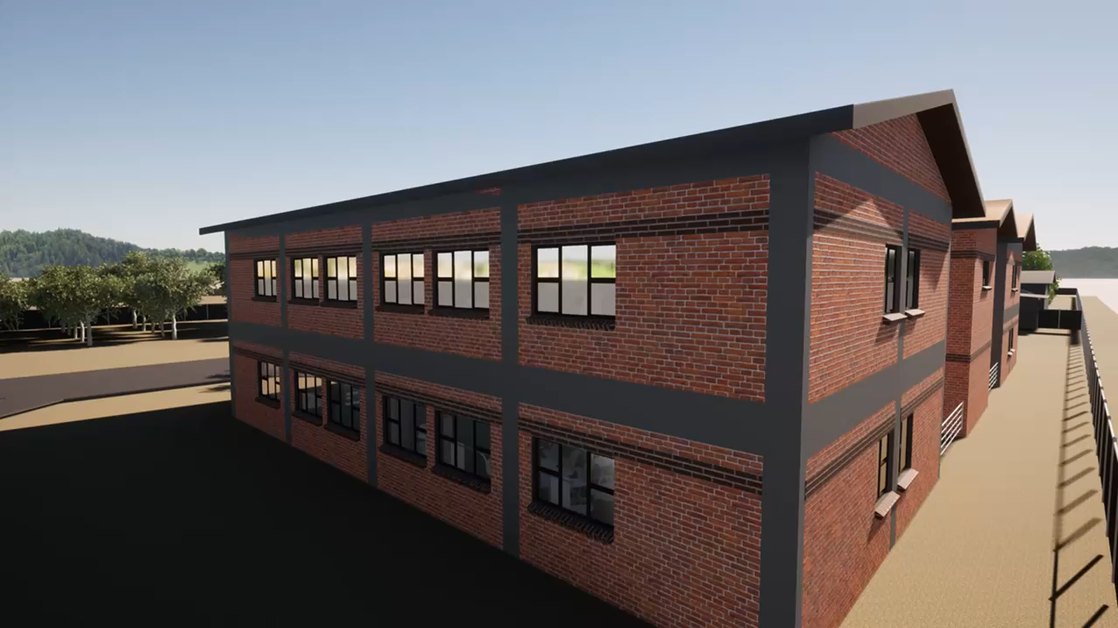
New Infrastructure at Plot 32(Abbattoir)

Slide 66
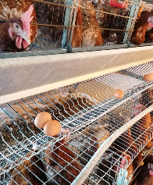
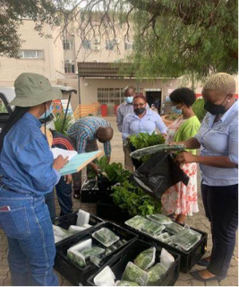
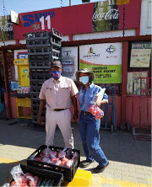
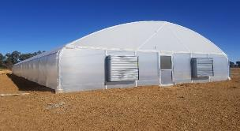
Chickens & Eggs
Sales to Staff
The Fresh Produce
PLOT 32
Sales to local stores
Green house

Slide 67
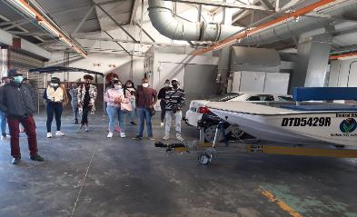
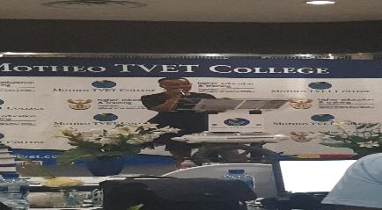
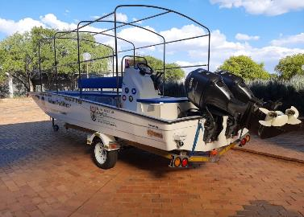


Slide 68


SA-Navy site suitability engagement meeting.
113

Slide 69



Maritime Studies
The College Boat
The students training as skippers
The Campus Manager address our students during the induction session

Slide 70



Maritime Simulator Building

Slide 71
Recommendations
Expand Employer Network for all dual training especially non-trade specific
Employment of students following OC qualification
Industry to offer Lecturers work placement opportunities
Soft Skills Training-work readiness programme
Industry to serve on Reference Committees
Industry Expertise e.g. Guest Lecturing
Student Placement for non-OC qualifications
Benchmarking against industry standards and international standards
Establishment of international reference groups would assist in delivering world-class TVET provision

Slide 72

THANK YOU

