Slide 1
Wellness

Slide 2
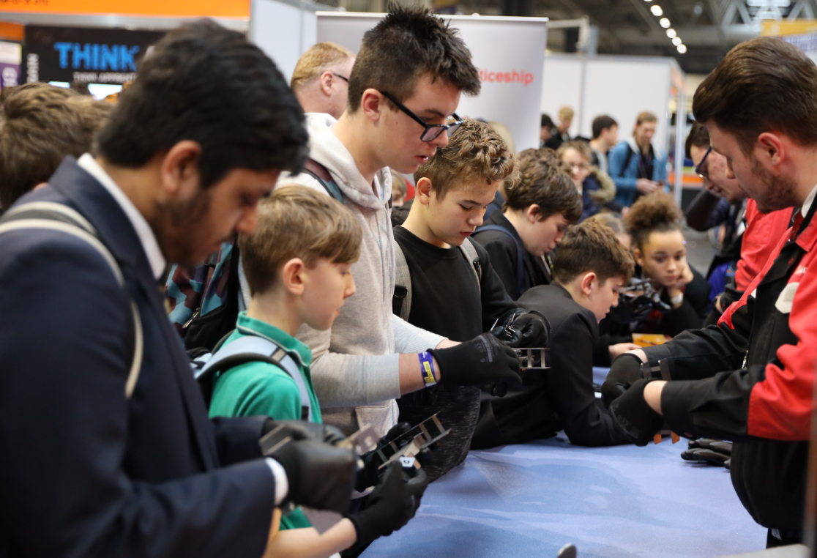
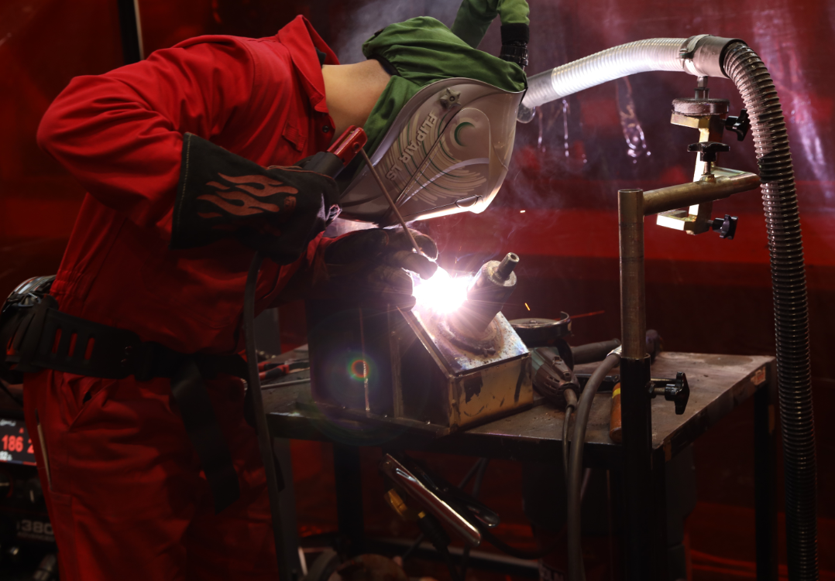
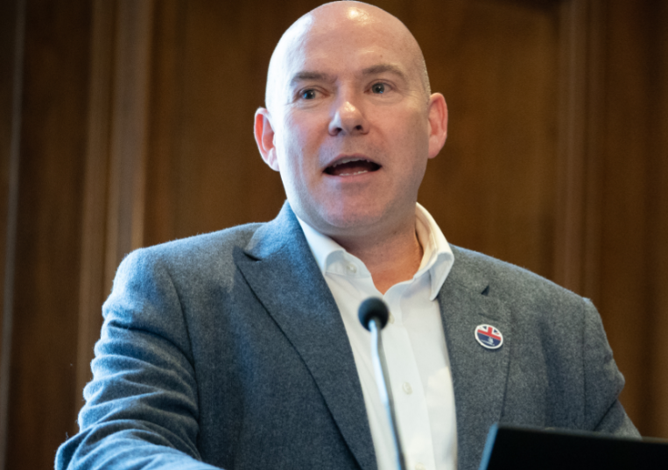
What we do
Inspire excellence
Develop excellence
Innovate excellence
We inspire young people via our careers advice resources to choose excellence through apprenticeships and technical education as a prestigious career route on their path to reaching their potential, whatever their background.
We develop excellence in young people by testing and assessing their skills and knowledge against their peers through our national and international competitions programmes, improving their confidence and potential.
We innovate to mainstream global excellence to help improve standards of teaching, training and assessment through international benchmarking to help young people, employers and the UK economy succeed.

Slide 3
Introduction
In this session you will learn about:
the importance of mental, physical and emotional wellbeing
how motivation and resilience now can have a huge impact on your future career and successes
how stress can lead to negative decisions
tools to keep motivated
coping strategies for everyday pressures
where and how you can ask for help and mental wellbeing support.

Slide 4
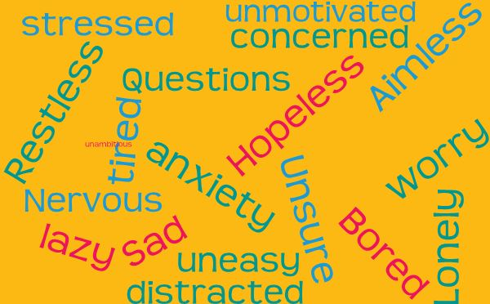
How do you feel?
Does the immediate future look different than what you were expecting?
The Covid-19 lockdown that we all find ourselves may have made you nervous about your present situation, and about your future.
It is completely normal for feelings of hopelessness and insecurity to have increased, and for your motivation levels to be at an all time low.
It is really important to look after yourself and your mental health at this time and not to lose momentum on your plans for the future.

Slide 5
The power of positive thinking
You would be amazed at how your emotional wellbeing affects so many different areas of your life.
If you are in a positive space, you tend to make positive decisions. Stress and anxiety can creep in without you noticing and can affect your mood, and negatively alter the decisions you make.
behaviour
decisions
thoughts

Slide 6

How do you stay stress free and motivated?
Being in lockdown can really affect your motivation, particularly if you were studying for exams that are no longer happening or you are struggling with online learning. It’s totally normal to feel stressed and to have lower levels of energy to do positive things.
Keep things in context and be kind to yourself.
Things are completely different from how you
expected them to be so don’t punish yourself for
having dips in mood or motivation now and then.
Look at the big picture: don’t worry about what this year has been like so far, it is a tiny chunk of time in comparison to your future ahead of you. Try and look beyond school and college to what you might want to do, and research which companies offer that career.
Be Kind
To Yourself

Slide 7
Hear from BAE Systems
Hear what hints and tips BAE Systems has for supporting your health and wellbeing:
If you don’t make time - you will never magically find it, there may never be a perfect time.
Every day for two weeks try and include three things into your day!
The total additional time is probably 15 – 20 minutes per day
But you will find you feel less tired and more positive than before you started!
Change your morning – give your self some you time!
At night - write 3 things your grateful for from that day.
Any of the below;
  meditation
  get outside
  affirmations
  readings
BAE Systems is one of the largest employers in the UK. To find out more information on how a career with them might be right for you visit their website here

Slide 8
Hear from BAE Systems
Looking after
yourself
It’s your responsibility!
don’t compare!
recognise your own state of wellbeing good or bad
mistakes happen just learn from them
be consistent with your routine
asking for help is OK!
social media is a window – nothing more…
get off your phone and get connected!

Slide 9
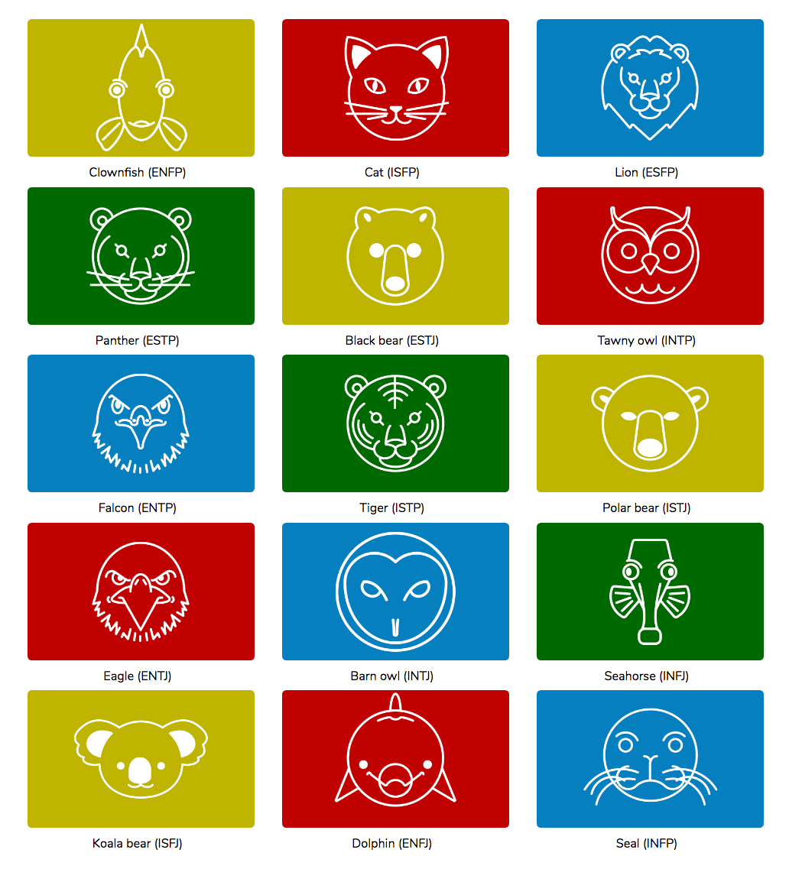
What type of animal are you?
Be proactive: Think about what jobs might interest you. Take the personality quiz at launchyourcareer.com/worldskills to see how your interests match to sectors and careers.
For your selected careers you
could research:
what qualifications and
experience you need to start a
career in those roles
what skills employers in those fields are looking for.

Slide 10
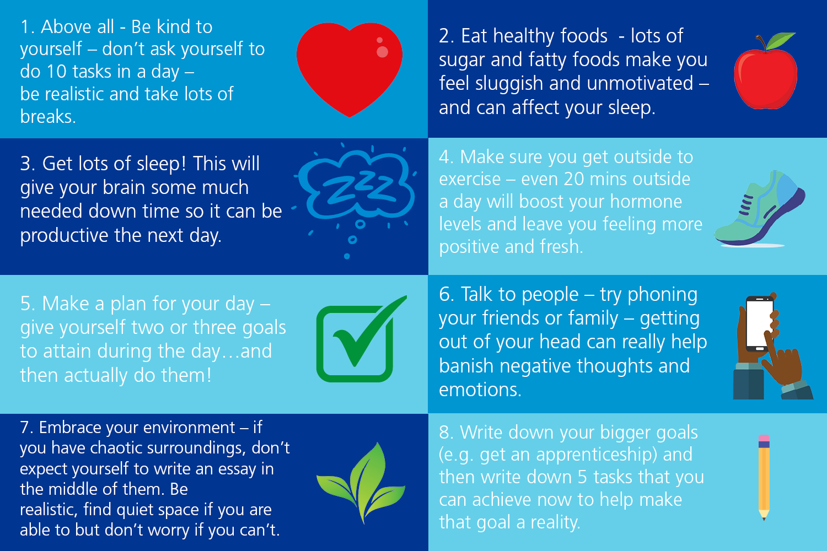
Stay positive and look after yourself

Slide 11
Listen to our wellness experts
Nikita Harron and Hayley Edwards are both WorldSkills UK alumni, having competed in the National Finals in 2013.
VIDEO
Now professionals in the healthcare industry, and performance coaches and wellness experts for WorldSkills UK, they share in this video their collective experience on wellbeing, and give tips and information on how to look after yours.

Slide 12
Wash-up
Hopefully you can draw on Nikita and Hayley’s experiences and absorb some of those tips into your own life.
You can see how important it is to be aware of your own wellbeing and to look after yourself.
Activity
  Complete the reflection sheet to show what it is you have learned from the session today and to see which skills you have already developed and progressed.

Slide 13
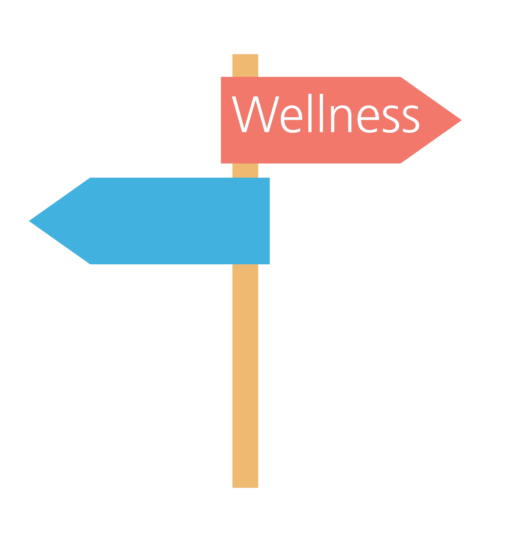
Signposts to more help
There is a huge array of resources available to assist you with your wellbeing and motivation levels. Take a look at any of the following for professional and comprehensive assistance:
NHS
https://www.nhs.uk/conditions/stress-anxiety-depression/improve-mental-wellbeing/
The Mix (essential support for under 25’s – talk to them
about almost anything)
https://www.themix.org.uk/
Young Minds (mental health support for
young people)
https://youngminds.org.uk/
BBC Bitesize (great lessons for independent learning and also tips on
motivation and wellbeing)
https://www.bbc.co.uk/bitesize/articles/zvyhpg8
Barclays Life Skills ( a free wellbeing toolkit full of videos, case studies and
advice)
https://barclayslifeskills.com/young-people/

