Slide 1
Preparing for interviews

Slide 2
Introduction
In this session you will learn:
what an interview is and the different types you may experience
how to prepare for an interview

Slide 3
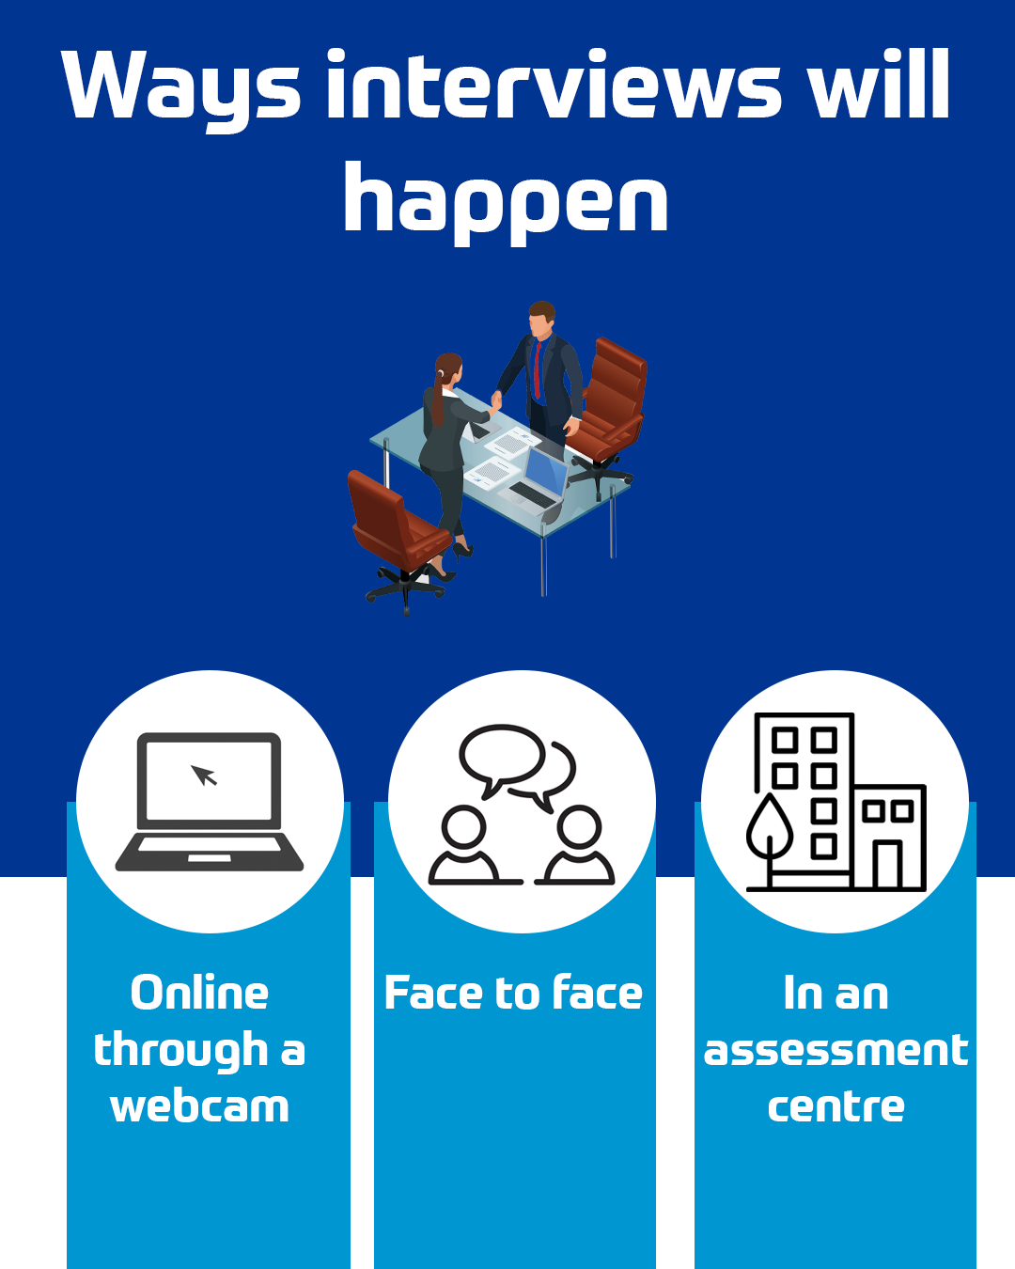
What is an interview?
An interview is an opportunity for someone who is hiring, to meet with a range of people who are interested in their job. The interviewer will be looking for the right person, so uses the interview to test someone’s skills, personality and performance.

Slide 4
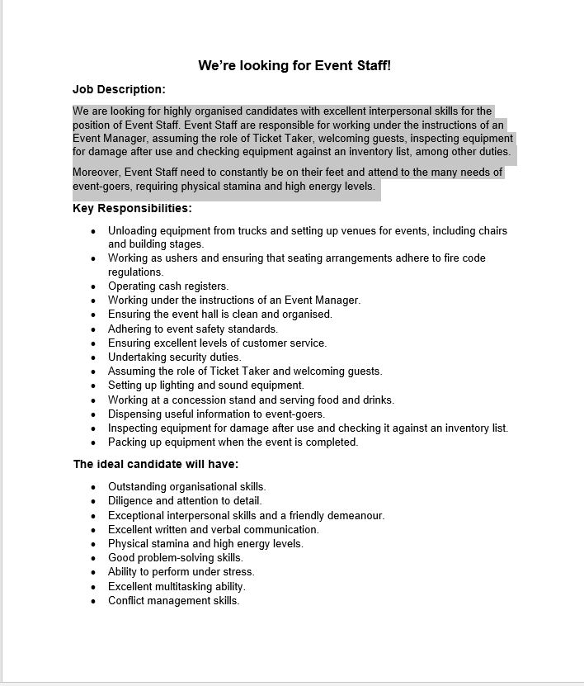
Every interview is different
Although every interview you have will be different, there are some common things the hiring person will be looking for:
Personal presentation
The character of the individual – will they fit into the team?
The skills a person has – does it meet the job description?
How prepared someone is – have they taken the time to learn about the company?
How enthusiastic they are – can you tell they care about the job?

Slide 5
Interview checklist
Activity
Complete the ‘Interview Checklist’ worksheet.

Slide 6
Interview practice questions
Work in pairs to answer the questions on the sheet. Remember that in a real interview session the employer is going to be looking to see:
how you present yourself - body language, motivation, etc.
if you will fit into the team
what your skills are and if they meet the job description
how prepared you are, that you have taken the time to learn about the company
how enthusiastic you are, that you care about the job

Slide 7
Wash-up
Activity
Complete the reflection sheet to show what it is you have learnt from the session today.
If you have a Young Professional account, do not forget you can use the reflection area to store your own reflections of this careers activity and record the skills you have used and have been developing.

