Slide 1
Preparing your first CV

Slide 2
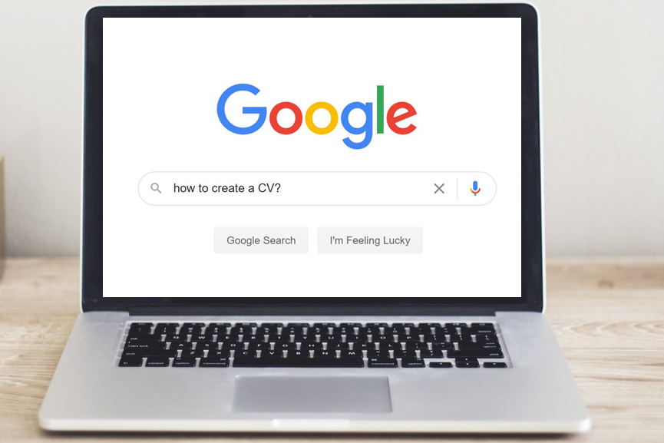
Introduction
In this session you will learn about:
what a CV is
how to create your own CV
about online job applications and sending a CV on spec.

Slide 3
What is a CV – Curriculum Vitae?
A CV is a document that details a person’s skills, education and work history. It is used by employers to understand a person’s capability for a job.
CVs are almost always required when you are applying for a job, even if it is a part-time job whilst you are still in education.
Often there will be multiple people applying for the same job, so a good CV can make all the difference in how successful you are.
What do you think are the key elements of a CV?

Slide 4
What do you include in your CV?
A CV has to include some key information:
name and contact details
a short statement
key skills
work experience
education experience
hobbies
references.
As you get older and have more
experiences, your CV will change.
It is important that you keep it up to date!

Slide 5
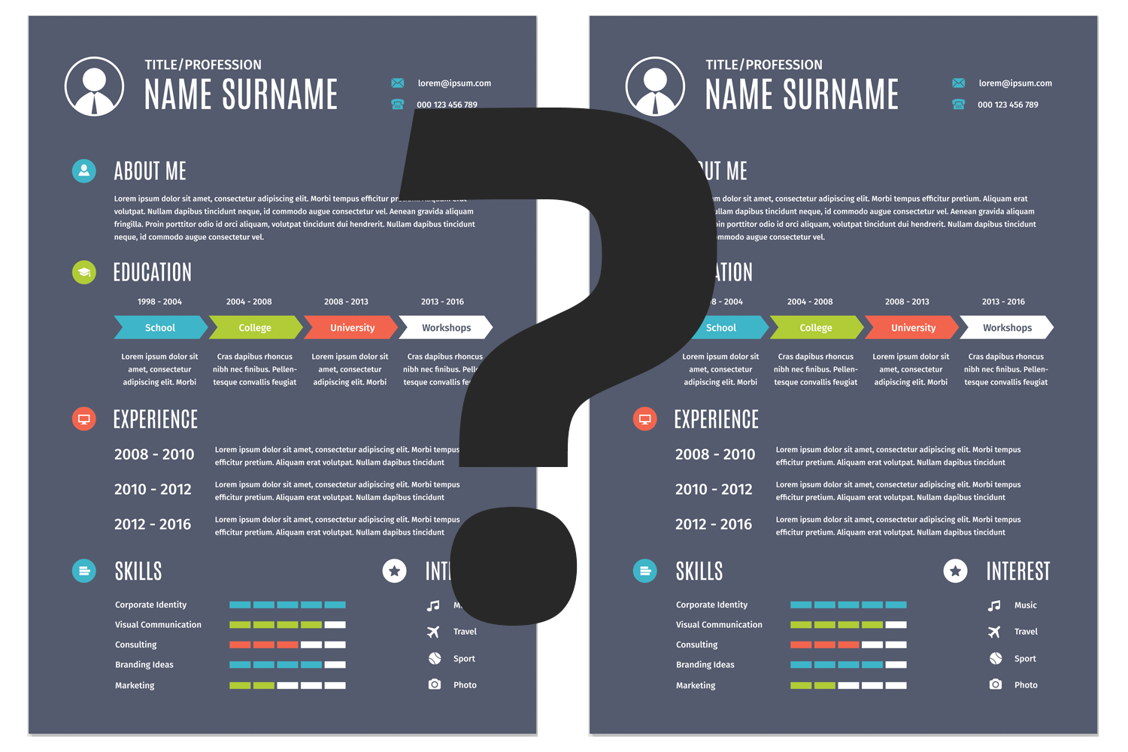
Can you get a CV wrong?
Imagine that you are applying for a customer service job in your local cinema. It is going to be a great job, will fit around school, the wages are good and you get free access to films.
Because it is a good job, the cinema is going to get more than 20 CVs in for one job. Do you think a CV can help you get the job, or do you not think it matters?
Imagine being the manager of the cinema and compare the two CVs you have in front of you – who would you pick and why?

Slide 6
Can you get a CV wrong?
Example 1
A great CV, with lots of information that the cinema manager can use to make a hiring decision.
Example 2 - Did you spot…?
email address
no phone number
personal statement
spelling mistakes
Hobbies
You get one shot at making a good impression with a CV.

Slide 7
Online applications
Some employers will not want you to send in a CV – this is because they have automated recruitment processes and so need the information provided to be in the same format as every applicant.
This might be major retailers such as Tesco, Primark, Next, etc. who get lots of interest in their jobs.
You usually apply online through the company’s website.
You can use the information from your CV to fill in the application form, as often they require the same data.

Slide 8
Wash-up
Activity
Complete the reflection sheet to show what it is you have learnt from the session today.
If you have a Young Professional account, do not forget you can use the reflection area to store your own reflections of this careers activity and record the skills you have used and have been developing.

