Slide 1
Building my skills for life and work
Notes:
Title slide

Slide 2
What we do
Inspire excellence
Develop excellence
Innovate excellence
We inspire young people via our careers advice resources to choose excellence through apprenticeships and technical education as a prestigious career route on their path to reaching their potential, whatever their background.
We develop excellence in young people by testing and assessing their skills and knowledge against their peers through our national and international competitions programmes, improving their confidence and potential.
We innovate to mainstream global excellence to help improve standards of teaching, training and assessment through international benchmarking to help young people, employers and the UK economy succeed.
Notes:
Standard slide and pic

Slide 3
In this session, learners will:
Match their personality type and interests to careers
Learn about the skills needed for the world of work
Identify Existing Skills
<Title of presentation>
1
Notes:
Standard slide

Slide 4
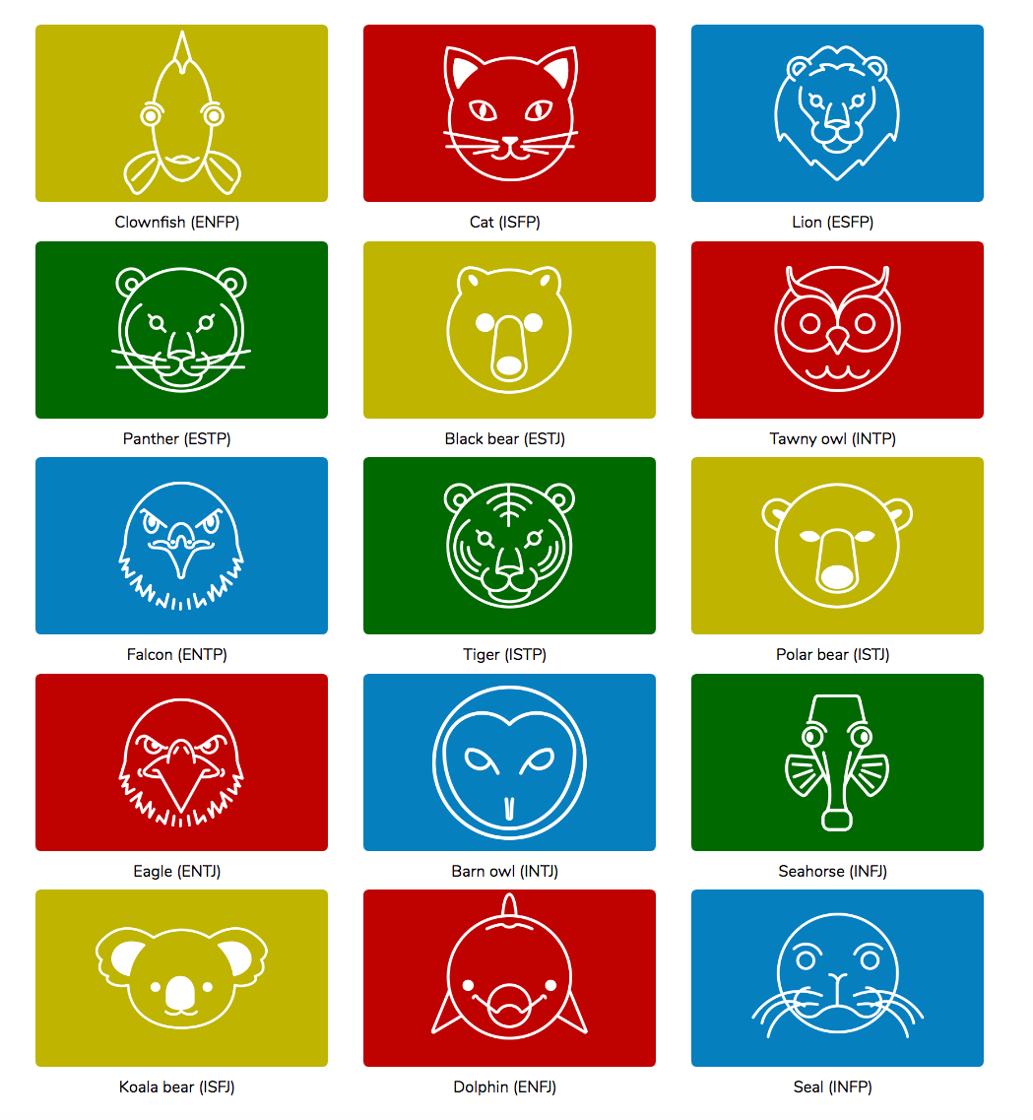
What type of animal are you?
Complete the Launchpad personality quiz...

Slide 5
Discussion
Briefly with the people next to you share which animal you got.
did anyone close to you get the same?
did you think your animal reflects you?
what sort of careers did it suggest you might enjoy?
did any of those jobs interest you?
Now click next to select your interests in the world of work. Your animal icon will show the areas you are most suited to.
Make sure you keep a note of your animal type and the types of careers the Buzz Quiz suggested!

Slide 6
Careers discussion
By selecting your interests and the sectors and sub sectors you should now have reached your chosen career – view the LMI stats and discuss
what does the job involve?
how much could you earn?
is this the demand for this job growing/declining?
watch the video to see what someone working in this career has to say.

Slide 7
The skills framework
Take the same Quiz again on the icould website.
This time you can see more of your behavioural skills.
Do you have all of the skills you need for the career and future of your dreams?
You are not born with the skills you need for the rest of your life – you learn and develop them each and every day!
Activity
Complete the Skills Framework sheet to find out what your skill strengths are and where you could improve.

Slide 8
Activity
Complete the reflection sheet to show what it is you have learnt from the session today.

