Slide 1

Post 16 Education: College

Slide 2
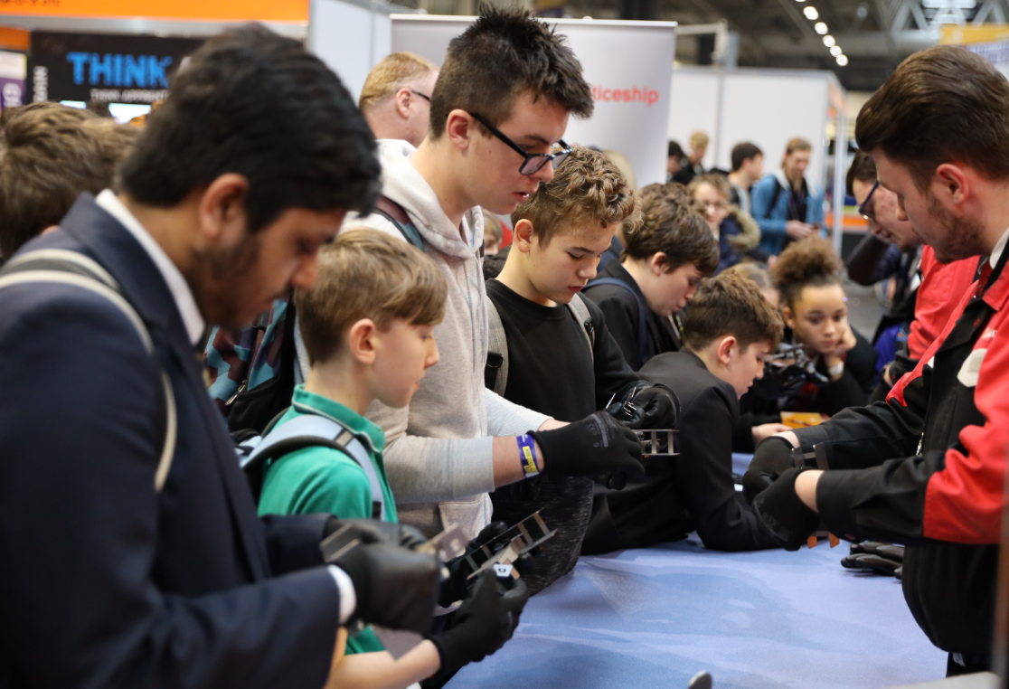
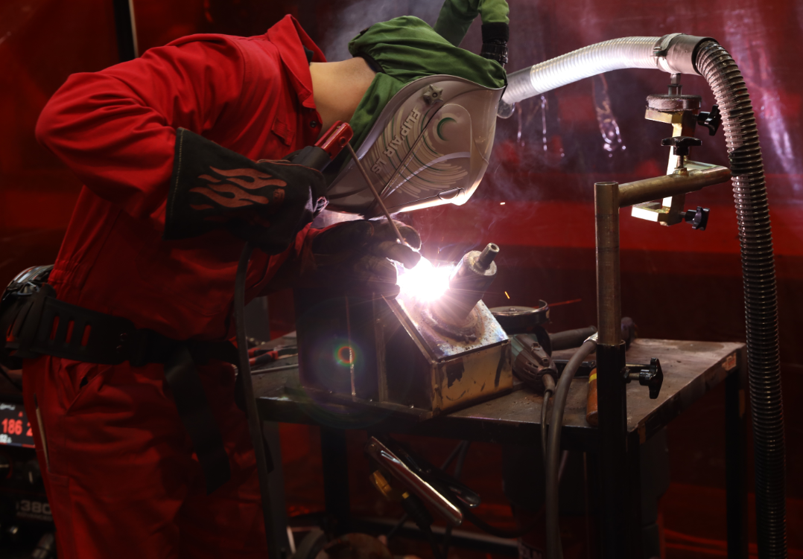
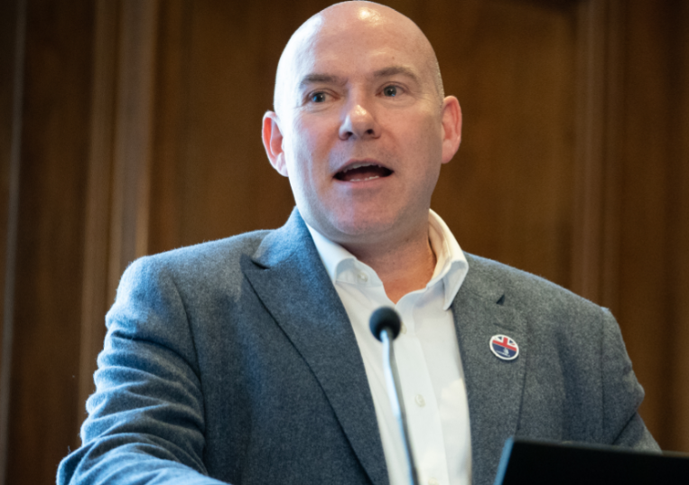
What we do
Inspire excellence
Develop excellence
Innovate excellence
We inspire young people via our careers advice resources to choose excellence through apprenticeships and technical education as a prestigious career route on their path to reaching their potential, whatever their background.
We develop excellence in young people by testing and assessing their skills and knowledge against their peers through our national and international competitions programmes, improving their confidence and potential.
We innovate to mainstream global excellence to help improve standards of teaching, training and assessment through international benchmarking to help young people, employers and the UK economy succeed.
Notes:
Standard slide and pic

Slide 3
How will this help you?
This resource is designed to:
Help you understand the next steps available to you in your education and career
Understand your own skills and motivators
Show you the benefits that a college environment and education can bring
Inspire you with real life stories of college successes
Aid you with the next steps you need to take if you decide you want to follow a further education pathway in college

Slide 4
Your future
Does the immediate future look a bit different
than what you were expecting?
The COVID-19 lockdown that we all found ourselves in may have made you uncertain about your education choices, and about your future, which may have made you feel confused and nervous to make decisions.
Don’t worry, you’re not alone – everyone is feeling this way at the moment.
However, It is really important not to lose momentum and to push forward with your future education plans.
It doesn’t stop you from taking the next step on your journey.
You might be at a point in your education where you are being asked to make decisions about your future, but to know the right way to go, it’s important that you have got lots of information about the different choices available to you.

Slide 5
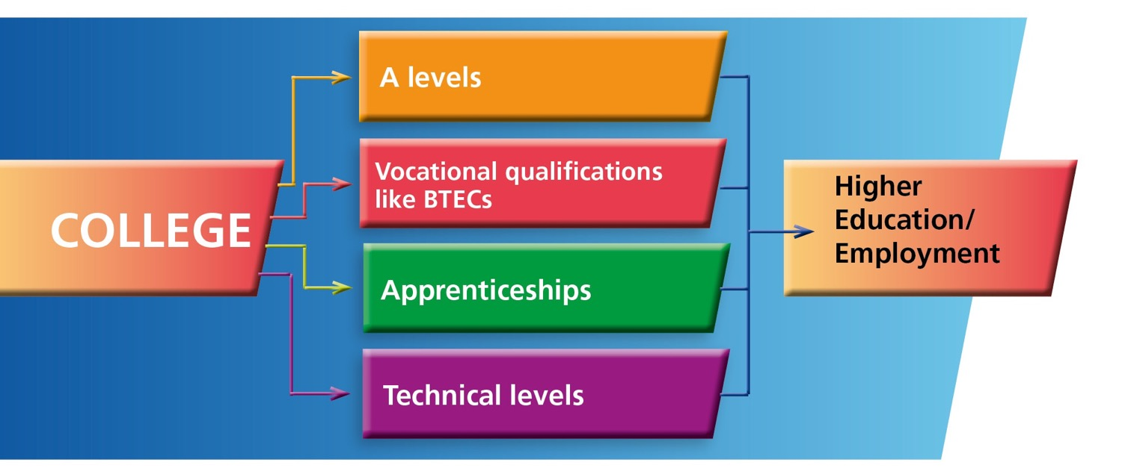
Choosing colleges
There are many choices open to you, but in this lesson we are going to specifically look at learning pathways of a college education and the huge benefits it can bring you.
5

Slide 6
Why college?
LEARNING: Colleges offer hundreds of different courses – making it more likely to find the perfect one to suit you
You can re-take maths and English GCSEs at college
Apprenticeships to suit whatever level you are working at
Specialist facilities and equipment
Emphasis on work experience
Options to do technical and vocational courses
Opportunities
to earn while
you train
Specialise in subjects you have chosen that really interest you
Great employer links
6

Slide 7
Why college?
2. ENRICHMENT OPPORTUNITIES: Enhance your learning and personal and social development outside of the classroom
Take responsibility for your own learning – be treated like an adult
Enrichment programmes to develop your learning outside of the classroom
Gain new skills in professional surroundings
It’s a new learning experience and a new exciting and dynamic environment
Join clubs and
enjoy subsidised
social events
Opportunities to learn online as well as the classroom
7

Slide 8
Why college?
3. SOCIAL AND SUPPORT BENEFITS
Brilliant wellbeing
and pastoral services for students
Meet lots of new
and diverse people
The class sizes are often smaller and there are flexible options for part time study
Gain independence and be better prepared for the world of work
New opportunities to socialise with people who share your passions
8

Slide 9

Life in a college
Life in a college is exciting, vibrant and full of opportunities for you to develop and progress.
Take a look at this video to see the dynamic space you could learn in, and hear from people who have flourished in a college environment.
9

Slide 10
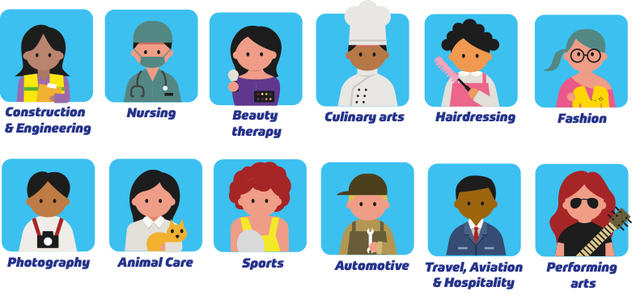
Courses
There are hundreds of courses to fulfil any career dream you might have. Colleges often have on-site, hands-on learning for courses that have a practical element like some of these:
10
(get your hands on some real cars)
(colleges have salons set up to learn in!)
(learn in an actual replica of a plane!)

Slide 11

Which course suits you?
The courses we have listed are just a fraction of the ones available. There are hundreds of college courses which can lead to thousands of jobs.
Take the personality quiz at: https://icould.com/buzz-quiz/
To see how your interests and character match to different specific careers to get an idea of what your next step might be!
For your selected careers you could research:
which college qualification you need for that job role
which college near you offers that course.
11

Slide 12

College creates excellence
College courses can lead to the advanced levels of employment in careers you might never have thought of.
Watch this video of Danny Hoang, who reached the highest level of international excellence with a journey that started at culinary college.
He fast-tracked into an incredible career by gaining hands-on experience on a practical course at college.
12

Slide 13
Take action
So how can you find out about colleges and courses?
The AOC (Association of Colleges) will provide you with a list of colleges in your area. https://www.aoc.co.uk/about-colleges/research-and-stats/key-further-education-statistics
You can also visit https://nationalcareers.service.gov.uk/ to see which courses and careers are right for you.
https://www.studential.com/further-education/sixth-form-or-college offers valuable insight into the benefits of further education learning
So does UCAS https://www.ucas.com/further-education/post-16-qualifications/choosing-where-study-or-train
13

Slide 14


Reflect
Don’t forget to complete the reflection sheet provided to see how your understanding and development has progressed during this lesson.
14

Slide 15
YOUR FUTURE
THANK YOU

