Slide 1
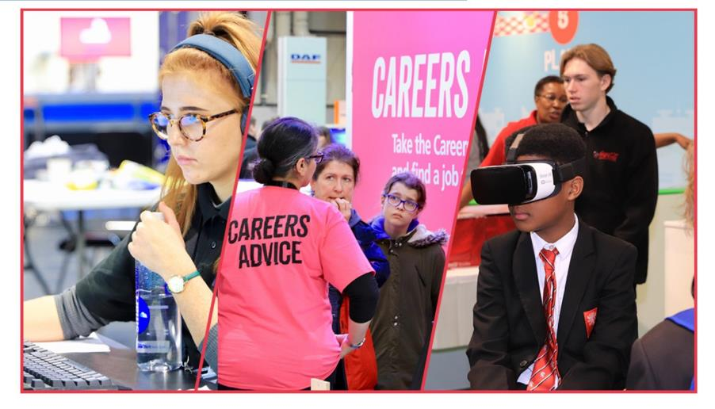
Building your Digital Skills
Notes:
Title slide

Slide 2
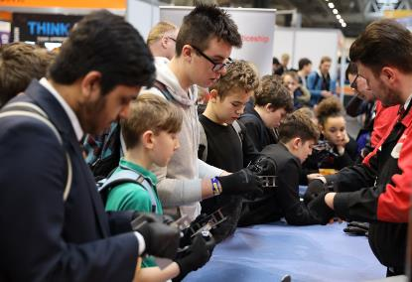
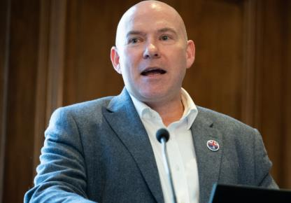
What we do at WorldSkills UK
Inspire excellence
Develop excellence
Innovate excellence
We inspire young people via our careers advice resources to choose excellence through apprenticeships and technical education as a prestigious career route on their path to reaching their potential, whatever their background.
We develop excellence in young people by testing and assessing their skills and knowledge against their peers through our national and international competitions programmes, improving their confidence and potential.
We innovate to mainstream global excellence to help improve standards of teaching, training and assessment through international benchmarking to help young people, employers and the UK economy succeed.
Notes:
Standard slide and pic

Slide 3
This module is supported by
Accenture is a leading global professional services company, providing services and solutions in strategy, consulting, digital, technology and operations.
Accenture Digital Skills programme is a series of accredited collaborative social learning courses available online, for free to help learners compete and stand out from the crowd in today’s digital workplace.

Slide 4
By the end of this session, learners will be able to:
Understand the differences between 'Digital' and 'Technology'
Understand how digital is changing the way we live and work
Identify how you can learn the skills you need to succeed in the digital workplace with Accenture
Notes:
Title slide

Slide 5
Digital or Technology?
Defining what we mean by digital can be difficult, it can often be confused with the term technology.
Digital typically describes the modern means by which you communicate and build relationships with family, friends and other people online.
Whereas Technology relates to pieces of hardware or software that are used for a specific function such as AI or an app for your phone.

Slide 6
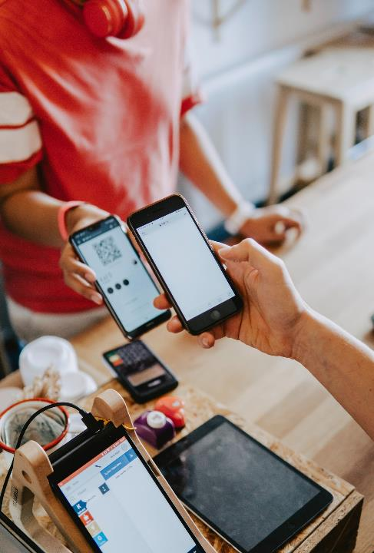
So what are basic Digital Skills?
According to UNESCO:
“Digital skills are defined as having the ability to use digital devices, communication applications, and networks to access and manage information."
This could include creating and sharing digital content online or communicating with friends and family all around the world.
With technology changing how we live and work at an accelerated pace, building digital literacy skills early on and honing these over time is becoming increasingly important.

Slide 7
Basic digital skills fall under 6 areas:
Digital foundation skills | Communicating | Handling information and content
Such as being able to use a browser (such as Chrome), connecting to the internet, and keeping passwords safe. | Being able to communicate, collaborate, and share information using things like social media (video, photos, messages etc), emailing someone or being able to attach files to media (WhatsApp, Skype etc). | Using search engines like Google or Bing to find content, understanding that online content isn’t always correct or reliable, and being able to review content across different types of devices (phones, tablets, PC’s).
Transacting | Problem Solving | Being safe online
Being able to set up accounts to make purchases (like on Amazon or eBay), use different payment methods to buy online (such as your bank card or payment apps), or register and apply for services (like applying for a job). | Being able to find solutions to problems using digital tools and online services. For example - using FAQs, chatbots or online tutorials for assistance. | It’s about being confident online – understanding the best way to store or share data/information, keeping passwords safe, and using anti-virus software.

Slide 8
What does digital look like to you at home?
You can listen to music or watch on-demand movies through streaming services
You don’t always have to wait in queues on the high street for your favourite trainers or clothes – you can order them online and have them delivered to your door
You can connect with friends or family no matter where they are in the world using the communication tools
You can play games online and interact with others doing the same
The list is endless…
we use digital daily in our lives
<Title of presentation>
1
Notes:
Standard slide

Slide 9
What does digital look like to you at work?
Use apps to help us with transport or logistics – think Uber, think Google maps, think Garmin.
Advertise to customers digitally – think social media! We don’t always need that giant billboard or magazine advert.
Watch live events – we no longer have to always travel to events, we can watch them in real time.
Store records digitally – from patient records to car MOT’s – we no longer need to print everything.
Transfer money all around the world whilst never leaving our office or visiting the bank.
Self-service check-ins for hotels or airlines.
Meet online – whether webinars, workshops or any meetings.
<Title of presentation>
1
Notes:
Standard slide

Slide 10
Why are digital skills so important?
Did you know, at least 82% of job adverts posted online in the UK in 2020 required digital skills?
Digital skills underpin every job role you may consider, and that’s due to the speed of growth in the world of technology.
Digital skills is an essential employability skill, and we all need to build on this to enter and navigate the world of work successfully and stay relevant in the future.

Slide 11
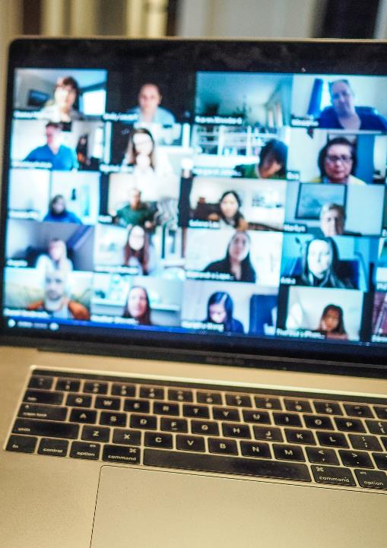
Why are digital skills so important?
Did you know that roles which require digital skills pay on average 29% more than those that don’t
According to an article from Futurelearn, the average UK salary for digital jobs is £45,625. This compares to the average (median) UK income of £25,000 to £30,000 for full-time work.
If you are looking for flexibility in your job, digital skills are an excellent choice for freelancers. With the right digital skills, software and a solid internet connection, digital freelance work is a great option. It also allows you to work remotely from anywhere!
Finally, during the COVID-19 pandemic, remote working and digital technologies helped us stay connected – something we will continue to rely on in the future.

Slide 12
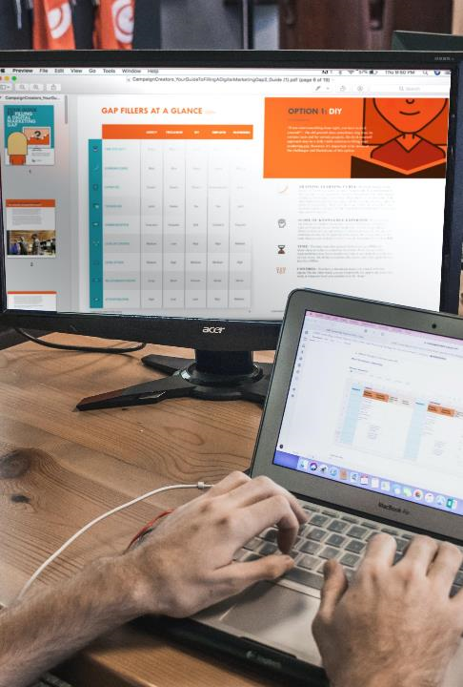
What does the future hold?
Did you know that the World Economic Forum estimated that 133 million new roles will be created by 2022 as a result of the new division of labour between humans, machines, and algorithms, including:
Advancements in technology such as AI have helped to make businesses more efficient/effective and have created new job roles
To engage customers, companies need to advertise online which meant that digital marketing opportunities have increased
How we interact with things like websites and apps has become increasingly important which has led to user experience roles being created

Slide 13
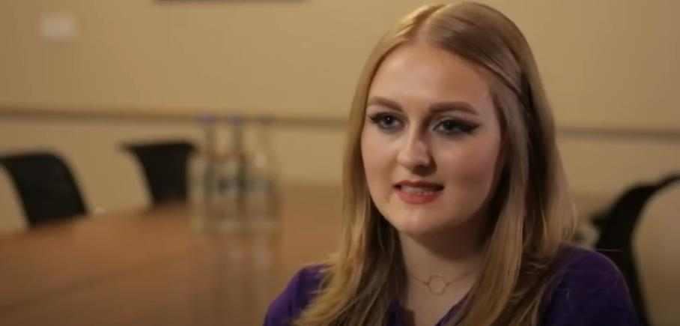
Hear from our role model Kim…
Name:
Kim Reid
Occupation: Cyber Security Analyst
Location:
London

Slide 14
How can I gain the digital skills I need?
Accenture Digital Skills is a series of free, online social learning courses designed to help you to compete and stand out from the crowd in today’s digital workplace.
Start here
Digital Skills for Work & Life
Learn how digital is changing our lives and work and develop the skills to thrive in the digital workplace and in life
Social Media
Learn how to use Social Media for business, from creating a social media presence to measuring success
User Experience
Learn about User Experience (UX) is important, the research and design basics, and the tools and testing techniques used in UX
Web Analytics
Learn about the role of analytics in business, the types of analytics, and the techniques used and why they’re important
Reimagine Your Career
Learn how you can develop the mindset and essential skills to enable you to succeed in today’s world of work
Retail
Discover the impact Digital is having on the Retail industry and what it means for you
Mobile
Learn about Mobile design, development, and creating experiences, and bigger concepts relating to mobile technology
Digital Marketing
Learn about some of the different Digital Marketing strategies and techniques that are available for businesses to use
Artificial Intelligence
Learn more about the past, present and future of artificial intelligence and explore its potential in the workplace

Slide 15
Tell me more…
What’s included:
Hosted on the platform FutureLearn, the Accenture Digital Skills courses are completely free to access and can help learners of all levels to:
Learn more about digital applications in life and work
Build your understanding of the basics of digital
Develop your knowledge on advanced digital concepts
Learn how to apply digital skills
Engage with others:
Through a social learning approach, you can leave comments, post questions and share ideas with other learners from all over the world.
Accenture digital skills mentors offer support throughout answering questions and facilitating discussion to build on what you have learnt.
All of the courses are CPD (Continuing Professional Development) certified, meaning that you’ll get a certificate at the end of each course you complete.

Slide 16
Tell me more…
Duration:
You can start a course at anytime and learn at your own pace. Courses are usually run over 2-3 weeks, with 1 to 2 hours study per week.
Getting started with Accenture Digital Skills:
To register, you’ll need a PC, tablet or phone, access to the internet and an email address.
We would recommend starting with our introductory course ‘Digital Skills for Work and Life’ designed to help you to demystify the world of digital, understand the implications for jobs and highlights the key skills that employers are looking for today.
Click here to access the course: Digital Skills for Work and Life

Slide 17
Next steps…
Visit Accenture’s digital skills courses: Free digital skills courses for all levels (futurelearn.com)
Visit govt websites for digital skills information: https://nationalcareers.service.gov.uk/careers-advice/build-foundation-digital-skills-to-help-your-career/
Search your local community websites or noticeboards for online or in-person courses.
Speak to your school or college careers advisor

Slide 18
Thank you
Any questions?
Additional image sources:
David Dvoracek, Dillon Shook, Marvin Meyer, Campaign Creators, Domenico Loia, John Schnobrich, Chris-Montgomery, Visuals (At7ozqXbq8I) and William Iven
all from the website Unsplash.com
Notes:
Final slide

