Slide 1
Career pathways in
Investment Management
Notes:
Title slide

Slide 2
What we do
Inspire excellence
Develop excellence
Innovate excellence
We inspire young people via our careers advice resources to choose excellence through apprenticeships and technical education as a prestigious career route on their path to reaching their potential, whatever their background.
We develop excellence in young people by testing and assessing their skills and knowledge against their peers through our national and international competitions programmes, improving their confidence and potential.
We innovate to mainstream global excellence to help improve standards of teaching, training and assessment through international benchmarking to help young people, employers and the UK economy succeed.
Notes:
Standard slide and pic

Slide 3
By the end of this session, learners will be able to:
Understand what Investment Management is all about
Identify career pathways in Investment Management
Be inspired by real life stories from apprentices at M&G plc
Notes:
Title slide

Slide 4
What do we mean by Investment Management?
The aim of the Investment Management industry is to manage people’s money so that they are able to achieve their own financial goals. ( whether you’re saving for an iPhone, a deposit on a flat or even your pension for retirement one day)
Investment managers help to grow peoples money by investing in businesses and projects all around the world. The aim is to invest in businesses that will be able to provide you (the investor) with a return on your investment (taking you closer to achieving your financial goals).
Along with financial gain, you can also choose to invest in businesses that care for the planet, or ones that help improve communities - you can help drive change for the greater good through your investment choices.
This industry offers a variety of career pathways – there’s something for everyone.

Slide 5
What types of careers are on offer in this industry?
Fund roles
Company roles
Systems and IT roles
There are a range of roles related to the investment of funds such as:
Research
Asset allocation
Wealth management
Consulting
Like all businesses, you can work in various departments within investment management such as:
Compliance and Legal
HR
Sales & Marketing
Finance & Accounting
There are specialist roles that include:
Working with specialist systems for trading
IT or tech infrastructure
Cyber security

Slide 6
Could this industry be for you?
Don’t you need to be a maths whizz?
NO
Are you…
Motivated and enthusiastic?
Happy to work as part of a team?
Able to work well under pressure?
This industry could be for you!
Don’t you need to have a degree first?
NO
Is this industry really open to anyone?
YES

Slide 7
Apprenticeships with M&G
Becoming an apprentice is a great way to gain real work experience while learning. The M&G Apprenticeship Programme offers you the chance to gain a qualification while learning on the job and earning a salary.
Work with people from different teams and develop a range of skills.
Enjoy personal and professional development, as well as business mentoring support.
You’ll work within a busy environment learning valuable job skills, building a bank of business knowledge and developing interpersonal and life skills.
There are 3 types of M&G apprenticeship programmes on offer:
Business and Investment apprenticeships
Tech, IT and Digital apprenticeships
Finance/Accountancy apprenticeships

Slide 8
Apprenticeships with M&G
With the M&G Apprenticeship Programme you can kickstart your career in:
Digital Marketing
Retail
Finance
Customer Services
Data and Business Analytics
IT
And study a qualification such as:
Business Administration
Investment Operations Technician
Software Development

Slide 9
M&G Apprentice recruitment process
Application form and CV Upload
Telephone interview
Psychometric tests
Video Interview
Assessment Centre Day (interview and group exercise)

Slide 10
The application process
Complete a simple online registration and application form. This should take roughly 30 minutes to complete.
A half-hour telephone interview covering your strengths, key skills and competencies required for the role.
You will be invited to complete a set of psychometric tests which will include verbal and numerical reasoning as well as error checking and personality tests. Allow up to 40 minutes for these.
You’ll be invited to a one-way online video interview which will take approximately 20 minutes to complete.
Finally, shortlisted candidates will be invited to a half-day assessment centre which will include a competency based interview with the hiring manager and a group or individual exercise.

Slide 11
Apprenticeships are a great way to get started
Enjoy structured on-the-job training
Gain a recognised qualification
Study in under 2 years
Enjoy a salary
Gain real work experience while learning
For more details on the M&G Apprenticeship Programmes click here

Slide 12
Meet Ethan
Ethan joined M&G as a Technical Valuations Analyst Apprentice in 2020. Learn more about his experience on his apprenticeship journey.
“I started my apprenticeship at M&G during a challenging year but thanks to a strong structure, a fantastic network and the support that surrounds me, I have had a very positive experience so far. I feel motivated and challenged but also inspired by my role, my colleagues, and the progress that I have made so far. As someone who’s totally new to this industry, I find it exciting and rewarding. Already it’s difficult to envisage myself working anywhere else - I am excited about the future opportunities which are open to me in M&G”

Slide 13
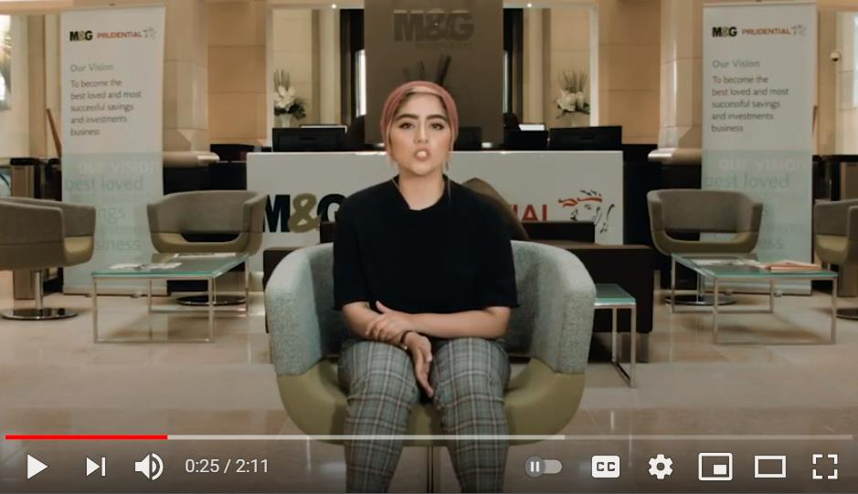
Video: Meet Hiba

Slide 14
What are your opportunities after an M&G apprenticeship
Take the practical skills and knowledge you have developed straight into the world of work!
Continue your studies through further education
Complete ‘top up’ year(s) to achieve a degree qualification.

Slide 15
Next steps…
Attend Open Days and Careers Fairs
Speak to your school or college careers advisor
Interested in an apprenticeship? Check out: https://www.apprenticeships.gov.uk/apprentices or visit https://www.investment2020.org.uk/
Are you still looking for guidance on what career is right for you?: Check out: https://nationalcareers.service.gov.uk/

Slide 16
Thank you
Any questions?
Additional image sources:
T. Mallorca; A. Neel; K. Farmer; J. Schnobrich and fotografierende - all from the website Unsplash.com
Notes:
Final slide

