Slide 1
Apprenticeships
Notes:
Title slide

Slide 2
What we do
Inspire excellence
Develop excellence
Innovate excellence
We inspire young people via our careers advice resources to choose excellence through apprenticeships and technical education as a prestigious career route on their path to reaching their potential, whatever their background.
We develop excellence in young people by testing and assessing their skills and knowledge against their peers through our national and international competitions programmes, improving their confidence and potential.
We innovate to mainstream global excellence to help improve standards of teaching, training and assessment through international benchmarking to help young people, employers and the UK economy succeed.
Notes:
Standard slide and pic

Slide 3
By the end of this session, learners will understand:
What an apprenticeship is
Why apprenticeships are so valuable
The rights and responsibilities that apprentices should know
Inspiring stories from UK apprentices
<Title of presentation>
1
Notes:
Standard slide

Slide 4
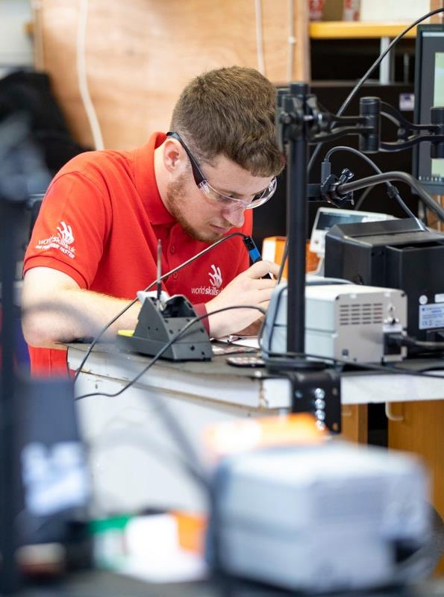
What is an apprenticeship?
Apprenticeships are a great way to enter the job market, earn a living and get a brilliant qualification – all in one go.
You’ll have a real job – meaning you’ll get first-hand experience of how to do the job you’re in (whether that’s a business manager, banker, engineer, lawyer, hotelier – the list of apprenticeships on offer is endless). The skills and the knowledge that you’ll gain in a real job make you incredibly valuable to any recruiter.
You’ll earn-while-you-learn meaning you’ll get paid a salary like everyone else you work with.
You’ll get a great qualification at the end of your apprenticeship.
Apprenticeships are widely available in the UK and cover many sectors and industries. Click here to search for apprenticeships near you.

Slide 5
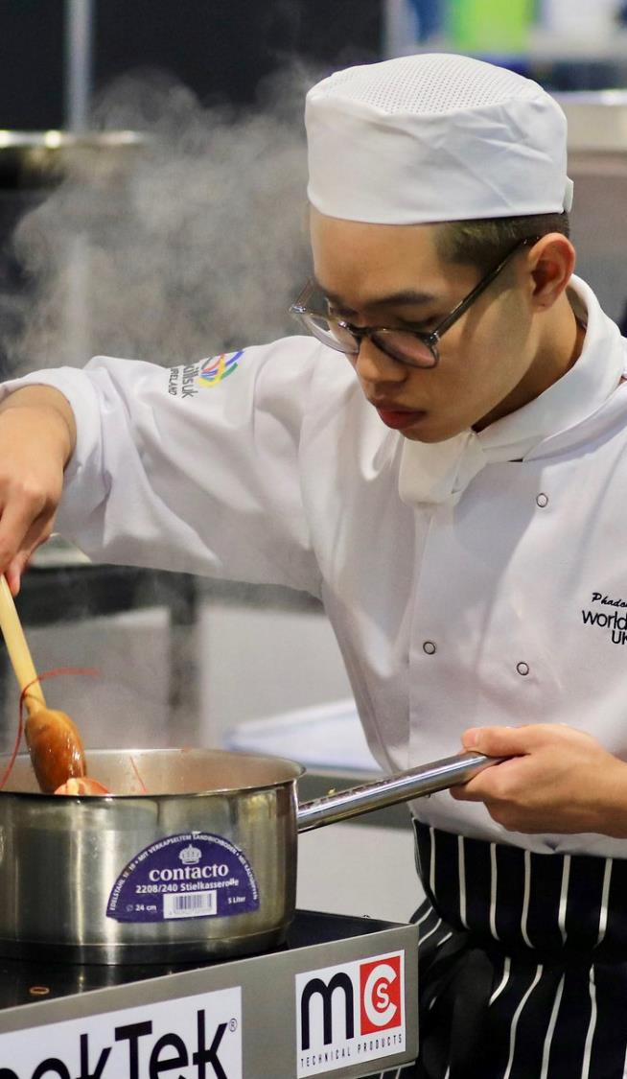
How do apprenticeships work?
You can start an apprenticeship at 16 after your GCSE’s, or at 18 after A Levels or vocational qualifications. In fact, you can start an apprenticeship at any point in your career – whether you’re growing your existing qualifications, or changing career direction completely.
You’ll become an employee of the business where your apprenticeship is being completed – we’ll explain this in more detail later.
You’ll spend 80% of the working week at your place of employment (usually at least 30 hours per week), and 20% at your place of study (usually at a college, university or with a training provider.) Your training takes place during working hours.
You’ll receive a recognised qualification at the end of your apprenticeship (intermediate, advanced, higher or degree apprenticeships are on offer).
You’ll have a job description so you know exactly what you have to do at work (and coaches or mentors to help you along the way).
Apprenticeships can take 1 to 6 years to complete, depending on which one you choose and at what level it is aimed at.
Apprenticeships are funded from contributions made by the government and your employer so your course fees will be taken care of. You will need to learn how to manage your time between work and study!!

Slide 6
What types of apprenticeships are available?
Each apprenticeship type has a level and an equivalent education level. You can start an apprenticeship at any level, although some apprenticeships may:
require that you have an English or Maths GCSE.
give extra training in the English or Maths skills needed so you’re at the right level.
Did you know?
Employers think that qualified apprentices are 15% more employable than those with other qualifications.
Apprenticeship TYPE | Level | Equivalent education level
Intermediate | 2 | GCSE
Advanced | 3 | A Level
Higher | 4, 5, 6 and 7 | Foundation degree and above
Degree | 6 and 7 | Bachelor’s or Master’s degree

Slide 7
Who employs apprentices?
There are so many employers (big and small) who employ apprentices that we can’t keep up. But here are just a few you might know…

Slide 8
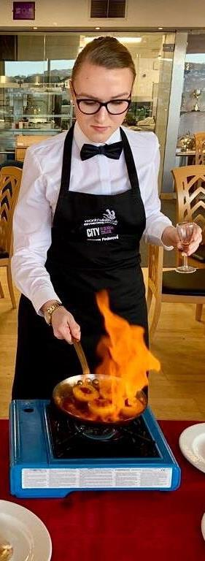
Why are apprenticeships so valuable?
Apprenticeships are RESPECTED across the world – mostly because you gain REAL work experience and a solid qualification.
You get first-hand on-the-job training, experience and support in a job or sector that you want to be in.
You can earn a living – so you can study debt-free.
You can get your foot in the door with a prospective employer – many apprentices who complete their journey with an employer are offered employment with them.
You can boost your earning potential. According to the Apprentice Learner Survey in 2017, one in three apprentices earned a promotion with their employer.
You can add to your qualifications if and when you chose to.
You can start an apprenticeship anytime – whether you want to add to your skill set or change career direction.

Slide 9
Let's take a look
"Being an apprentice has been the best time of my life, I've been able to do things that I'm passionate about. I've been able to meet so many different people. I've built up my confidence. It's been the best experience it could have been." Alim 22, CHANNEL 4, LONDON

Slide 10
"I wasn't a hundred percent sure what I wanted to do after 6th form. Then, my mum showed me an ad in the local paper for an apprenticeship. I want to be earning six figures by the time I'm thirty. And that's the beauty of starting young, it's all possible." Ella 22, OPERATIONS MANAGER, CHIPPING CAMPDEN

Slide 11
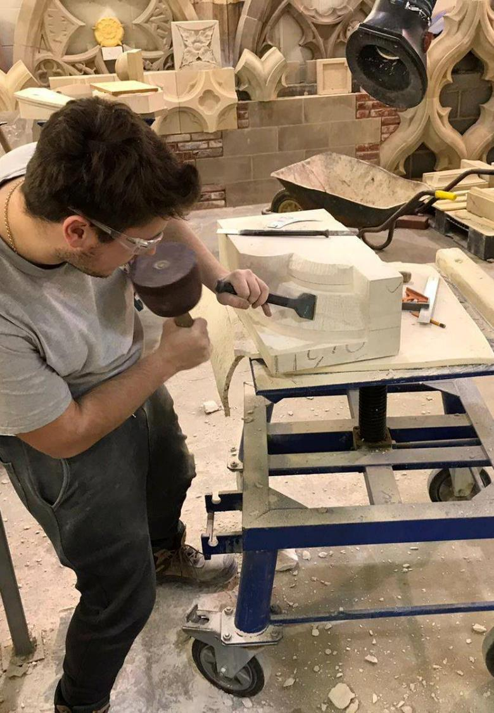
What kind of salary can I expect as an apprentice?
What you earn will depend on the industry, location and type of apprenticeship you choose. According to https://www.apprenticeships.gov.uk/:
If you're aged 16 to 18 or in the first year of your apprenticeship, you’re entitled to the apprentice rate.
If you're 19 or over and have completed the first year of your apprenticeship, you’re entitled to the National Minimum Wage.
This is the lowest amount of money you could earn – a vast number of employers offer their apprentices competitive salaries.
Because the government and your employer fund your studies, you don’t pay any fees or need to find a student loan. You just need to cover your day-to-day expenses such as meals and travel.
Another great perk of being an apprentice is that you can get hold of an NUS Apprentice Extra card which gives you discounts at the Co-op, Amazon Prime, Domino’s, BSM and hundreds more. For London-based apprentices, there is an Apprentice Oyster Card to help with the costs of travel.

Slide 12
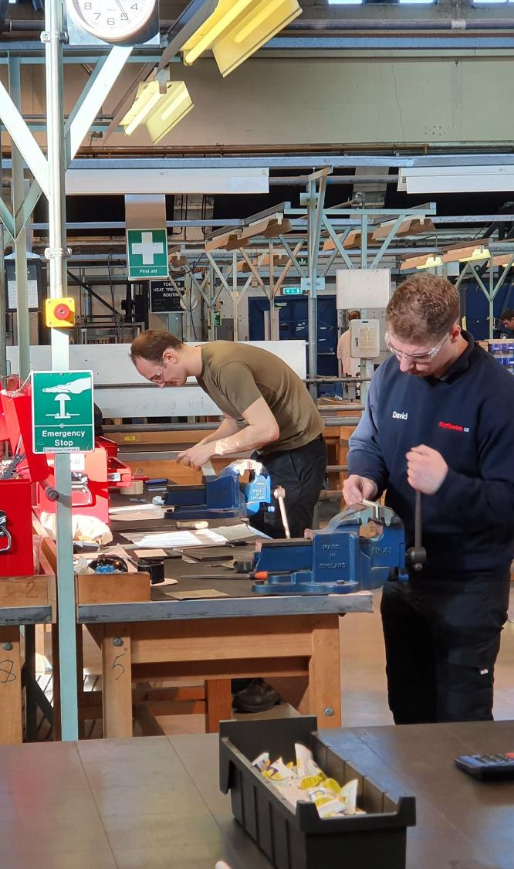
What are your rights as an apprentice?
Your employer should provide you with an apprentice agreement and/or an employment contract. These documents explain:
what skill or occupation you are being trained for
The specifics of the training you'll be given
The details of the qualification you will be working towards.
You must receive a full induction into the workplace, including a Health & Safety induction.
You must have a job description and have access to the skills, experiences and knowledge to be able to complete your qualifications.
Must be allowed 20% of the work week to complete your studies.
You must receive the minimum wage (or more) / a fair wage.
You are entitled to sick pay.
As a full-time apprentice you'll get at least 20 days paid holiday each year, plus 8 public and bank holidays. That's a minimum — your employer could offer more.
You must have access to coaching or mentoring support to deal with any problems that arise.
You must have access to a safe and secure working environment.
You must be given regular assessments and reviews to ensure you’re on track or getting assistance if required.

Slide 13
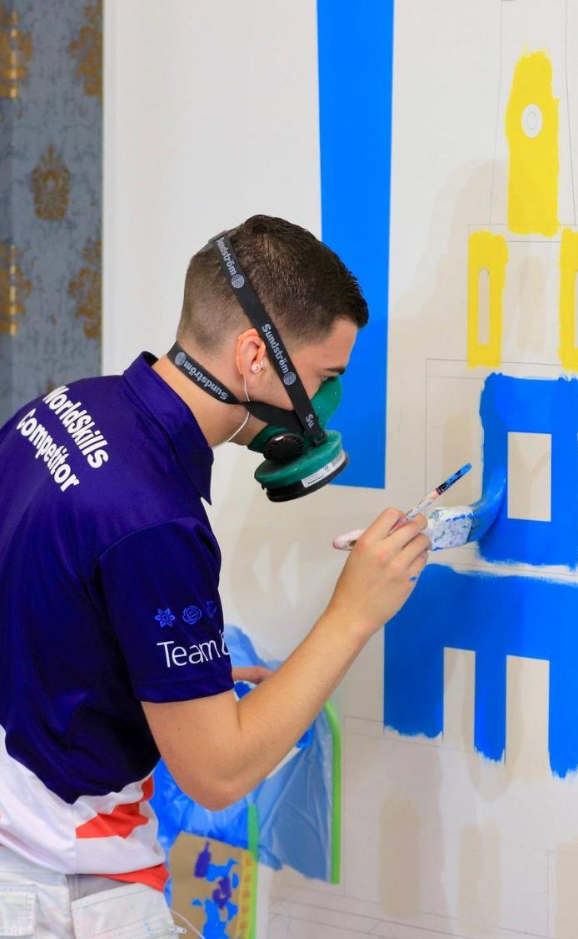
What are your responsibilities as an apprentice?
You must abide by the terms and conditions of your employment or apprenticeship agreement.
You must accept training or instruction in your workplace by your employer (supervisor or manager).
You must attend all scheduled training delivered by the training organisation you are enrolled with.
You must complete all of your assignments, assessments and any other training related tasks on time.
You must maintain and complete the work evidence book or file if you have been given one to complete.

Slide 14
Lets hear what our WorldskillsUK apprentices say…
Name:
Ethan Davies
Occupation: Aircraft
Automation Robotics
Education:
Coleg Cambria
Company:
CNC Milling
Location:
North Wales
I believe that the apprenticeship was the right route for me. I’ve enjoyed every minute of it – now I’m mentoring the future generation of apprentices in my company.

Slide 15
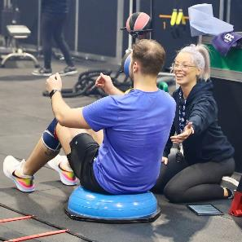
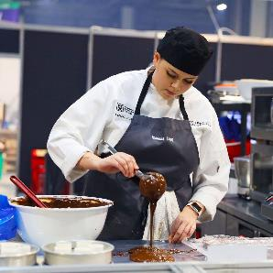
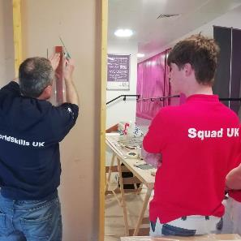
Next steps…
Your school or college : Speak to your school or college careers advisor
Interested in knowing more about apprentice rights and responsibilities? Check out: https://www.gov.uk/employing-an-apprentice/pay-and-conditions-for-apprentices
Interested in an apprenticeship? Contact local employers or check out: https://www.apprenticeships.gov.uk/apprentices
Are you still looking for guidance on what career is right for you?: Check out: https://nationalcareers.service.gov.uk/

Slide 16
Thank you
Any questions?
Notes:
Final slide

