Slide 1
Higher Technical Education >
Notes:
Title slide

Slide 2
What we do
Inspire excellence
Develop excellence
Innovate excellence
We inspire young people via our careers advice resources to choose excellence through apprenticeships and technical education as a prestigious career route on their path to reaching their potential, whatever their background.
We develop excellence in young people by testing and assessing their skills and knowledge against their peers through our national and international competitions programmes, improving their confidence and potential.
We innovate to mainstream global excellence to help improve standards of teaching, training and assessment through international benchmarking to help young people, employers and the UK economy succeed.
Notes:
Standard slide and pic

Slide 3
By the end of this session, learners will be able to:
Understand Higher Technical Education (HTE)
Identify the pathways into Higher Technical Education
Learn the benefits of studying Higher Technical Education
<Title of presentation>
1
Notes:
Standard slide

Slide 4
What is Higher Technical Education?
<Title of presentation>
1
Notes:
Standard slide

Slide 5
What is Higher Technical Education?
Higher technical education is a form of Higher Education that describes classroom-based qualifications and higher apprenticeships that are designed to lead to high skilled jobs in many occupations, making it likely that you will find an area of study that interests you!
Including:
Accountancy
Adult Care
Agriculture
Business Administration
Construction
Cyber Security
Dentistry
Engineering
Laboratory Research
Nursing
Software Development
Visual Media
Did you know? The government has produced ‘occupational maps’ which links technical education like HTE to jobs and shows you how you could progress in your career
<Title of presentation>
1
Notes:
Standard slide

Slide 6
Why study Higher Technical Education?
Skills enhancement
Engage with industry
Social & support benefits

Slide 7
Skills enrichment
Gain skills and qualifications that make you highly employable
Learn by doing – HTE takes a practical approach to learning
Develop knowledge, understanding and skills required for current and future employment
Many HTE programmes count towards membership of a professional body
The opportunity to use specialist facilities and equipment whilst you study

Slide 8
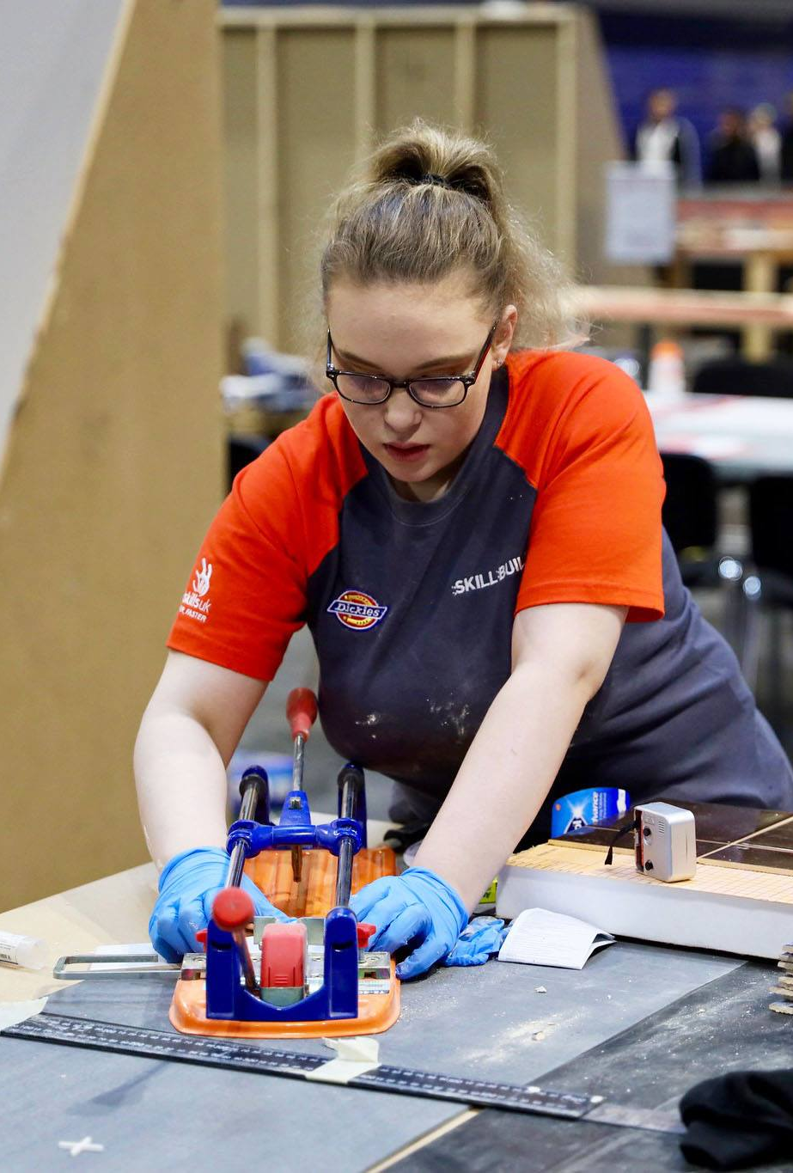
Engage with industry
Work with local employers, often helping to solve real problems
Programmes are often designed with employers, making them highly industry relevant
HTE is designed to provide a direct route into a job
Develop knowledge and skills that are valuable to the economy
Learn from teachers with lots of industry experience

Slide 9
Social & support benefits
Different modes of study
Often smaller class sizes than other forms of higher education
Flexible study – PT/FT and distance learning
Access to loans and bursaries
Programmes are shorter and cheaper than degrees
Earn whilst you learn, if on a higher apprenticeship

Slide 10
How can you study Higher Technical Education?
Classroom based qualifications
Apprenticeships

Slide 11
Classroom based qualifications:
Qualifications that often combine study and the development of practical skills.
There are many types of classroom-based higher technical qualifications, some examples are:
Foundation Degree
Higher National Diploma (HND)
Higher National Certificate (HNC)
Certificate of Higher Education (CertHE)
Most of these qualifications can be completed in two years full-time study or less, with part time and distance learning opportunities available – to find out more enquire with your local provider!

Slide 12
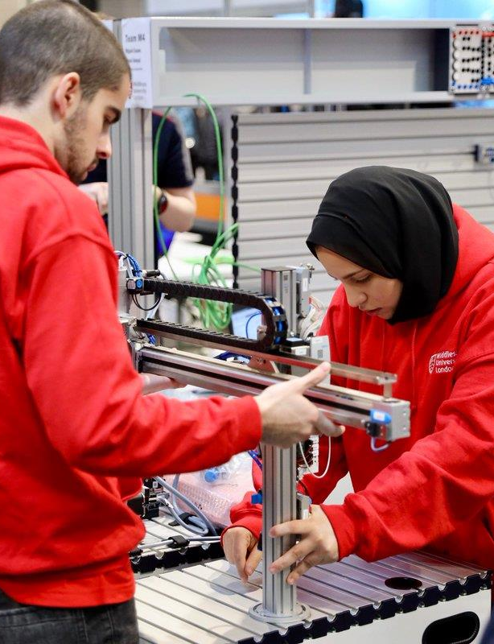
Apprenticeships:
The opportunity to have a real job where you will gain practical training experience, whilst also studying through a college, university, training provider or training at work.
Higher Apprenticeships can take between one to four years to complete.

Slide 13
Where can you study Higher Technical Education?
Further Education Colleges: Local providers of high quality technical and professional education.
Universities: Larger institutions that offer both undergraduate and degree programmes.
Independent training providers: Offer vocational courses and training to young people and adults.
Institutes of Technology (IoTs): Collaborations between further education (FE) providers, universities, and employers. IoTs have a particular focus on STEM.

Slide 14
Let’s hear from a role model
Name:
Emily
Occupation: Mechanical Designer
Employer:
UK Atomic Energy Authority
Location:
Oxford

Slide 15
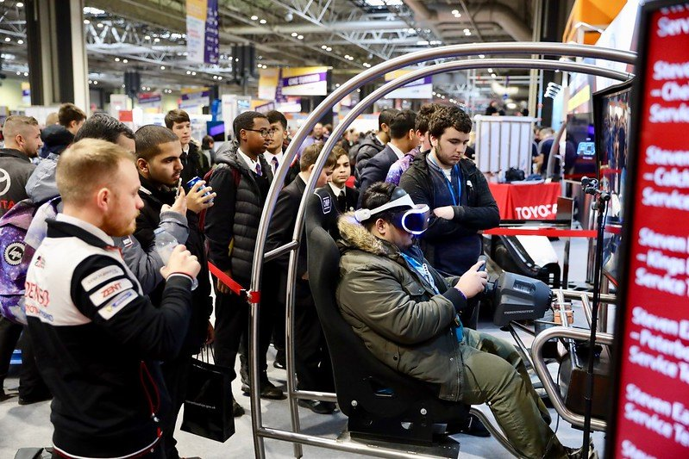
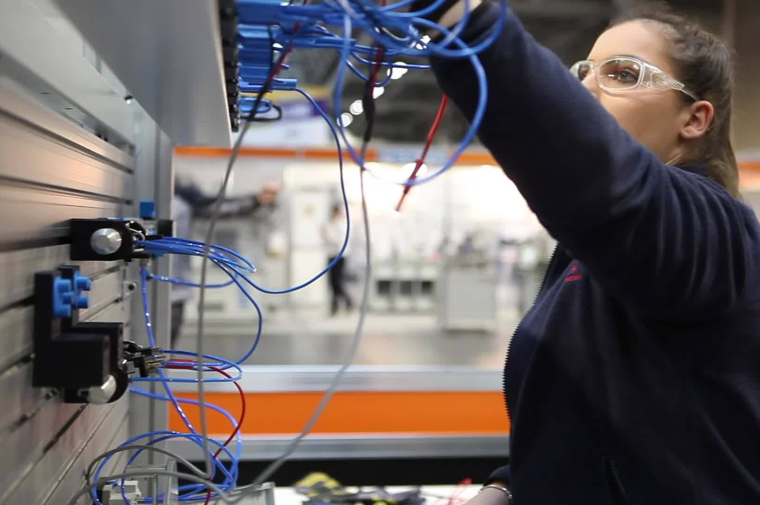
Next steps…
Local Institutes of Technology or Further Education Colleges: Attend Open Days
Your school or college : Speak to your school or college careers advisor
Interested in a higher apprenticeship?: Contact local employers or check out: https://www.apprenticeships.gov.uk/apprentices
Are you still looking for guidance on what career is right for you?: Check out: https://nationalcareers.service.gov.uk/

Slide 16
Next Steps #2
Take the Quiz
Reflection Sheet

Slide 17
Thank you
Any questions?
Additional image sources: N. Azevedo, S. Balye, and J. Schnobrich @ Unsplash.com
Notes:
Final slide

