Slide 1
IFATE: Green Apprenticeships and Technical Education
Jane Pierce, Deputy Director - Engineering, Construction and Transport Division

Slide 2
Moving to a net zero economy represents a huge skills challenge
410,000
Estimated green jobs already in 2019
6m
Number of jobs expected to be impacted by the transition*
£12bn
Mobilised by the government’s 10 point plan
12k workers need to be trained in retrofit each year
10k heat pump installers need to be trained each year
50k+ will be trained to support EV production
70k workers needed in offshore wind
8k jobs needed in low carbon hydrogen
20k jobs created in improving flood defences
2k jobs created in afforestation
250,000
Green jobs created by the government’s 10 point plan
Heat and buildings, Power, Transport
Sectors with most jobs created by ten point plan

Slide 3
WHAT IS THE INSTITUTE’S ROLE?
The UK has set an emissions target of net-zero greenhouse gases by 2050 to tackle climate change – one of the most ambitious targets in the world
The Institute for Apprenticeships and Technical Education (IfATE) is part of the Green Jobs Delivery Group, which will support the delivery of up to 480,000 skilled green jobs by 2030 that will be created and supported by government policies set out in the Energy Security Strategy and Net Zero Strategy.
Technical education and apprenticeships are important in both retraining the current workforce and equipping young people with the skills required for the transition to net zero. We have already have a number of standards ready to help meet green skills needs, including sustainability business specialist, ecologist, and countryside ranger.
Our environmental policy sets out several provisions including assessing social value in all of our procurements. This specifically includes tackling climate change and reducing waste
We have also created a staff committee to encourage and support green behaviours in our employees, and to hold us to account on IFATE’s green behaviours; this is at a baselining stage.

Slide 4
GREEN ADVISORY PANEL
Focuses efforts to ensure the right skills are in place for the future workforce to deliver the green technology shift the UK needs.
Advises on two main areas:
  enhancing our current apprenticeships to ensure that they meet the needs of the employers within the growing green economy
  creating new apprenticeships to reflect new occupations to meet the challenge to reach net-zero carbon.
Worked closely with the Green Jobs Taskforce set up by BEIS and DfE and will now help deliver our contributions to the Green Jobs Delivery Group.
Green Advisory Community
Supports the GAP and offers greater expertise on particular occupations.
Shares insight with the GAP and helps them shape their final recommendations.
We have the following sub groups
Carbon Zero Construction Subgroup
Battery technology and electric vehicles
Forestry and Agritech
Energy
Green finance and enabling roles
Wider impact and communication
To join the green advisory community, please contact
Institute.Sustainability-Team@education.gov.uk

Slide 5






Progress on green occupations
Sustainability Framework has been created and now being used by Trailblazers when developing or revising new apprenticeships
Green Apprenticeship Advisory Panel mapping has taken place against priorities set in the 10 Point Plan and the Green Jobs Taskforce
GAAP have recommended 12 new apprenticeships to be developed
Trailblazers have been contacted for the 207 standards in scope
We are supporting Trailblazers to make those revisions where necessary
Energy and Utilities Advisory Panel established and will meet in July 2022.
Notes:
12 new apprenticeships = Carbon Advisor, Carbon Risk Analyst, Food Engineer, Food supply chain , Natural Capital Assessor, Natural Capital Advisor, Site Decarboniser, Agricultural Engineer, Land Based Sustainability Practitioner, High Voltage Prototype Engineer Technician, Hydrogen Fuel Cell, materials planning.

Slide 6
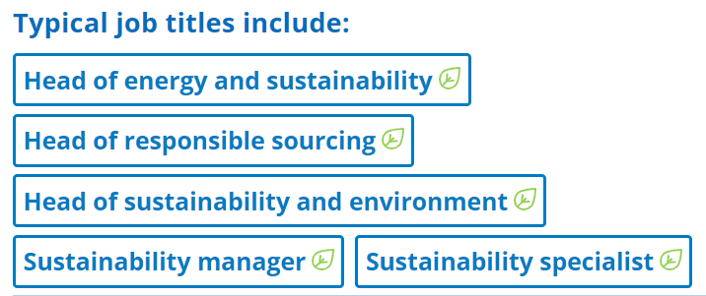
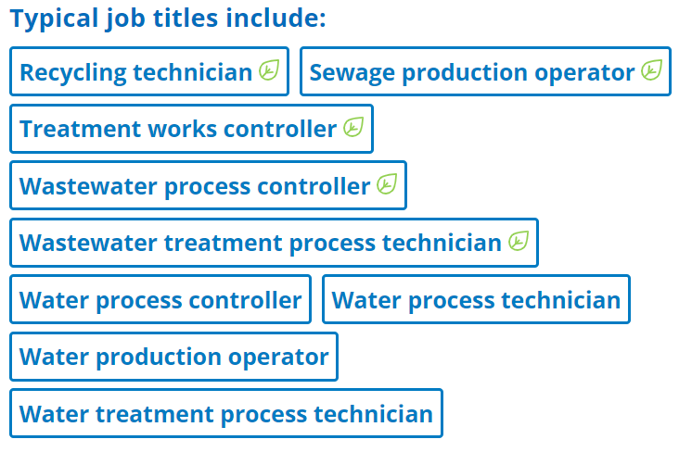
Signposting Green jobs and Skills
We know stakeholders want to understand what green skills the apprenticeship and technical education system is providing.
We are:
  working to improve the data available for green jobs and green skills,
  and collaborating across departments to make sure our data aligns across government.
Our new search tool will help apprentices, employers, training providers and other stakeholders find the occupations that include green job roles.
While there are a small number at the moment, over the coming months you will see more and more as we continue to incorporate our pre-existing catalogue of occupational standards and apprenticeships
IfATE is committed to ensuring that opportunities for progression across technical education are made clearer than ever through our occupational maps.
To date, the maps have only represented apprenticeships, but they are being updated to represent all IfATE’s approved technical qualifications such as T Levels and Higher Technical Qualifications.

Slide 7
Flexible apprenticeships
We support government plans for flexi-job apprenticeships which will make it possible for many SMEs to support apprenticeships.
Apprenticeships are at least 12 months long. Some sectors with flexible employment patterns and short-term roles, such as construction, previously found it challenging to take full advantage of them.
The government’s new Flexi-Job Apprenticeship Agencies will put help with this by allowing apprentices to complete short placements across a number of businesses during their training.
Now an apprentice in construction, working in short term roles, could fulfil several contracts over the course of their apprenticeship – from working on home repairs to bigger infrastructural project.

Slide 8
What’s next
Later this year we plan to publish a refreshed green strategy, which will set out the occupational areas we will prioritise, how we will ensure that apprenticeships and technical education products deliver green skills, and how we will strengthen green processes within IFATE.
Continuing to work closely with the Green Jobs Delivery Group, the Green Advisory Panel, and the Unit for Future Skills to help form the evidence base to understand where new or revised apprenticeship and technical education standards are required.
Local skills improvement plans need to consider the skills, capabilities or expertise required in relation to jobs that directly contribute to, or indirectly support adaptation to climate change and meeting climate change goals. This makes them good sources of data and we will monitor them closely for emerging green skills requirements.

Slide 9
Meeting the future Skills needs of the country
The Institute is looking to prioritise the development and revision of standards that meet the future skills needs of the country, including carbon reduction and technological advances
INPUTS
FE/HE providers
This will ensure the technical education system:
Is forward looking and future proofed
By identifying, collating and embedding emerging skills into the occupational standards, the Institute will be able to ensure that occupational standards and the technical education products aligned to them are future proofed and forward facing giving apprentices and technical education learners the skills they need for now and in the future.
Delivers for Employers
Developing a forward-facing skills and technical education system supports employers to meet their future skills needs, reducing the risk of skills gaps and productivity lags. By being future facing, we can also support the early adoption of new and emerging technologies which in turn will provide a pipeline of talent for employers.
Foresighting organisations
To do this the Institute is working with a number of foresighting organisations and government departments (examples in the diagram) to explore how we can diffuse intelligence into the Institute's technical education products and share with employers, providers and learners. We are currently piloting this with the High Value Engineering Catapult.
Research institutes
Catapults
Big Data
Employer intel
OGDs
Professional bodies
Skills and occupations are captured and diffused through our TE Products
both cross-cutting and industry specific
OUTPUTS
Apprenticeships
T Levels
HTQs

Slide 10
Equity, Diversity and inclusion
Apprenticeships and technical qualifications should support everyone to learn new skills and make the most of new career opportunities, no matter their background.
We have launched a project to embed equity, diversity, and inclusion (EDI) across all our products and work and intend to publish an action plan later this year. The project will cover our internal culture, operational work, and how we interact with other organisations.
We will be working with partners to coordinate efforts to drive greater opportunities for all.
We have an active and engaged Diversity and Inclusion Network, which is also playing a central role in helping us to make sure that all our staff think about diversity and inclusion carefully.

