Slide 1
Meeting green skills demand and creating the workforce for a net zero future
Mark Armitage
Emma Carrigy

Slide 2
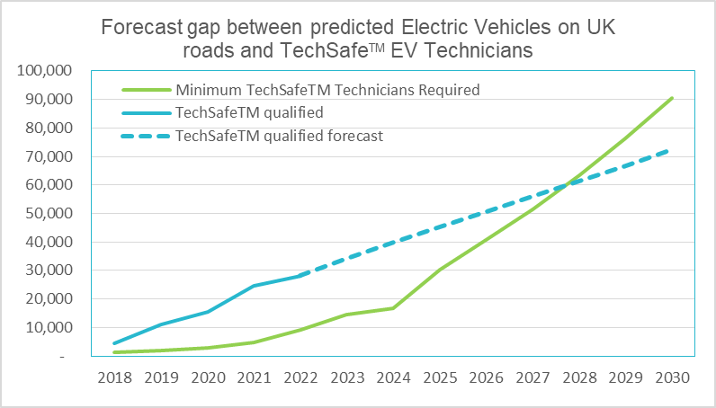
The core challenge
The automotive sector is facing the most turbulent period of change in over 100 years.
The move away from the internal combustion engine towards new power trains, is driving the need for skilled technical specialists to maintain electric vehicles
New sales of diesel and petrol car sales ending by 2030
The number of qualified technicians required to work with electric vehicles by 2030 is 90,000
To date 28,000, 13% of all technicians in the sector

Slide 3
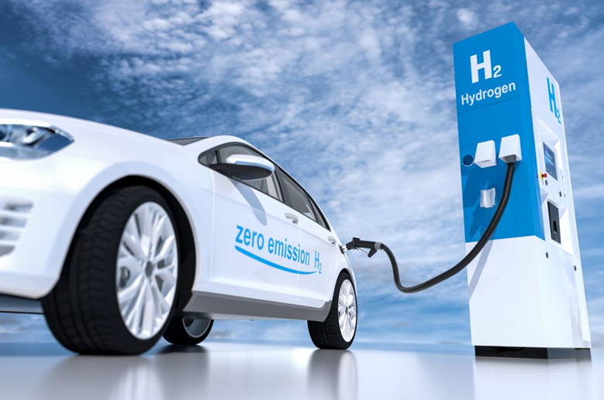
Other challenges
Attracting individuals to apprenticeships, no specific EV framework
Sector facing 20 year vacancy high
Lack of diversity - As a sector that currently only has 14% disabilities, 19% female and 7% non-white-British, the sector needs to divisive in order to attract more people into the sector.
Other fuel trains – Bio fuel and hydrogen
Changing occupations
  Management of end-of-Life vehicles and recycling
Notes:
BULLET 1:
At the IMI, we believe passionately that the automotive industry is a driver of innovation, employment opportunities and economic growth . We also believe that the people working in the industry need the most relevant, up-to-date skills and qualifications in order to progress and thrive – especially during periods of intense change.
BULLET 2:
IMI’s purpose is to provide, and continuously evolve, the means by which people working in the automotive sector can attain relevant professional competence and appropriate recognition.
BULLET 3:
Today the automotive sector is going through another period of profound change. New technologies and market entrants are reshaping the industry’s value chain – from design and manufacturing through to sales, distribution and the aftermarket. Many people are concerned about how to keep themselves relevant.
The IMI is the only professional body for the whole automotive industry . It’s our mission to make sure that individuals and organisations can meet the exacting standards of professionalism that the digital and AI era will demand.

Slide 4
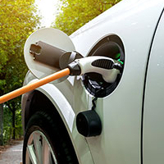



What are we doing?
IMI TechSafe
Sector advisory Panel
Diversity Task Force
Lobbying
Qualifications
Professional recognition
CPD
100 representatives across multiple sub sectors
Working with industry leaders to make positive changes
Developing qualifications
Encourage diverse role models
Cost of training
Apprenticeship Levy

Slide 5
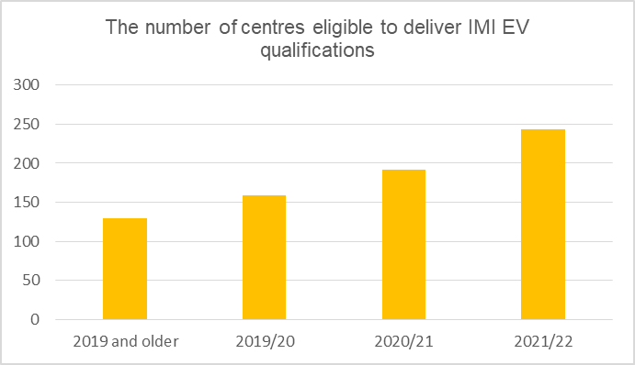
How is the sector reacting?
The number of technicians qualified to work on electric vehicles (EVs) in the UK is rising rapidly. The first three months of 2022 had the highest quarterly increase of EV qualified technicians on record. The data also suggests that the shortfall between EVs on the UK’s roads and approved technicians to service, repair and MOT them, will hit later than first anticipated, now 2028 instead of 2026.
2021 ended with 11% of technicians being EV qualified. At the end of March 2022 the dial had moved to 13%, representing over 28,000 technicians across the UK - it’s a real sign that the sector is responding to the increasing adoption of EV motoring
44% of all automotive qualifications awarded in 2022 Q1 (irrespective of AB) were EV related
27%
21%
22%
The number of centres approved to deliver IMI EV qualifications has been increasing over the past 3 years and is currently 243, 87% more than in 2019.
Apprentice numbers increasing - The first 8 months on of the academic year 2020/21 are 58% higher than the same time period in 2020 however 18% lower than 2019.

