Slide 1

WSUK Bitesize - Welding
Notes:
Title slide

Slide 2
By the end of this session, learners will understand:
What the role of a Welder involves
How to become a welder
What routes
What are their next steps
<Title of presentation>
1
Notes:
Standard slide

Slide 3

Key info
£20,000
Entry level
£35,000
Experienced
Typical hours: 44 - 46 per week
Working pattern: You may work evenings and weekends

Slide 4

What does a welder do?
Welders cut, join and shape metal plate, pipework and composite materials in the aerospace, construction and civil engineering industries
Example day-to-day job responsibilities
Setting out the metals, plastics or alloys you need to cut and join
Carrying out your welding by following engineering drawings and instructions
Using precision instruments to check, measure and test the cuts and joins you’ve made
Using semi-automatic spot-welding equipment.

Slide 5

Career progression
If you start off as a welding apprentice or junior welder, with time and experience you can become a team leader, supervisor or workshop manager.
You could also move into welding inspection, testing and quality control. You could even specialise in underwater welding if you take on commercial diver training. You would most likely use this to work on shipbuilding or offshore rigs. You might even be called in to explore new shipwreck discoveries under the sea.

Slide 6
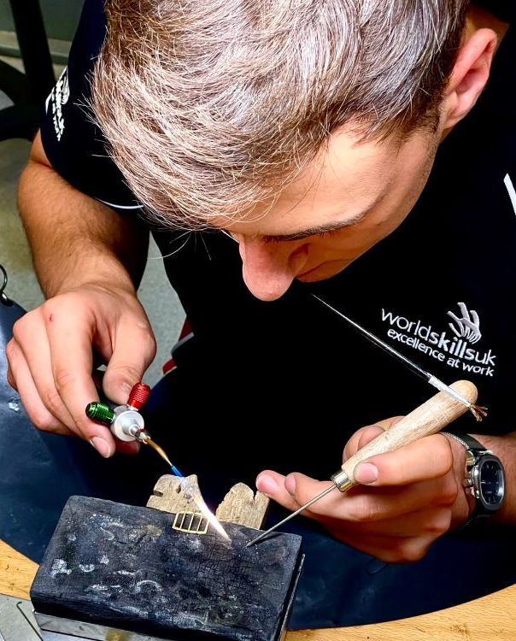
What routes you can take to be a welder?
Apprenticeship:
An apprenticeship can lead to a job as a trainee welder. You will need to pass competency tests for the type of welding you do and develop technical, maths and measuring skills. Level 2 Apprenticeships typically take 18 months, and Level 3 take around 3-4 years
College:
You can go to College to study Engineering full-time. Relevant courses include:
  Level 2 Award in Welding Skills
  Level 2 Award in Welding Techniques and Skills
  Level 3 Diploma in Fabrication and Welding Engineering Technology
  T Level in Engineering, Manufacturing, Processing and Control

Slide 7

What subjects do I need to enter this sector?
English
Maths
Biology
Chemistry
Physics
Design and Technology
Geography
Foreign languages
Art and design
Physical education
Computing
History
What subjects could I focus on?

Slide 8

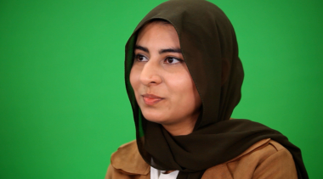


Our role models
Our role models are inspirational individuals who have achieved career success in their chosen field through Apprenticeship and Technical Education pathways. They represent the impact that such a chosen pathway can have to future generations. Their wealth of experience in their field is combined with an exciting and inspirational career journey that has successfully utilised the skills learnt through our competition skills development programme.
On the next slide you will get the chance to hear from one of them.

Slide 9
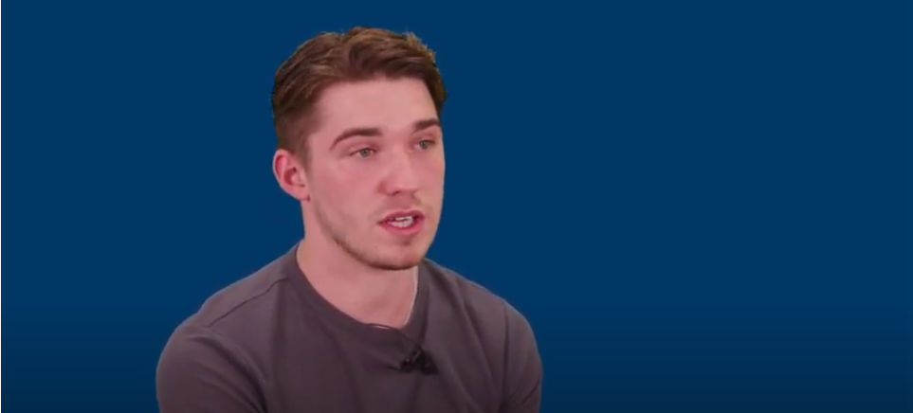
Conversations with a welder
Name:
Charlie Marshall
Occupation: Welder
Education:
College
Location:
North East

Slide 10

Discussion
Is this a sector you would consider entering?
What do you see as the positives for this career pathway?
What do you see as the negatives?

Slide 11
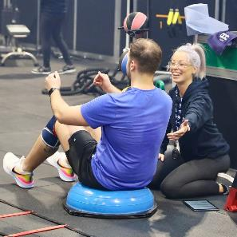

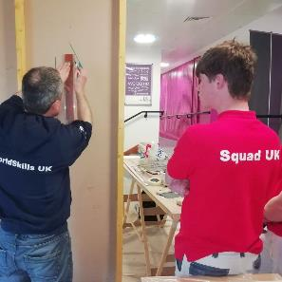
Next steps…
Find an Apprenticeship:
https://www.findapprenticeship.service.gov.uk/apprenticeshipsearch
Find a course:
https://nationalcareers.service.gov.uk/find-a-course/search
Not sure what role would be right for you?
INSERT Conversations with link here

Slide 12
Thank you
Any questions?
Notes:
Final slide

