Slide 1

Web Design
Notes:
Title slide

Slide 2
By the end of this session, learners will understand:
What the role involves
Key information about the role
What routes are available to you
What are your next steps
<Title of presentation>
1
Notes:
Standard slide

Slide 3

Key info
£28,000
Entry level
£40,000
Experienced
Typical hours: 37 - 39 per week
Working pattern: You may work as a contractor/ self-employed

Slide 4
What does a web designer do?
Web designers use their creative and technical skills to design new websites and redesign existing ones
Example day-to-day job responsibilities
You could:
take a lead role in maintaining and developing a site
attend meetings with internal and external clients to plan and develop site content, style and appearance
use web content management systems (CMS)
analyse website usage statistics
write reports for senior managers, clients and partnership organisations
carry out quality assurance checks on content
report technical problems to IT support staff

Slide 5

Career progression
With experience you could move into design team management or expand your skills to become a web content manager.
You might work towards a move into business management.
You could also work as a freelance web designer or set up your own web design business.

Slide 6

What routes you can take to be a web designer?
You can get into this job through:
a university course
a college course
an apprenticeship
working towards this role
College
You could take a college course to learn some of the skills needed in this job. For example:
Level 3 Certificate in Web Design and Development
T Level in Digital Production, Design and Development
Level 4 Certificate in Digital Media Design

Slide 7

What subjects do I need to enter this sector?
English
Maths
Biology
Chemistry
Physics
Design and Technology
Geography
Foreign languages
Art and design
Physical education
Computing
History
What subjects could I focus on?

Slide 8

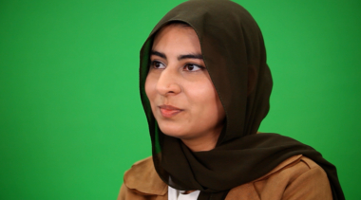


Our role models
Our role models are inspirational individuals who have achieved career success in their chosen field through Apprenticeship and Technical Education pathways. They represent the impact that such a chosen pathway can have to future generations. Their wealth of experience in their field is combined with an exciting and inspirational career journey that has successfully utilised the skills learnt through our competition skills development programme.
On the next slide you will get the chance to hear from one of them.

Slide 9
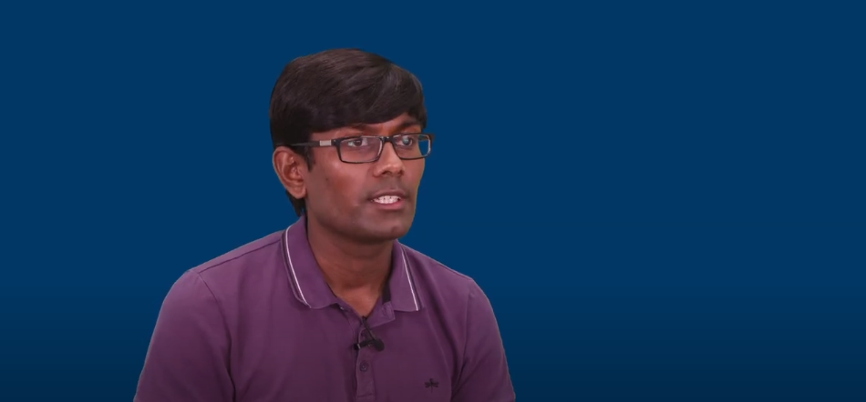
Conversations with a web designer
Name:
Yogi Raghvani
Occupation: Business owner
Education:
College
Location:
London

Slide 10

Discussion
Is this a sector you would consider entering?
What do you see as the positives for this career pathway?
What do you see as the negatives?

Slide 11
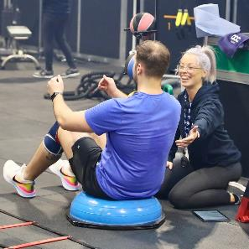

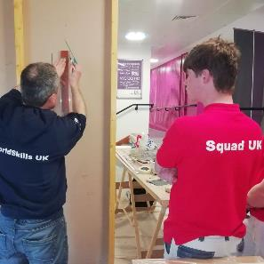
Next steps…
Find an Apprenticeship:
https://www.findapprenticeship.service.gov.uk/apprenticeshipsearch
Find a course:
https://nationalcareers.service.gov.uk/find-a-course/search
Not sure what role would be right for you?
INSERT Conversations with link here

Slide 12
Thank you
Any questions?
Notes:
Final slide

