Slide 1
Video Game Designer
Notes:
Title slide

Slide 2
By the end of this session, learners will understand:
What the role involves
Key information about the role
What routes are available to you
What are your next steps
<Title of presentation>
1
Notes:
Standard slide

Slide 3
Key info
£25,000
Entry level
£59,000
Experienced
Typical hours: 30 - 40 per week
Working pattern: You may work evenings and weekends

Slide 4
What does a video games designer do?
Computer games developers make games that can be played online, and on mobile phones, PCs and games consoles
In your day-to-day tasks you could:
work in a team with designers and artists
define what a game will look like and how it can be played
develop your own original ideas or work from an existing concept
create the game's visual characters, objects and scenery
produce concept art and drawings or storyboards at the planning stage
create the code to programme the game
quality test and debug code
use computer modelling and animation software to produce the characters and scenes
add audio sound effects

Slide 5
Career progression
With experience, you could become a senior developer, producer or technical director.
If you develop your own successful game independently, you could increase your income significantly.

Slide 6
What routes you can take to be a video games designer?
College
You could do a college course, which may lead onto more advanced qualifications or a higher apprenticeship, or help you to get a trainee position with a company. Courses include:
A level in Computing
T Level in Digital Production, Design and Development
Higher National Diploma in Creative Media Production Games Development
Entry requirements
You may need:
4 or 5 GCSEs at grades 9 to 4 (A* to C), or equivalent, including English, maths and computing
4 or 5 GCSEs at grades 9 to 4 (A* to C), or equivalent, including English and maths for a T level
1 or 2 A levels, or equivalent, for a higher national certificate or higher national diploma

Slide 7
What subjects do I need to enter this sector?
English
Maths
Biology
Chemistry
Physics
Design and Technology
Geography
Foreign languages
Art and design
Physical education
Computing
History
What subjects could I focus on?

Slide 8
Our role models
Our role models are inspirational individuals who have achieved career success in their chosen field through Apprenticeship and Technical Education pathways. They represent the impact that such a chosen pathway can have to future generations. Their wealth of experience in their field is combined with an exciting and inspirational career journey that has successfully utilised the skills learnt through our competition skills development programme.
On the next slide you will get the chance to hear from one of them.

Slide 9
Conversations with a video game designer
Name:
Tommy Beaton
Occupation: Games Designer
Education:
College
Location:
Bristol

Slide 10
Discussion
Is this a sector you would consider entering?
What do you see as the positives for this career pathway?
What do you see as the negatives?

Slide 11
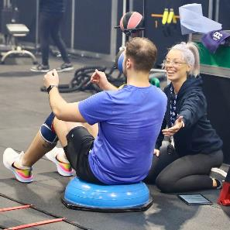
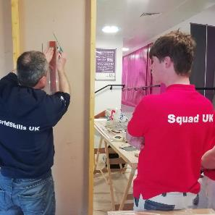
Next steps…
Find an Apprenticeship:
https://www.findapprenticeship.service.gov.uk/apprenticeshipsearch
Find a course:
https://nationalcareers.service.gov.uk/find-a-course/search
Not sure what role would be right for you?
INSERT Conversations with link here

Slide 12
Thank you
Any questions?
Notes:
Final slide

