Slide 1

Producer
Notes:
Title slide

Slide 2
By the end of this session, learners will understand:
What the role involves
Key information about the role
What routes are available to you
What are your next steps
<Title of presentation>
1
Notes:
Standard slide

Slide 3

Key info
£25,000
Entry level
£55,000
Experienced
Typical hours: 38 - 40 per week
Working pattern: You may work evenings and weekends

Slide 4
What does an Producer do?
Producers creatively plan and manage the business side of creating television programmes and films for clients
In your day-to-day tasks you could:
decide which projects to produce, or create programme ideas yourself
read scripts
identify sources of funding and raise finances
work out what resources are needed
check and approve locations
pitch to television broadcasters to commission your programme
plan filming schedules
hire staff, cast and crew
manage cash flow, schedule and budget
work with marketing companies and distributors

Slide 5
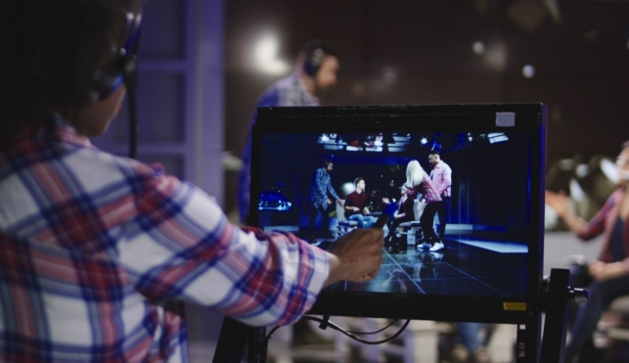
Career progression
With experience, you could become an executive producer, or set up your own production company.

Slide 6
What routes you can take to be a Producer?
College
You could start by doing a college course, which may help you to get a job as a production assistant or runner. With experience, you could then move on to become a producer. Courses include:
Level 3 Diploma in Creative Media Production
Level 3 Diploma in Film and Television Production
T Level in Media, Broadcast and Production
Entry requirements
You'll usually need:
4 or 5 GCSEs at grades 9 to 4 (A* to C), or equivalent, for a level 3 course
4 or 5 GCSEs at grades 9 to 4 (A* to C), or equivalent, including English and maths for a T level
Apprenticeship
You could start by doing a broadcast production assistant advanced apprenticeship and work your way up to a producer role.
Entry requirements
You'll usually need:
5 GCSEs at grades 9 to 4 (A* to C), or equivalent, including English and maths, for an advanced apprenticeship

Slide 7

What subjects do I need to enter this sector?
English
Maths
Biology
Chemistry
Physics
Design and Technology
Geography
Foreign languages
Art and design
Physical education
Computing
History
What subjects could I focus on?

Slide 8

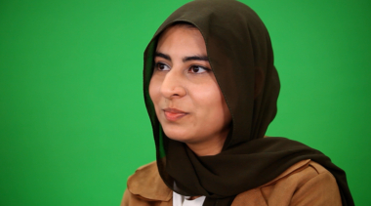
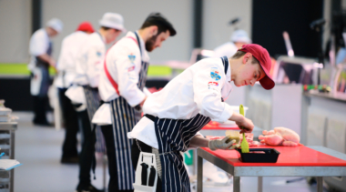

Our role models
Our role models are inspirational individuals who have achieved career success in their chosen field through Apprenticeship and Technical Education pathways. They represent the impact that such a chosen pathway can have to future generations. Their wealth of experience in their field is combined with an exciting and inspirational career journey that has successfully utilised the skills learnt through our competition skills development programme.
On the next slide you will get the chance to hear from one of them.

Slide 9
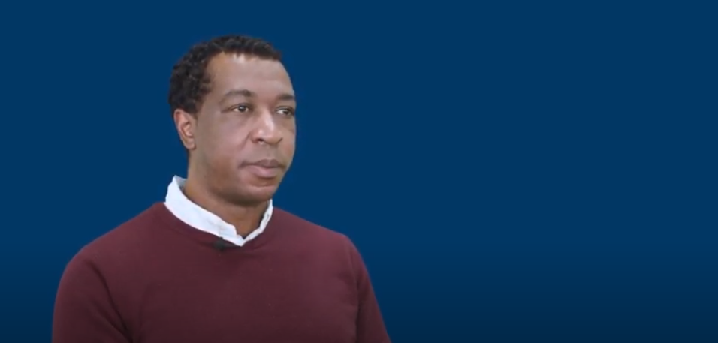
Conversations with a Producer
Name:
Jose Tavares
Occupation: Producer
Education:
College
Location:
London

Slide 10

Discussion
Is this a sector you would consider entering?
What do you see as the positives for this career pathway?
What do you see as the negatives?

Slide 11
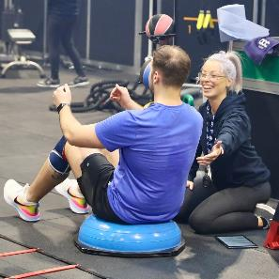
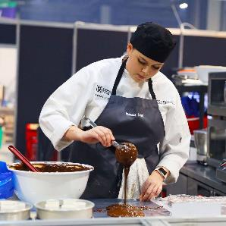
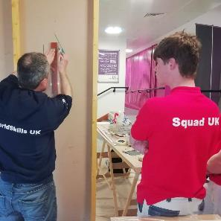
Next steps…
Find an Apprenticeship:
https://www.findapprenticeship.service.gov.uk/apprenticeshipsearch
Find a course:
https://nationalcareers.service.gov.uk/find-a-course/search
Not sure what role would be right for you?
INSERT Conversations with link here

Slide 12
Thank you
Any questions?
Notes:
Final slide

