Slide 1
Personal Trainer
Notes:
Title slide

Slide 2
By the end of this session, learners will understand:
What the role involves
Key information about the role
What routes are available to you
What are your next steps
<Title of presentation>
1
Notes:
Standard slide

Slide 3
Key info
£18,000
Entry level
£28,000
Experienced
Typical hours: 32 - 34 per week
Working pattern: You may work evenings, weekends and bank holidays

Slide 4
What does a personal trainer do?
Personal trainers work with clients to improve their health and fitness
On a daily basis you might:
help clients set short-term and long-term fitness goals
plan a fitness programme to help clients achieve their goals
teach, motivate and coach clients in how to follow their programmes safely and effectively
give advice on health, nutrition and lifestyle changes
help clients with their workouts
check and record clients' progress, using methods like measuring heart rate and levels of body fat
promote your services and do business admin tasks if you are self-employed

Slide 5
Career progression
You could take further instructor courses to learn new skills to offer clients, like yoga, pilates, nutrition or aerobics.
With further training, you could also work with people recovering from illness or who have medical conditions.

Slide 6
What routes you can take to be a personal trainer?
College
You could take a college course to help you get into this career. Courses include:
Level 2 Diploma in Instructing Exercise and Fitness
Level 2 Certificate in Fitness Instructing
Level 3 Certificate in Personal Training
Entry requirements
You'll need:
2 or more GCSEs at grades 9 to 3 (A* to D), or equivalent, for a level 2 course
4 or 5 GCSEs at grades 9 to 4 (A* to C), or equivalent, for a level 3 course

Slide 7
What subjects do I need to enter this sector?
English
Maths
Biology
Chemistry
Physics
Design and Technology
Geography
Foreign languages
Art and design
Physical education
Computing
History
What subjects could I focus on?

Slide 8
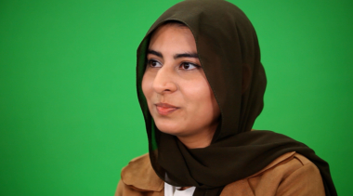
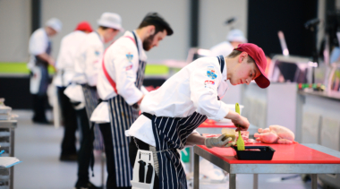
Our role models
Our role models are inspirational individuals who have achieved career success in their chosen field through Apprenticeship and Technical Education pathways. They represent the impact that such a chosen pathway can have to future generations. Their wealth of experience in their field is combined with an exciting and inspirational career journey that has successfully utilised the skills learnt through our competition skills development programme.
On the next slide you will get the chance to hear from one of them.

Slide 9
Conversations with a Personal trainer
Name:
Shawna Natalia
Occupation: Personal Trainer
Education:
College
Location:
London

Slide 10
Discussion
Is this a sector you would consider entering?
What do you see as the positives for this career pathway?
What do you see as the negatives?

Slide 11
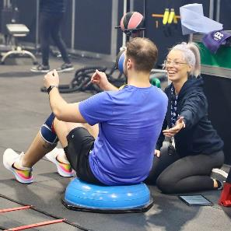
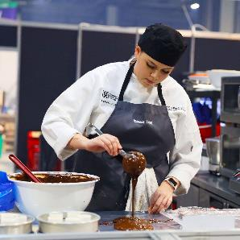
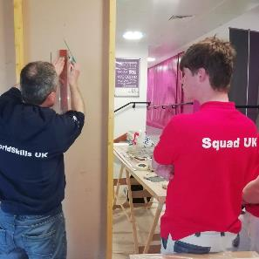
Next steps…
Find an Apprenticeship:
https://www.findapprenticeship.service.gov.uk/apprenticeshipsearch
Find a course:
https://nationalcareers.service.gov.uk/find-a-course/search
Not sure what role would be right for you?
INSERT Conversations with link here

Slide 12
Thank you
Any questions?
Notes:
Final slide

