Slide 1

Why choose a Technical Education or Apprenticeship Pathway?
Notes:
Title slide

Slide 2
By the end of this session, you will understand:
What we mean by Apprenticeships and technical education
How our role models benefitted from the pathway they chose
Why choosing technical education or an apprenticeship could be right for you
What are your next steps
<Title of presentation>
1
Notes:
Standard slide

Slide 3

Self – assessment (part 1)

Slide 4
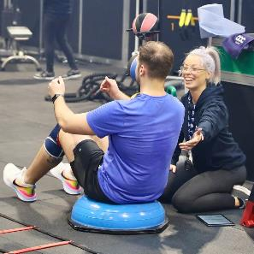

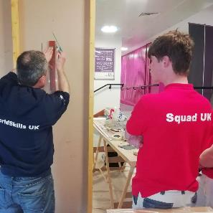
What do we mean by…
Technical Education
You may decide to go to college after you have finished GCSEs or 6th form study. A college can offer a range of vocational and technical courses that allow you to begin studying key elements specific to a career whilst continuing full-time study. These courses should have a large element of hands-on learning giving you practical insight into the subject.
Apprenticeships
An apprenticeship is a qualification combined with employment. You work for an employer from day one of the apprenticeship. This means you get paid a salary, have a job description and there will be clear expectations of you. Depending on your training you may do the study part of your apprenticeship at work, in a college, with a training provider or at university.

Slide 5
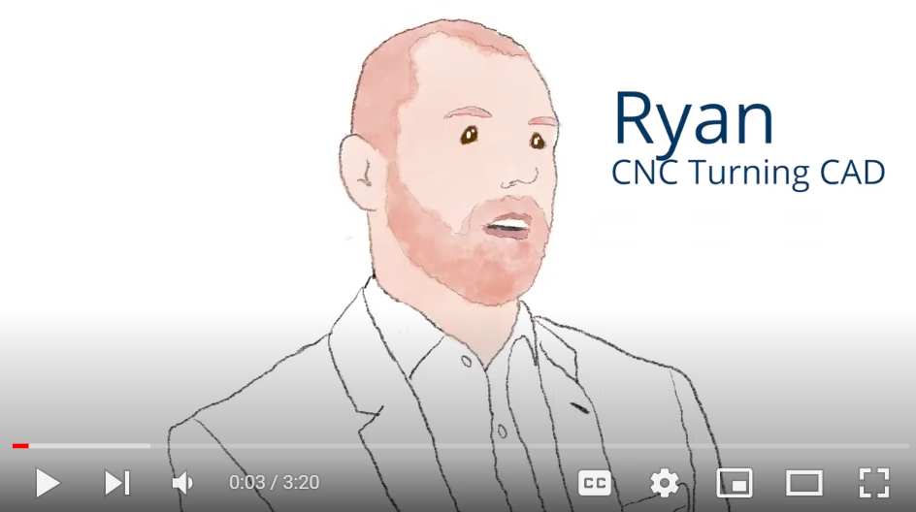
Pathways video
Name:
Ryan Smith
Occupation: Graphic Designer
Education:
College
Location:
East of England

Slide 6
Misconceptions

Slide 7
Getting an apprenticeship or going to college is worse than other academic routes
There are numerous apprenticeship and college pathways available which lead to degree level roles. They can be just as valuable and open up as many opportunities as a degree. Apprenticeships are available from Level 2 (GCSE) up to Level 7 (post-graduate)
<Title of presentation>
1
Notes:
Standard slide

Slide 8
Apprentices don’t get paid
Apprentices wages start at over £4 per hour under 19s and increase depending on sector and age!
<Title of presentation>
1
Notes:
Standard slide

Slide 9
Apprentices are entitled to annual holidays but not sick pay
As an apprentice you are a registered employer of the organisation and entitled to all of the benefits
<Title of presentation>
1
Notes:
Standard slide

Slide 10
Apprentices are entitled to annual holidays but not sick pay
As an apprentice you are a registered employer of the organisation and entitled to all of the benefits
<Title of presentation>
1
Notes:
Standard slide

Slide 11
Technical pathways are only for manual jobs
Apprenticeships and colleges courses are available in alomsot eery sector, ranging from IT to accountancy to project management
<Title of presentation>
1
Notes:
Standard slide

Slide 12
Now we want you to complete the second part of the Self Assessment

Slide 13
Thank you
Any questions?
Notes:
Final slide

