Slide 1

Graphic Designer
Notes:
Title slide

Slide 2
By the end of this session, learners will understand:
What the role involves
Key information about the role
What routes are available to you
What are your next steps
<Title of presentation>
1
Notes:
Standard slide

Slide 3

Key info
£18,000
Entry level
£35,000
Experienced
Typical hours: 37 - 40 per week
Working pattern: You may work evenings

Slide 4
What does a graphic designer do?
Graphic designers create visual branding, adverts, brochures, magazines, website designs, product packaging and displays
On a daily basis you might:
help clients set short-term and long-term fitness goals
plan a fitness programme to help clients achieve their goals
teach, motivate and coach clients in how to follow their programmes safely and effectively
give advice on health, nutrition and lifestyle changes
help clients with their workouts
check and record clients' progress, using methods like measuring heart rate and levels of body fat
promote your services and do business admin tasks if you are self-employed

Slide 5

Career progression
You could become a senior designer, creative director or move into management.
You could go freelance or start your own design agency.
Another option is to move into teaching or lecturing.

Slide 6

What routes you can take to be a graphic designer ?
College
You could take a college course like a Level 2 Technical Award in Graphic Design or A level Graphic Communication, and use this to join a company as a design assistant.
You would need a good portfolio to showcase your skills to employers.
Entry requirements
You may need:
4 or 5 GCSEs at grades 9 to 4 (A* to C), or equivalent, for a level 3 course
1 or 2 A levels, a level 3 diploma or relevant experience for a level 4 or level 5 course

Slide 7

What subjects do I need to enter this sector?
English
Maths
Biology
Chemistry
Physics
Design and Technology
Geography
Foreign languages
Art and design
Physical education
Computing
History
What subjects could I focus on?

Slide 8

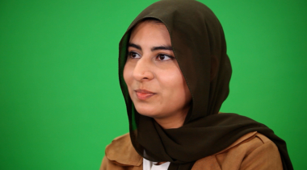
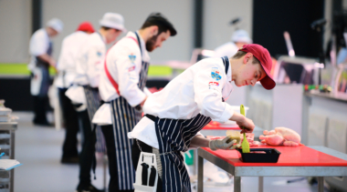

Our role models
Our role models are inspirational individuals who have achieved career success in their chosen field through Apprenticeship and Technical Education pathways. They represent the impact that such a chosen pathway can have to future generations. Their wealth of experience in their field is combined with an exciting and inspirational career journey that has successfully utilised the skills learnt through our competition skills development programme.
On the next slide you will get the chance to hear from one of them.

Slide 9
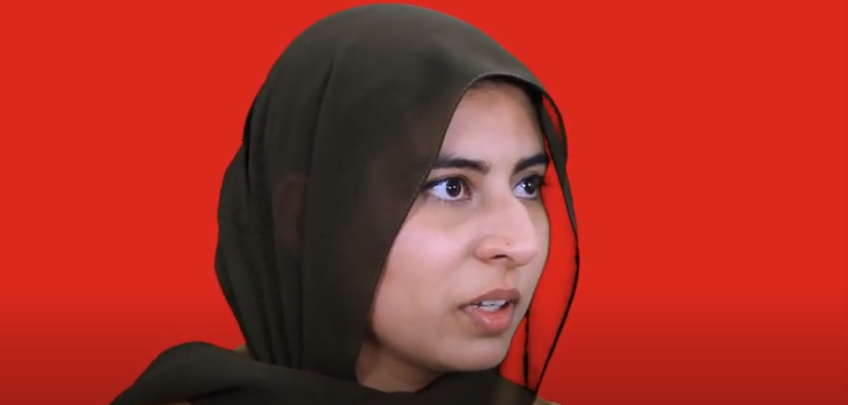
Conversations with a Graphic Designer
Name:
Shafia Ali
Occupation: Graphic Designer
Education:
College
Location:
North West

Slide 10

Discussion
Is this a sector you would consider entering?
What do you see as the positives for this career pathway?
What do you see as the negatives?

Slide 11
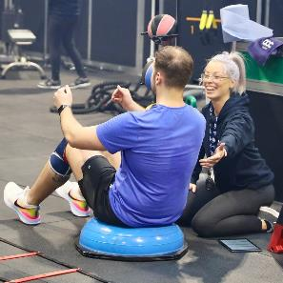
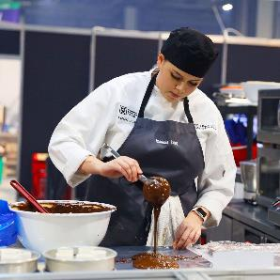
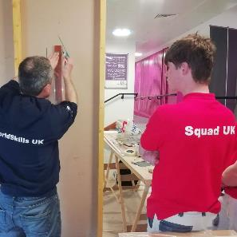
Next steps…
Find an Apprenticeship:
https://www.findapprenticeship.service.gov.uk/apprenticeshipsearch
Find a course:
https://nationalcareers.service.gov.uk/find-a-course/search
Not sure what role would be right for you?
INSERT Conversations with link here

Slide 12
Thank you
Any questions?
Notes:
Final slide

