Slide 1

Chef
Notes:
Title slide

Slide 2
By the end of this session, learners will understand:
What the role involves
Key information about the role
What routes are available to you
What are your next steps
<Title of presentation>
1
Notes:
Standard slide

Slide 3

Key info
£17,000
Entry level
£50,000
Experienced
Typical hours: 40 - 45 per week
Working pattern: You may work evenings, weekends and bank holidays

Slide 4
What does a Chef do?
Chefs prepare, cook and present food in hotels, bars and restaurants
On a daily basis you might:
prepare attractive menus to nutritional standards
control and order stock and inspect it on delivery
prepare meat and fish for cooking
scrape and wash large quantities of vegetables and salads
cook and present food creatively
monitor production to maintain quality and consistent portion sizes
work under pressure to make sure food is served on time
keep to hygiene, health and safety and licensing rules

Slide 5
Career progression
With experience, you could progress to section chef (station chef) and look after a particular area like desserts. The next step is sous chef, running an entire kitchen when the head chef is busy.
As head chef (also known as chef de cuisine), you'll run a kitchen, create menus and manage the budget.
Very large establishments have executive chefs, usually in charge of multiple outlets. This is a management role and you would do very little cooking.

Slide 6

What routes you can take to be a Chef?
College
One way into the job is to take a college course. These include qualifications like:
Level 3 Diploma in Professional Cookery
T Level in Catering
Level 4 Diploma in Professional Culinary Arts
Entry requirements
You'll usually need:
4 or 5 GCSEs at grades 9 to 4 (A* to C), or equivalent, for a level 3 course
4 or 5 GCSEs at grades 9 to 4 (A* to C), or equivalent, including English and maths for a T level
1 or 2 A levels, a level 3 diploma or relevant experience for a level 4 or level 5 course
Apprenticeships
The following apprenticeships are relevant to this role:
production or commis chef intermediate apprenticeships
senior production chef or a chef de partie advanced apprenticeship
You can also train to be a chef through an apprenticeship in the armed forces.

Slide 7

What subjects do I need to enter this sector?
English
Maths
Biology
Chemistry
Physics
Design and Technology
Geography
Foreign languages
Art and design
Physical education
Computing
History
What subjects could I focus on?

Slide 8


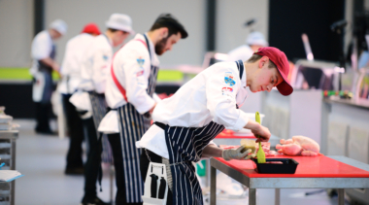

Our role models
Our role models are inspirational individuals who have achieved career success in their chosen field through Apprenticeship and Technical Education pathways. They represent the impact that such a chosen pathway can have to future generations. Their wealth of experience in their field is combined with an exciting and inspirational career journey that has successfully utilised the skills learnt through our competition skills development programme.
On the next slide you will get the chance to hear from one of them.

Slide 9
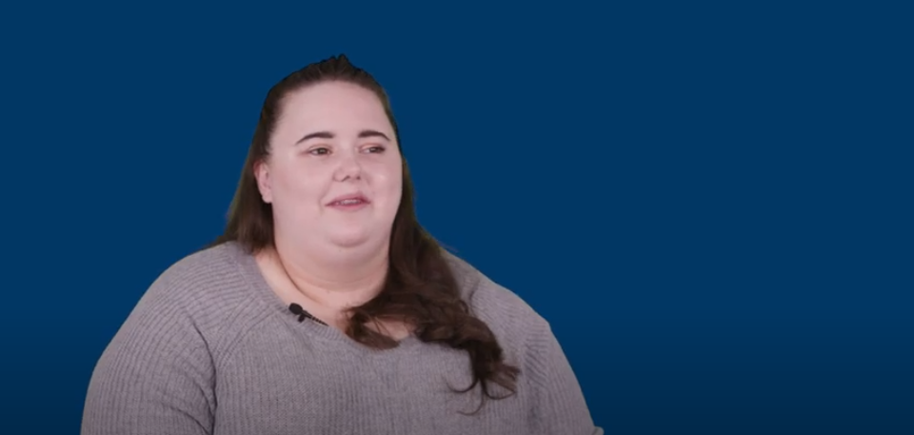
Conversations with a Chef
Name:
Eden
Occupation: Chef
Education:
College
Location:
South West

Slide 10

Discussion
Is this a sector you would consider entering?
What do you see as the positives for this career pathway?
What do you see as the negatives?

Slide 11

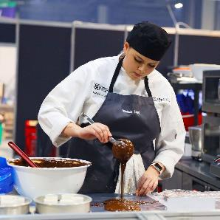
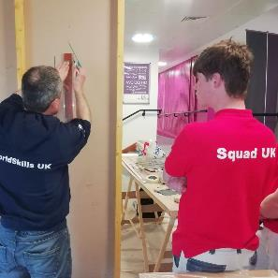
Next steps…
Find an Apprenticeship:
https://www.findapprenticeship.service.gov.uk/apprenticeshipsearch
Find a course:
https://nationalcareers.service.gov.uk/find-a-course/search
Not sure what role would be right for you?
INSERT Conversations with link here

Slide 12
Thank you
Any questions?
Notes:
Final slide

